Slide 2
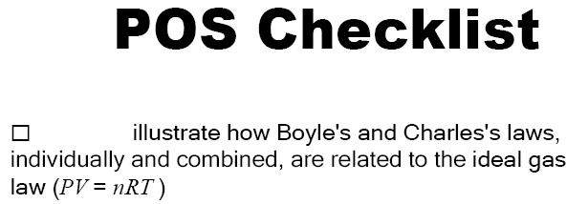

Slide 3
From our discussions last day we found that the volume of a gas and the pressure it exerts on it's container are related.

Slide 6
Boyle's Law applet

Slide 7
