Slide 2
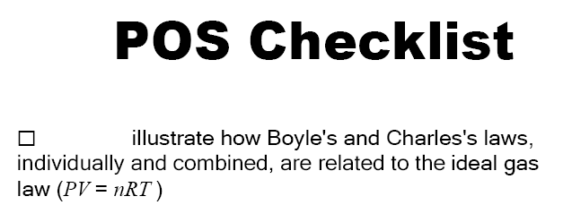
Anti-helium

Slide 6
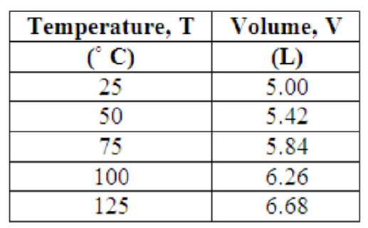
Activity: Charles’ Law

