Slide 1
Polyprotic Acids and Bases

Slide 4
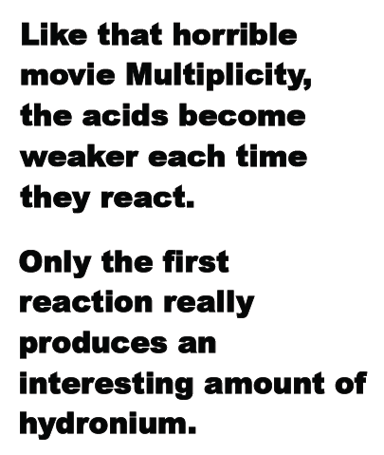

Slide 5
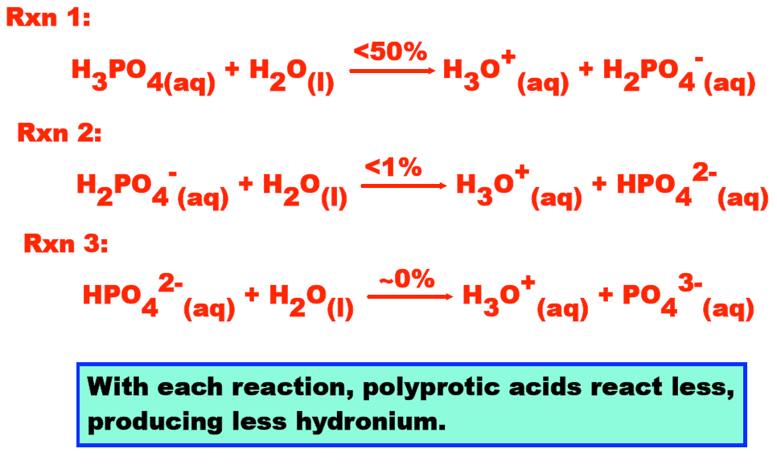

Slide 6
