Slide 2
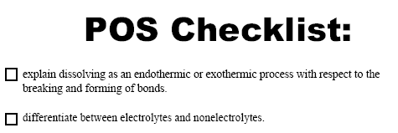

Slide 4
Molecular View of Dissolving
Acid Ionization

