Slide 16
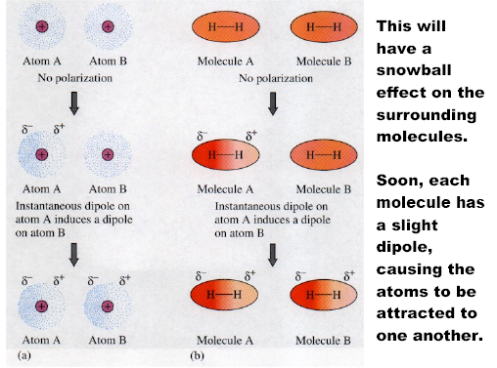

Slide 18
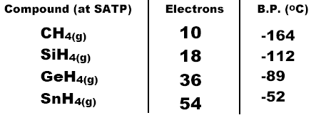

Slide 25
Hexagonal Shape of Ice

Slide 27
