Slide 12
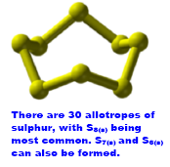
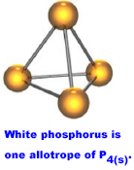
Polyatomic Elements
It has been shown experimentally that elemental phosphorus forms the polyatomic molecule P_{4 (s)}, while sulfur forms S_{8 (s)}.
Challenge: Using LDD, draw a possible structure for S_{8(s)}and P_{4(s)}.

