Slide 1
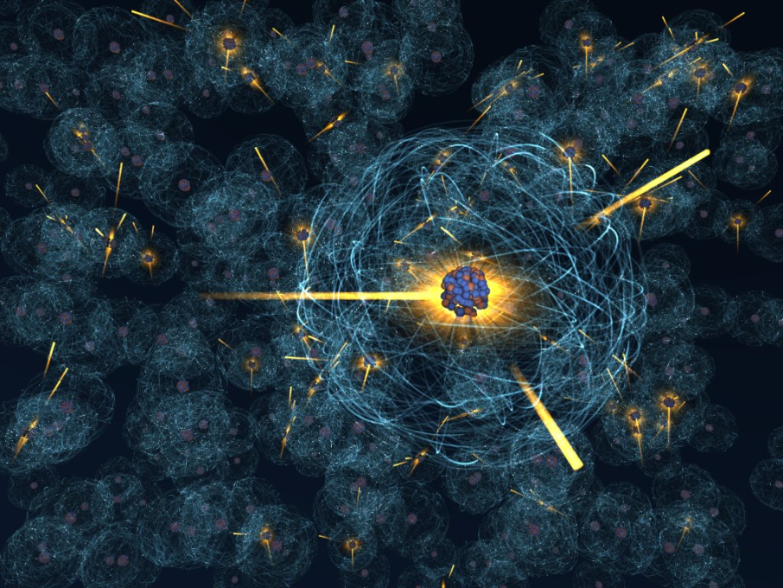
Nuclear Reactions
Lesson 7

Slide 2
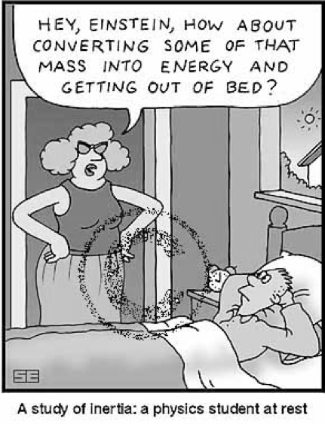
Objectives
Compare and contrast the characteristics of fission and fusion reactions
Relate the energy released, both qualitatively and quantitatively, produced by fission and fusion

Slide 3
Fission
Fission is the process whereby complex nuclei break apart into smaller components and release energy.
This process is done by artificial transmutation (ex: causing a nucleus to split into two different elements by colliding it with excess neutrons)

Slide 4
Fission
Just as radioactive nuclei can lose neutrons through alpha and beta decay, thus becoming a new element, we can "shoot" an alpha particle into a nucleus, causing it to artificially decay.
ex) Natural Decay:

Slide 5
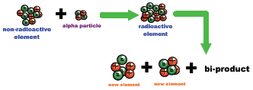
Fission
ex) Artificial Decay:

Slide 6
Examples
This was first carried out by Rutherford in 1919:
Later, in 1938, Fermi decided to shoot a neutron at the largest known element at the time: uranium.
What do you think happened when he took the largest known element and made it a little larger?

Slide 7
Chain Reactions
This new isotope of uranium, U-236, was highly unstable and quickly split into two more stable isotopes.
This splitting apart of a nucleus is called nuclear fission. Notice that this (and most) reactions requires a neutron to initiate the process but 2 or more are released. These new neutrons are available to create other reactions.
This is the chain reaction that releases large amounts of energy in atomic bombs and nuclear reactions

Slide 8
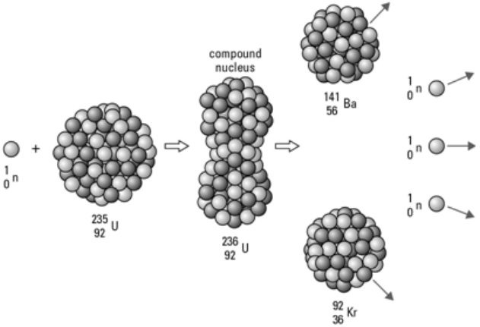
Time-Out
.
Q: What did the nuclear physicist have for lunch?
A: Fission Chips

Slide 9
Examples
ex) Determine the amount of energy released from the reaction:
m_{U-235} = 235.043903 u
m_{Ba-141} = 140.914412 u
m_{Kr-92} = 91.926156 u
m_{n} = 1.008665

Slide 10
Nuclear Fusion
This can be thought of as the opposite of fission.
In fusion, smaller atoms are recombined into larger atoms. This process releases large amounts of energy.
The principle spot this takes place in is in the sun.

Slide 11
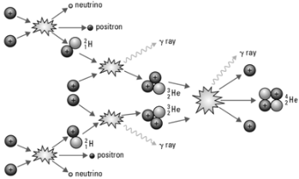
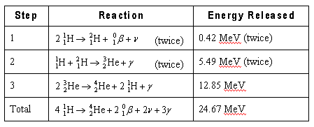
Fusion
It is difficult to produce fusion reactions on Earth because the temperatures required to maintain a self sustaining thermonuclear reaction are very high. (4 x 10⁸ K)
High temperatures are required to give the molecules enough kinetic energy to overcome the repulsion of the protons in each molecule

Slide 12
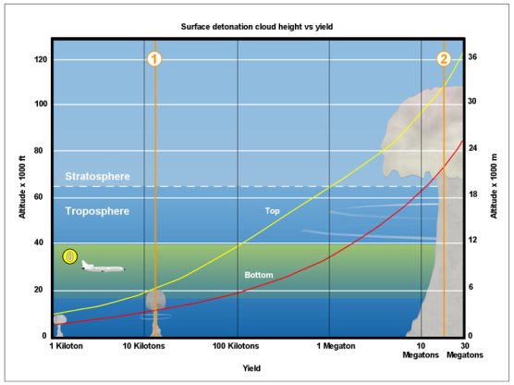
Comparing Reactions
As you can see, the amount of energy released by a nuclear reaction far outweighs that of a chemical reaction:
1 = Fat Man 22.5 kt bomb
2 = Castle Bravo 15 Mt bomb

Slide 13
Comparing Fission to Fusion
Similarities:
Both nuclear
Both release energy
Differences:
Fission is splitting; fusion is joining together
Fission can be accomplished at easily attainable temperatures whereas fusion requires extremely high temperatures

Slide 14
Comparing Fission to Fusion
Differences (con’t)
Fission by-products are highly radioactive materials that are difficult to dispose of. Fusion products are simple, harmless molecules.
Fission requires radioactive materials that are limited resources (such as uranium) and expensive to maintain. Hydrogen isotopes for fusion are plentiful and easy to obtain (deuterium is found in sea water)

Slide 15
Question
Fission and fusion seem to be reverse processes of one another:
So why is it that there is energy released in both reactions? Shouldn't energy be absorbed in one reaction?

Slide 16
Answer
In reality, there can be a net absorption of energy in fission or fusion. It just depends on the types of nuclei used.
Experiment has shown that iron has the largest binding energy per nucleon of all elements. It has also been shown that:
Fusion of two nuclei with masses less than iron releases energy
Fusion of two nuclei with masses more than iron absorbs energy.
Fission of nuclei with masses more than iron releases energy.
Fission of nuclei with masses less than iron absorbs energy.

Slide 17
Implications
In order for fission to be energy profitable, we must use large nuclei (i.e. uranium, plutonium, etc).
In order for fusion to be energy profitable, we must use small nuclei (i.e. hydrogen).
The problem with fusion is that the conditions needed to fuse hydrogen are not easy to maintain. Temperatures of 45-400 million K are needed to begin fusion, and special containment units are needed to contain all that hot gas. The fuel source must also be held together with a very strong magnetic field.

Slide 18
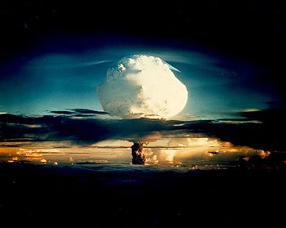
Finally…
So far, we have been able to produce fusion small scale, but the amount of energy gain has been so small, it is not practical to use as an energy source.
We do use fusion as the ignition for the fission reaction that takes place in nuclear explosions.
Cold fusion????

