Slide 1
Lesson 8
Radioactive Half-Lives

Slide 2
Objectives
perform simple, non-logarithmic half life calculations.
graph data from radioactive decay and estimate half life values.
graph data from radioactive decay and infer an exponential relationship between measured radioactivity and elapsed time.

Slide 3
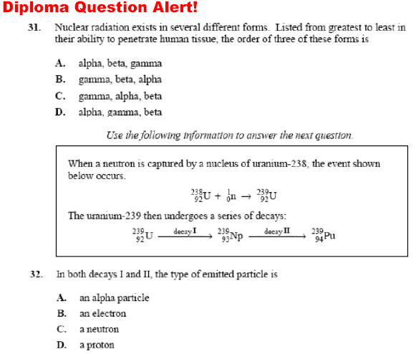
Review Questions
Ans:
B
Ans:
B

Slide 4
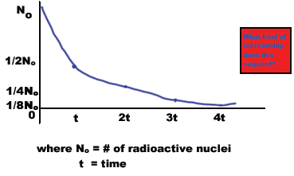
Half-Lives
In P30, we are concerned with the rate at which decay occurs
If we construct a graph of the number of atoms vs. time of a particular radioactive isotope, we would find the following:

Slide 5
Explanation
The graph is exponential, so there must
be an exponential relationship between
the number of nuclei decaying and
time.
In one period of time, one half of the
initial nuclei, N_{o}, decay.
In another period of time, one half of
one half (1/4N_{o}) decay.

Slide 6
Formula
Once a radioactive element has
undergone decay it is changed into
something else (trasmuted).
This means that the number of parent
nuclei is continuously decreasing.
A quantitative measure of longevity of a
particular isotope is its half-life.
This is the time it takes one half of a
radioactive sample to decay.

Slide 7
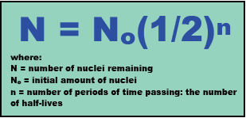
Formula
A mathematical equation that can
model this decay is:

Slide 8
Three Units of N
Sometimes questions are phrased with
N = number of nuclei,
but this is not practical in real life. More
often,
N = a mass of a radioactive material (kg).
Other times, N is expressed as an activity,
the number of decays per second:
N = activity of radioactive material (Bq).

Slide 9
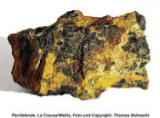
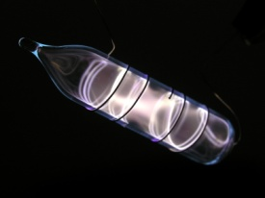
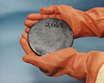
Half-Life Examples
Some elements have very short half-lives:
polonium-214 has a half-life of 1.64 x 10⁻⁴ s,
krypton-89 is 3.16 min
uranium-238 is 4.47 x 10⁹ years
indium-115 is 4.41 x 10¹⁴ years.

Slide 10
Number of Decays
We can calculate the number of half lives
of a substance by taking the time it is
decaying for and dividing by the time of
one half life.

Slide 11
Example
Radon-222 has a half-life of 3.83 days.
How many half-lives have passed after
one year?
If we start off with 10 mg of this sample,
how much remains after a year?
Answer:
95
Answer:
2.05x10⁻³⁴ kg

Slide 12
More Examples
The t_{1/2} of strontium is 28.5 years. What
percentage of the original sample remains
after 100 years?
A sample of putnamium-11 has a half life of 20
weeks. After 52 weeks, its activity is 18.0 Bq.
What was the sample’s original activity?
Answer:
8.79%
Answer:
109 Bq

