Slide 1
Diffraction
Lesson 6

Slide 2
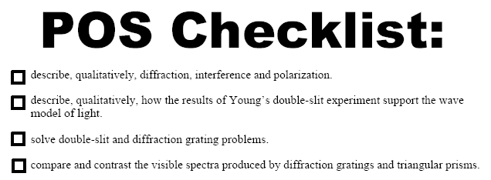

Slide 6
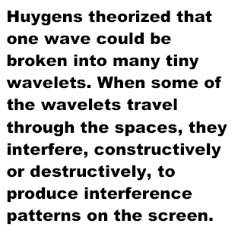
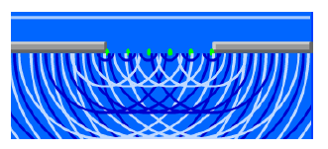
Diffraction

Slide 7
Interference
Recall that waves interfere (superposition) in a predictable way.
Where two crests meet we have maximum displacement of the medium which is called an antinode.
Where a crest meets a trough we have complete destructive interference and a node is formed.

Slide 8
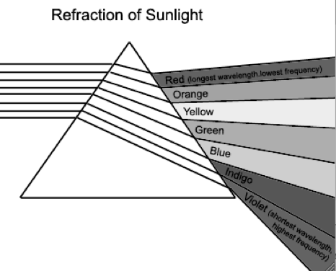
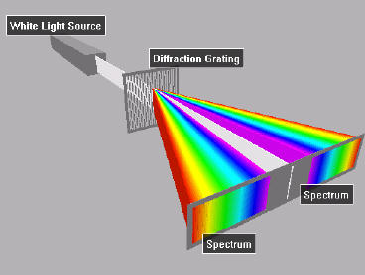
Dispersion Compared to Diffraction
Notice the order of colors.

Slide 10
Double Slit Laser

Slide 12
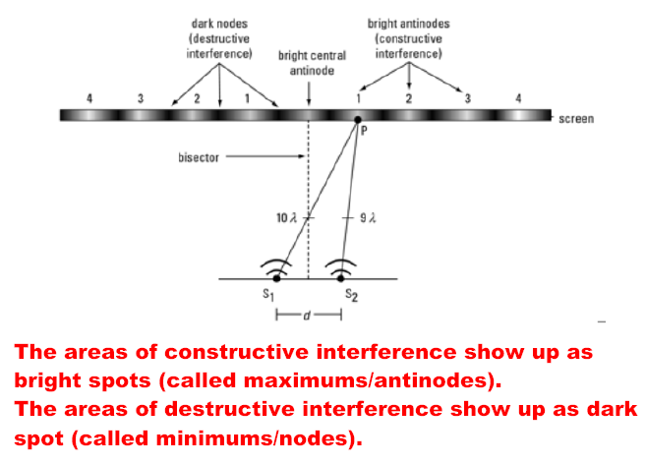

Slide 15
Wave Particle Duality and the Double Slit Experiment

Slide 17
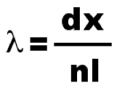
Diffraction
In most practical situations, the angle of diffraction can be difficult to measure because it is small. The equation is used in these situations:
Here, the angle of diffraction is approximated by tanθ = x/L
This approximation works because for small angles, sinθ ≈ tanθ.
where
λ = wavelength
d = distance between slits
l = distance from slits to antinode**
x = distance between fringes
**NOTE: l = distance to central maximum only if Θ < 10°

Slide 18
Example
1. Light falls on a pair of slits 1.28 x 10⁻⁵ m apart. The maxima are 4.11 x 10⁻² m apart and the screen is 1.00 m from the slits. What is the wavelength and color of the light?
2. Monochromatic yellow light, wavelength 580nm, shines on a pair of slits. The second dark spot is 21.8cm from the central anti-node on a wall that is 5.00 m away. What is the separation of the slits?

Slide 19
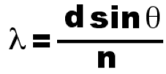
Diffraction Grating
A device consisting of transparent glass with opaque scratches placed very close together such that it acts like multiple slits.
The formula for this device is

Slide 22
Using the Formula
When using diffraction gratings, the distance between the slits (d) is not given, rather the density of lines is given (#lines/length).
3. Example: A diffraction grating has 4000 lines/cm. Calculate the distance between adjacent lines (d).

Slide 24
Examples
4. A diffraction grating has 5000 lines/cm and red light (700 nm) passes through it. Find the angle of deviation for the second order maximum (second antinode).
5. Find the maximum order number for the above grating. The maximum n corresponds to a turning angle of 90º.

Slide 26
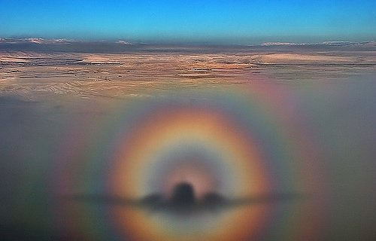
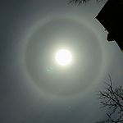
Diffraction in Nature
When sunlight or moonlight passes through water droplets of nearly uniform size, it is diffracted in a circular pattern.
“Glory”

Slide 28
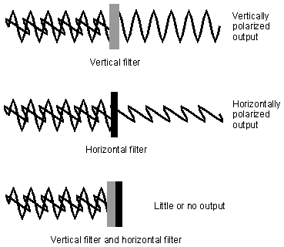
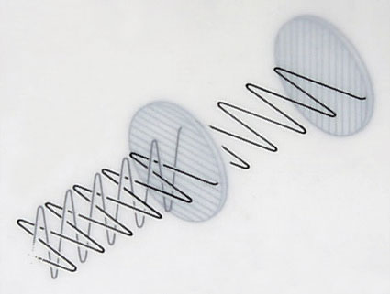
Light is said to be polarized if it vibrates in only one plane. Only transverse waves can be polarized.
A polarization disk is nothing more than a barrier with a slit (or series of slits) in it.

Slide 30
3D Photography with color
Other 3D pictures offset colors. Usually red and blue.
http://www.nasa.gov/mission_pages/stereo/news/stereo3D_press.html

