Slide 1
Down The Rabbit Hole: Quantum Physics
Lesson 7

Slide 2
Objectives
Objectives
Define a quantum
Calculate the energy of a photon
Relate photon energy to wavelength and frequency of EMR

Slide 7
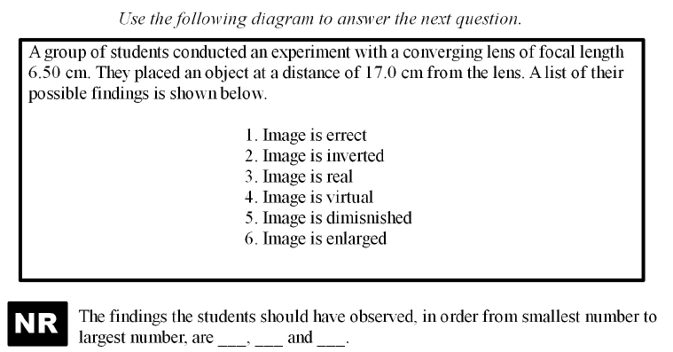

Slide 11
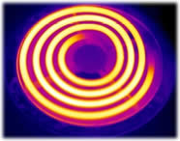
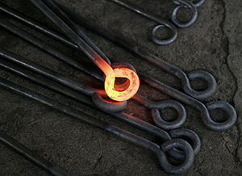
Blackbody Radiation
Stove burner

Slide 12
Blackbody Radiation
It was known that as one heats an object it changes color. What colors can you name as objects heat up?
The color corresponds to the emission of EMR. As the object gets hotter it should emit greater and greater frequencies of EMR.

Slide 13
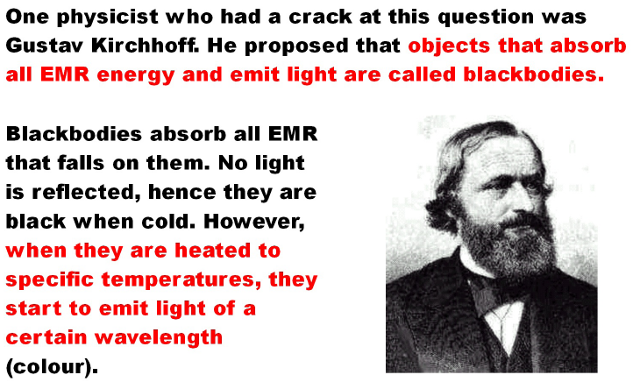

Slide 14
Predicted Wavelengths
It was predicted that an ideal blackbody at thermal equilibrium will emit EMR with infinite power under classical physics
However, blackbodies only emit wavelengths of certain color when at certain temperatures as shown by the graph on the next page

Slide 15
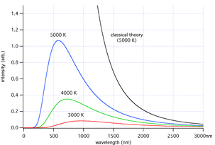
Predicted vs. Actual Blackbody Radiation

Slide 16
Ultraviolet Catastrophe
Since values above the visible light region did not occur in increasing amounts as predicted, scientists were at a loss to explain the results and called this the Ultraviolet Catastrophe.

Slide 17
Max Planck
Max Planck resolved this issue by postulating that electromagnetic energy did not follow the classical description
Planck assumed that the energy given off by these objects had to occur in discreet units (bundles) of energy. Each of these bundles had a specific quantity of energy associated with it. He called these units Quanta.

Slide 29
Examples
1. How much energy does a photon (quantum) with a frequency of 2.00 x 10¹⁴ Hz have in J and eV?
2. What is the wavelength of a photon having 5.97 x 10⁻¹⁵ J of energy? What part of the EMR spectrum is this?
3. How many photons are given off each second by a green (λ = 555 nm) 60.0 Watt light bulb?

