Slide 7
Images
When you look into a plane (flat) mirror, it appears that your reflection is behind the mirror. This type of image is said to be a virtual image.
Optically, there is no difference between a virtual image and a real image; that is, your eye can not tell the difference between the two.

Slide 8
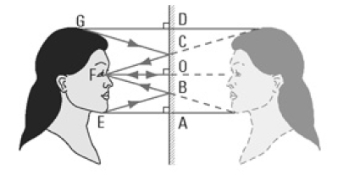
Images

Slide 10
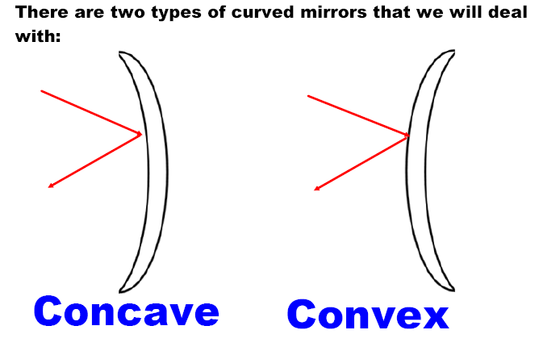

Slide 12
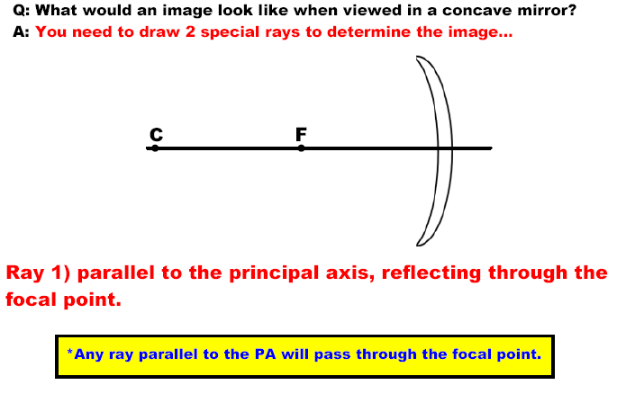

Slide 14
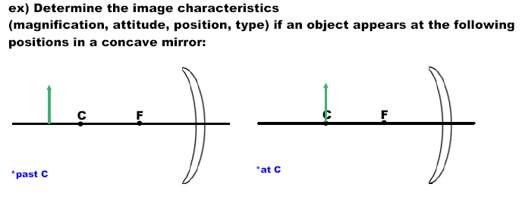
Mirror App

Slide 17
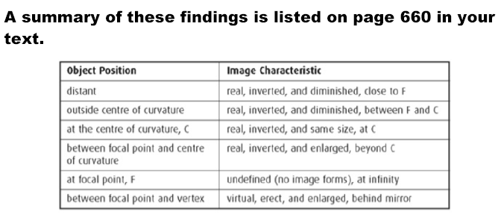

Slide 18
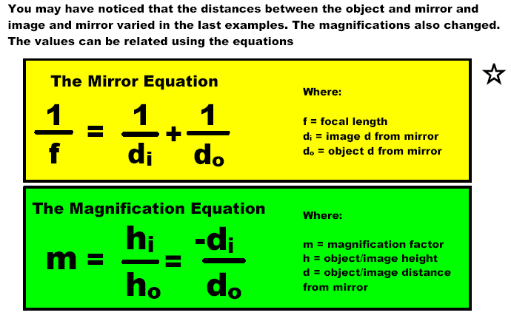

Slide 19
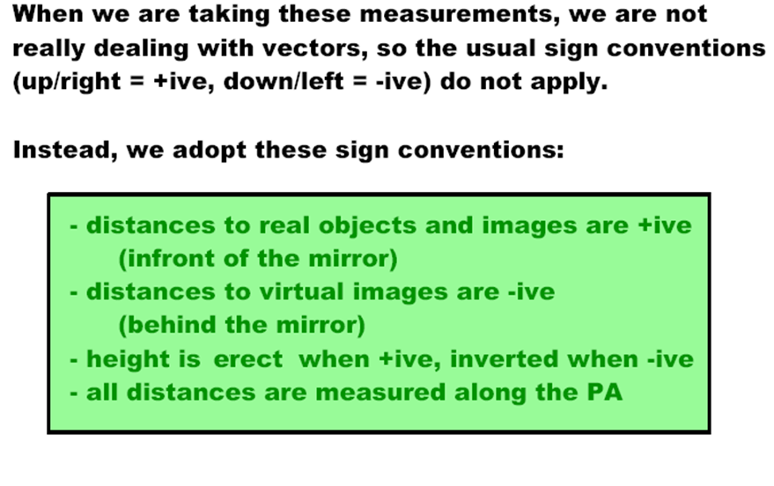

Slide 22
