Slide 1
Refraction
Lesson 4

Slide 2
Objective
You will be able to qualitatively and quantitatively describe the behavior of waves as they pass from one medium to another.

Slide 3
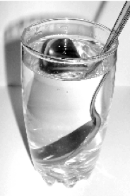
Definition
Refraction occurs when a wave changes the direction in which it is moving. This change in direction is caused by a change in speed as the wave passes from one medium to another.
As light travels from the water into the air, its path changes because light travels at different speeds, and the spoon appears to be bent.

Slide 4
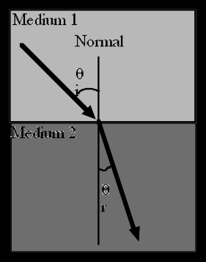
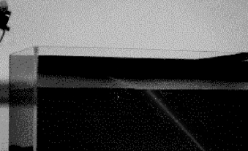
Waves v. Particle
For water waves, it was shown that as they slowed, going from one medium to another, they bent toward the normal.
Light also bends toward the normal (if travelling from less dense to more dense).

Slide 5
Waves v. Particle
According to wave theory, light would bend toward the normal if it slowed down upon entering a different (more dense) medium.
According to Newton, if light were a particle, it would experience gravitational attraction and speed up after entering a different medium.

Slide 6
Waves v. Particle
It was not until 1850 (almost 120 years after Newton) that two French scientists, Fizeau and Foucault, were able to measure the speed of light in water. They found that it traveled slower in water compared to air, thus supporting the wave theory.

Slide 7
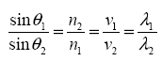
Snell’s Law
Snell had compared speed, wavelength and the angles of incidence and refraction to arrive at his equation.
The n is called the absolute index of refraction and is a ratio of how much light bends when it enters a different medium. Air is always 1.00

Slide 8
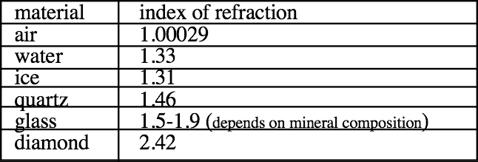
Index of Refraction
The greater the index the more light bends or slows down. This means that all indices will be greater than 1.00.

Slide 9
Example 1
Light goes from water (n=1.33) to air. Calculate the angle in the air if the angle in the water is
47º
48º
49º
This is the angle at which light stops refracting and is reflected. It is the critical angle.

Slide 10
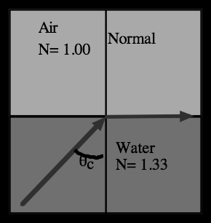
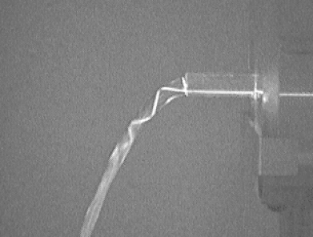
Internal Reflection
The angle of incidence creating an angle of refraction equal to 90° is called the critical angle.
An incident angle greater than the critical angle will always result in total internal reflection.

Slide 11
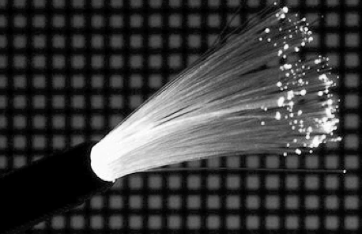
Example 2
Calculate the critical angle for light moving from diamond (n=2.40) to glycerine (n=1.46).
Total Internal Reflection is the principle involved in Fiber Optics.

