Slide 1
Light
Lesson 2
Measuring the Speed of Light

Slide 2
Objectives
You will be able to :
Describe qualitatively some experiments measuring the speed of light
Quantitatively calculate the speed of light using Michelson’s apparatus.

Slide 3
Speed of Sound
It was known that the speed of sound was about 330 m/s.
One experiment was to place an observer on hill A and another on B.
Person at A fires a cannon and drops flag. Person at B starts water clock. When person at B hears sound the water clock is stopped.
The time that it took sound to get to person B could be measured. ( v = d/t ).

Slide 5
Speed of Light

Slide 7
Roemer and Huygens
The difficulty in showing that light had a finite speed is apparent from the above example.
Not until distances become very great is one able to truly see that it is so.
Olaus Roemer was an astronomer in 1676. He studied the moon of Jupiter called Io and its 42.5 h orbit.

Slide 9
Roemer and Huygens
He made 70 measurements and found that the time that Io would appear from behind Jupiter would vary by as much as 14 s.
He extrapolated his data and concluded that the maximum difference in the time it takes to travel to earth would be 22 minutes and that it was due to the movement of the Earth away from Jupiter as it moves around the Sun.

Slide 10
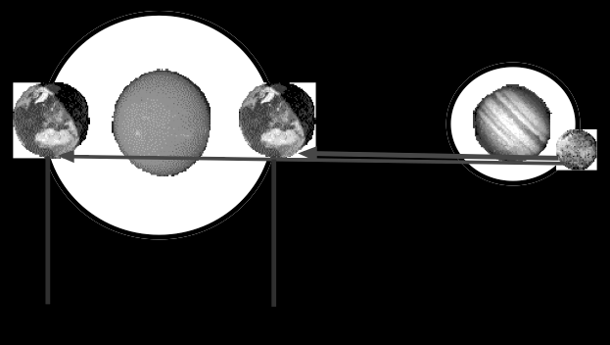
Roemer and Huygens
This “late” time was the time it took light to cover the extra distance.

Slide 11
Roemer and Huygens
Roemer could not calculate the speed of light because the distance from the Earth to the Sun (R_{E}) was not known at this time.
Huygens estimated the diameter of the Earth's orbit around the Sun and used Roemer's data to calculate the speed of light. He obtained a value of 2.00 x 10 ⁸m/s.
The error was due to the error in “late time” observed by Roemer. The actual late time is 16 mins and not the 22 mins that Roemer stated.
**The modern value for the speed of light in air is 3.00 x 10⁸ m/s.

Slide 12
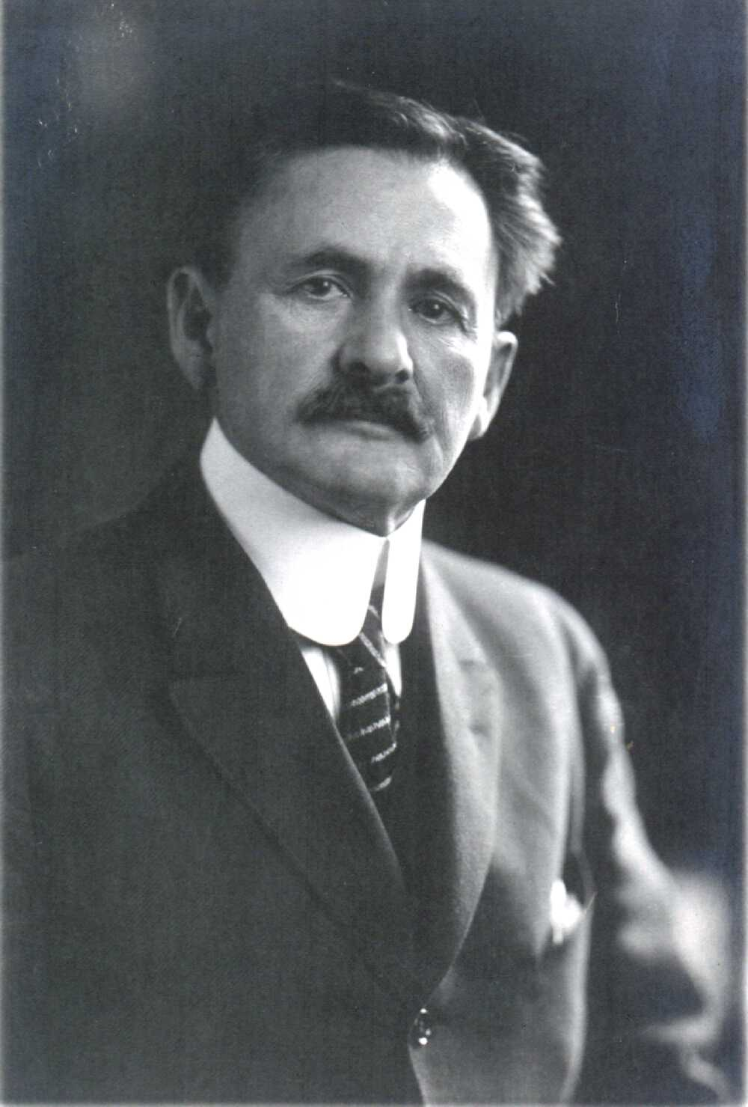
Michelson’s Wheel
The most accurate measurements were performed by A.A. Michelson in the period between 1880 - 1930.
In 1926 he measured the time required for light to travel through an evacuated pipe that was constructed between two mountains 35 km apart.

Slide 13
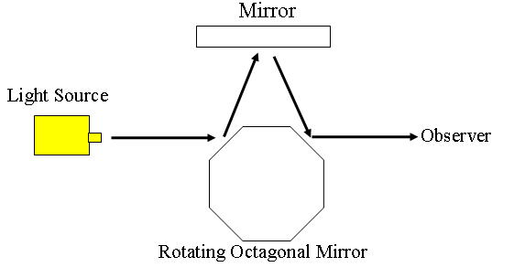
Michelson’s Wheel
He used a high speed rotating octagonal mirror set up as follows.
B
A
C

Slide 14
Michelson’s Wheel
Line everything up while the 8 sided mirror is stationary.
The image (light) will return to the same position on the screen if side B moves to exactly the same position as side C was in the time that it takes the light to go to the plane mirrors and back. (1/8 of a revolution)

Slide 15
Example
The octagonal wheel turns at 30000 RPM (frequency) and an image is seen on the screen.
How many times does the mirror turn in 1 s?
Determine the time required for the mirror to go totally around once.
Calculate the time for side B to get to side C.
This formula must be memorized!

Slide 16
Example
Using the currently accepted value for the speed of light, calculate how far apart the two mirrors would need to be placed if the octagonal mirror is able to turn at 30 000 RPM.
How fast would a hexagonal mirror need to turn if the stationary mirror is 20.0 km from the rotating mirror?

