Slide 1
Lesson 5
Lenses

Slide 2
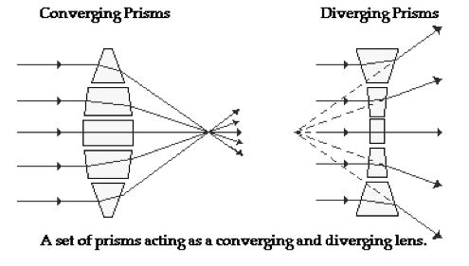
Anatomy of a Lens
Transparent material is capable of causing parallel rays to either converge or diverge depending upon its shape.

Slide 3
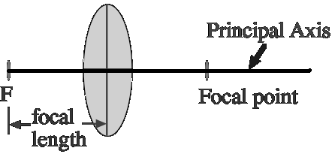
Double Convex Lenses
A double convex lens will cause light rays
that approach parallel to the principal axis to
converge to a point called the focal point.
The distance between the central axis and
the focal point is known as the focal length.

Slide 4
Case 1
Object is located beyond 2F
• The image is inverted, smaller, real
and closer to the lens than the object.

Slide 5
Case 2
Object located at 2F
• The image is inverted, same size,
real and same distance from the lens
as the object is.

Slide 6
Case 3
Object between F and 2F
• The image is inverted, larger, real and
further away than the object is from the
lens.

Slide 7
Case 4
Object at F
Refracted rays are parallel so no
image is formed.

Slide 8
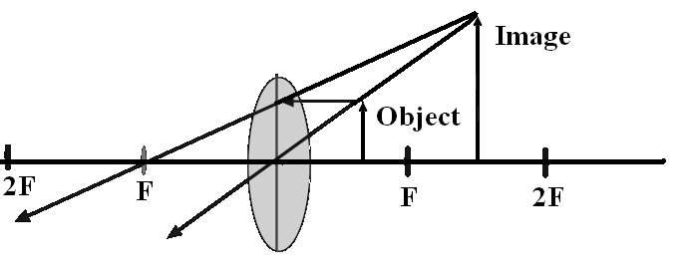
Case 5
Object between F and the lens
The image is erect , larger and on the
same side of the lens as the object
(virtual).

Slide 9
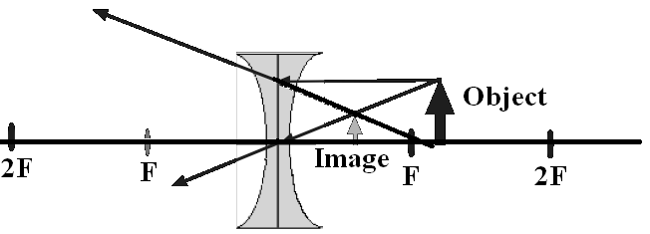
Case 6 - diverging lens
The ray from the object to the lens
parallel to the axis is bent outward as if
it had started from the first focal point.
• Image is erect, smaller, virtual and
between object and lens.

Slide 10
Lens Formulas
Formulas are the same as for mirrors:

Slide 11
Example
A 4.0-cm tall light bulb is placed a
distance of 45.7 cm from a double convex
lens having a focal length of 15.2 cm.
Determine the image distance and the
image size.

Slide 12
Sign conventions
f is + if the lens is a double convex lens
(converging lens)
f is - if the lens is a double concave lens
(diverging lens)
d_{i} is + if the image is a real image and located
on the opposite side of the lens.
d_{i} is - if the image is a virtual image and located
on the object's side of the lens.
h_{i} is + if the image is an upright image (and
therefore, also virtual)
h_{i} is - if the image an inverted image (and
therefore, also real)

Slide 13
Solution
The image will be inverted, 1.99-cm tall and
located 22.8 cm from the lens. The results of this
calculation agree with the principles discussed
earlier in this lesson. In this case, the object is
located beyond the center of curvature (which
would be two focal lengths from the lens), and the
image is located between the center of curvature
and the focal point.
The negative values for image height indicate that
the image is an inverted image. In the case of the
image height, a negative value always indicates an
inverted image

