Slide 1
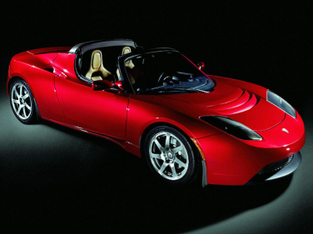
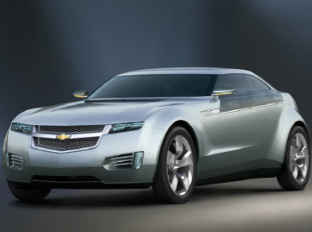
The Electric Motor
Lesson 6

Slide 2
Objectives
explain, quantitatively, the effect of an external magnetic field on a current-carrying conductor.
describe, qualitatively, the effects of moving a conductor in an external magnetic field, in terms of moving charges in a magnetic field.

Slide 3
Diploma Question Alert!

Slide 4
Diploma Question Alert!

Slide 5
Diploma Question Alert!

Slide 6
Diploma Question Alert!

Slide 7
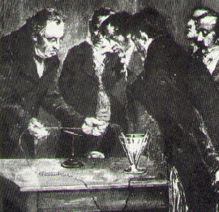
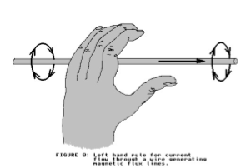
Current Carrying Wires
Recall Hans Christian Oersted‘s discovery:
"A current carrying wire produces a magnetic field!"
We can determine the direction of this B-field using the first LHR:

Slide 8
Force…
We have also seen that charged particles placed in an external magnetic field experience a magnetic force:

Slide 9
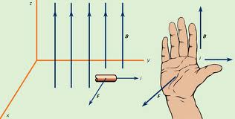
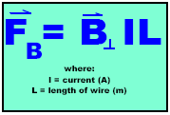
Force in a Current Carrying Wire
A current carrying wire placed in an external magnetic field experiences a magnetic force, just like a point charge.
The direction of the force can be found by using the 3rd LHR.
The magnitude of the force can be found using the equation:

Slide 10
The discovery of this force led to many important inventions such as:
The Electric Motor
The Galvanometer

Slide 11
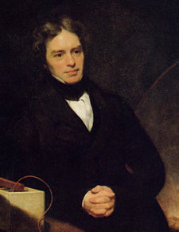
The Electric Motor
Oersted's discovery that a current carrying wire can experience a force in a B-field interested another giant in the world of science: Michael Faraday.
Faraday built a simple motor out of a current carrying wire suspended in a pool of mercury containing a magnet
This acted as a forerunner for other modern electric motors

Slide 12
Building a Simple Motor
Building a motor

Slide 13
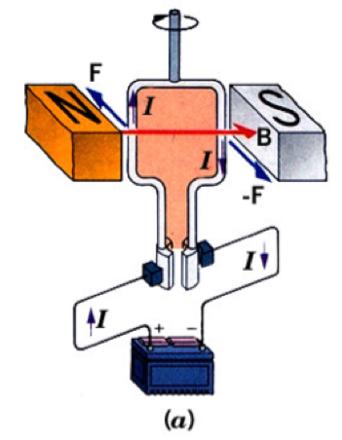
Workings of an Electric Motor
Made of 4 main parts:
1. Magnetic Field
2. Armature/Rotor
3. Brushes
4. Split Ring/Commutator
*Note: this diagram uses conventional current, so you will need to use your 3rd RHR to analyze it.

Slide 14
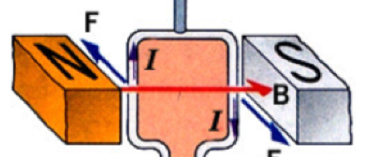
1. The Magnetic Field
All electric motors need an external magnetic field provided by a permanent magnet
The magnet and the apparatus holding it is sometimes called the stator

Slide 15
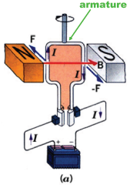
2. The Armature/Rotor
A loop of current carrying wire
often more than one loop to increase the overall force
The direction of the force can be found using the 3rd *HR
The loop is attached to the payload (what you want to spin...)

Slide 16
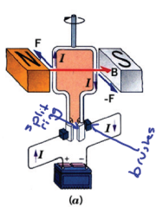
3. Brushes and 4. Split Ring/Commutator
In order for the motor to keep spinning, the direction of the current must reverse every half-rotation
The split ring contains a gap that momentarily breaks the circuit before allowing current to reverse
The brushes provide a contact point between the armature and the split ring

Slide 17
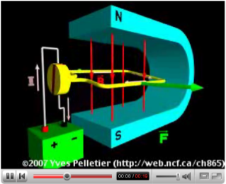
http://www.youtube.com/watch?v=FjNnRyLexNM&feature=related
http://www.youtube.com/watch?v=Xi7o8cMPI0E&NR=1

