Slide 1
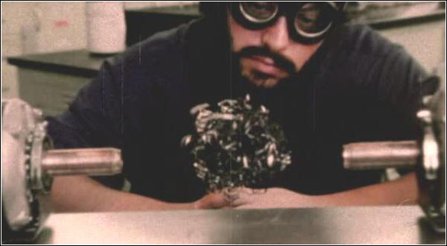
Electricity and Magnetism
Lesson 2

Slide 2
Objectives
describe how the discoveries of Oersted and Faraday form the foundation of the theory relating electricity to magnetism.
describe, qualitatively, a moving charge as the source of a magnetic field and predict the orientation of the magnetic field from the direction of motion.

Slide 4
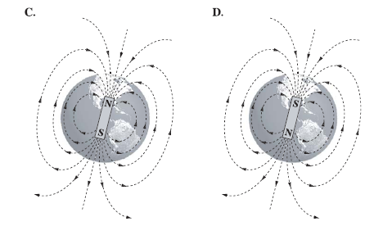
Diploma Question Alert!

Slide 5
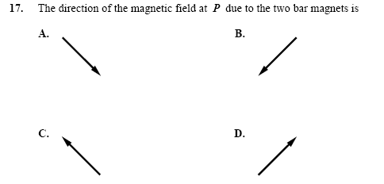
Diploma Question Alert!

Slide 6
Electricity and Magnetism
Early physicists treated electricity and magnetism as two different disciplines.
They saw no reasons the two should be related.
And everyone was OK with that...
everyone but...

Slide 7
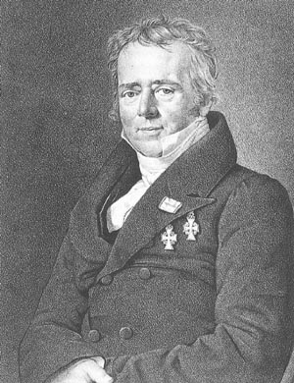
Hans Christian Oersted
18th century physics teacher
great lecturer
easy to excite
one of the first to determine a relationship between electricity and magnetism

Slide 8
The story goes like so...
“I was performing an experiment with a wire and a battery.”
“There was a current passing through the wire...”
“…and I noticed my compass (which I always have with me)”
“…started to do some very unusual things...”

Slide 9
“when the current was passing through the wire, the compass deflected from north...”
“…but when the current was turned off, the needle went back to normal."
It was if a current in a wire produced a magnetic field!

Slide 10
“I wanted an easy way of finding the direction of the magnetic field produced by a current carrying wire. So I took out my favorite hand (the left one) and yelled at the top of my lungs...”
“POINT THE THUMB OF YOUR LEFT HAND IN THE DIRECTION OF CURRENT FLOW! LET YOUR FINGERS CURL AROUND THE WIRE! THE DIRECTION OF YOUR FINGERS IS THE DIRECTION OF THE MAGNETIC FIELD!”
This has become known as the First Left Hand Rule

Slide 11
First Left Hand Rule
Thumb – current direction
Fingers – magnetic field direction

Slide 12
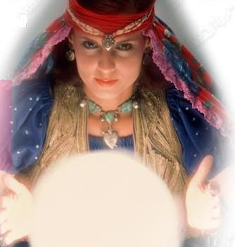
Don’t Be Shy and Fail...
Get used to using these hand rules…you need to do these hand actions! Don’t just ‘envision it in your head’. That stuff is for psychics, not physicists! You’re not a psychic, are you?!?!

Slide 13
Conventions for Drawing Current Carrying Wires

Slide 14
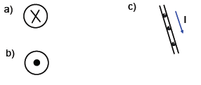
Examples
Determine the direction of the B-field around each wire.

Slide 15
What about my Right Hand?
We would use the same rule with the right hand for:
Conventional current
(proton flow)
NOTE: conventional current is not actually possible but is still used in some questions to evaluate understanding of principles of magnetism!

Slide 16
Coiled Wires
If a wire is coiled, a uniform field is produced inside the coil. This field is similar to that produced by a bar magnet.
This effect leads to many important technologies, like...

Slide 17
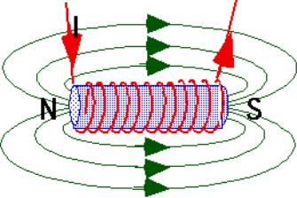
Solenoids (Electromagnets)
The wires produce a magnetic field (electromagnet).
The B-field is uniform and straight inside the solenoid.
Outside the solenoid, the field is comparatively weak and is the same shape as a field around a bar magnet.

Slide 18
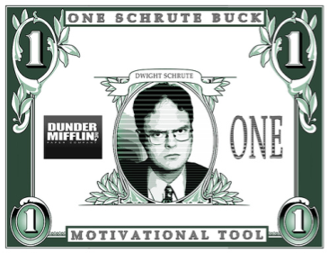
Question: How can we determine the direction of the B-field in a solenoid?
Answer: Develop another Left Hand Rule

Slide 19
Second Left Hand Rule
To determine the direction of current/B-field in a solenoid, curl your fingers and point your thumb, the fingers move in the direction of current flow the thumb moves in the direction of the B-field

Slide 20
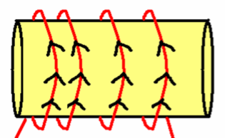
Example
Determine the direction of the B-field in this electromagnet. Label the N and S poles on the magnet.

Slide 21
Interactions of B-Fields
Field Lines move out from north poles into south poles.
Like poles repel…
Unlike poles attract…
What about current carrying wires?

Slide 22
To determine the interaction between two current carrying wires:
Draw the wires and direction of magnetic field.
Recall: direction of magnetic field is direction that a compass points.
Place a small imaginary bar magnet along each field line.
Check if the wires repel or attract.

Slide 23
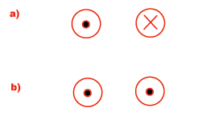
Example
What is the interaction between the wires?

Slide 24
Diploma Question Alert!

