Slide 1
Charged Particles in Electric Fields
Lesson 6

Slide 2
Behaviour of Particles and Newton’s Laws
An electric field shows the direction and relative magnitude of an electric force. (Field theory, E = F/q)
The electric force will cause an acceleration. (Newton's Second Law)
An acceleration will cause an object to start moving one direction or another. (Newton's First Law)
So, if we place a charged particle in an electric field, it will start to accelerate!

Slide 3
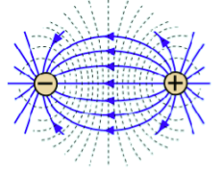
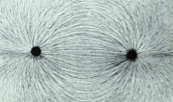
Recall the two categories of fields:
Non-uniform fields
Produced by single point charges or spheres
The field changes as the position of the test charge changes
Described by the equation
**In a non-uniform field, the field strength is constantly changing. This makes a full analysis of the motion beyond our scope (needs calculus).

Slide 4
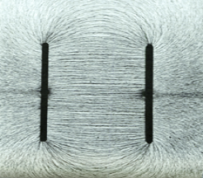
2. Uniform Fields
Produced by parallel plates field
has the same strength everywhere
Described by eqns:

Slide 5
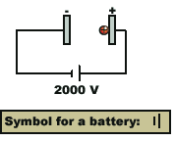
Examples
Two parallel plates are connected to a battery as shown. The battery supplies a potential of 2000 V. A sphere of mass 3.0 x 10⁻¹⁵ kg and q = +2.6 x 10⁻¹² C is placed on the +ive plate and released. Ignoring gravity,
a) what is the motion of the sphere?

Slide 6
b) if the separation between the plates is 4.5 cm, what is the electric field strength?

Slide 7
Examples
A small charge of mass 5.0 x 10⁻⁴ kg traveling at 350 m/s goes into a parallel plate capacitor as shown. The separation between plates is 5.50 cm and the potential difference between plates is 1000 V. The test charge has a q = +3.00 μC.
a) Which plate is the positive plate in the capacitor?

Slide 8
b) Assuming the charge enters at the top of the capacitor how far from the entrance will the charge hit the bottom plate?

Slide 9
c) What is the final velocity of the particle when it hits the bottom plate?

