Slide 1
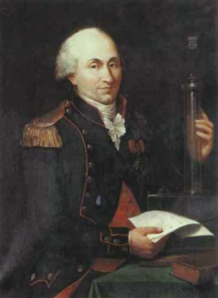
Coulomb's Law
Lesson 2

Slide 2
Objectives
explain, qualitatively, the principles pertinent to Coulomb’s torsion balance experiment.
apply Coulomb’s law, quantitatively, to analyze the interaction of two point charges.
compare, qualitatively and quantitatively, the inverse square relationship as it is expressed by Coulomb’s law and by Newton’s universal law of gravitation.

Slide 3
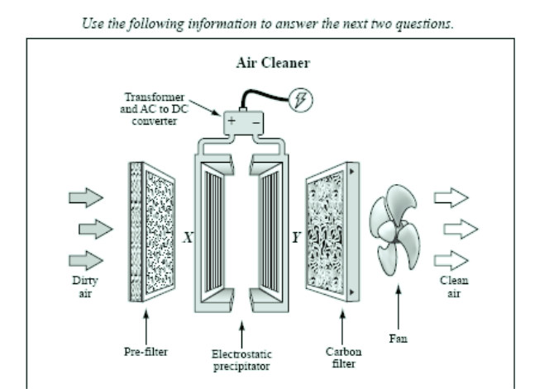
Diploma Question Alert!

Slide 4
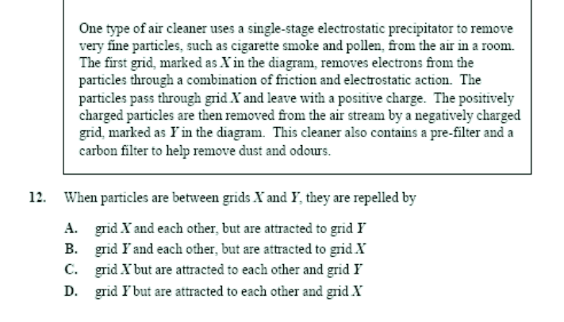

Slide 5
Coulomb's Law
The problem of the electric force puzzled a great physicist: Charles Coulomb (1736-1806).
Coulomb wanted a way of measuring the force acting between two charged objects.
But because the force was quite small (he could only generate charge by friction), he had to use a very delicate apparatus...
What kind of apparatus should he use?

Slide 6
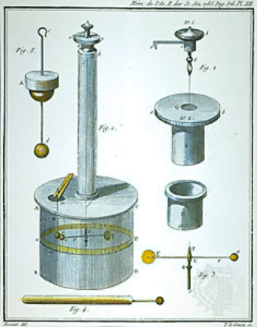
Coulomb needed a way of measuring very small forces between objects: his idea for measuring was called a torsion balance (1777).
A similar apparatus was used again in 1798 by Henry Cavendish in order to determine the density of the Earth and, eventually, G.

Slide 7
How did the Torsion Balance Work?
Coulomb would charge the balls by friction.
The red balls are attached to an axis which is suspended by a wire and are free to rotate.
As the red balls are either attracted or repulsed from the grey ball, the axis and wire twists. By measuring the twist in the wire, the force can be determined.

Slide 8
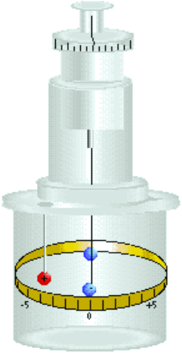
Coulomb's Torsion Balance

Slide 9
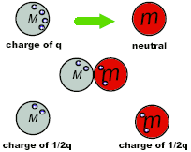
Because Coulomb had no way of measuring the actual charge on each ball, he used the concept of charge sharing to determine the relative charge on each.
He placed some charge on one ball. He did not know how much charge was on it, so he just called it q.
Through this method, he was able to vary the charge in fractions of some original charge q and could use these relative values in his calculations.

Slide 10
Q – So What Did Coulomb Find?
Coulomb made two observations:
Observation 1:
There is an inverse square relationship between the magnitude of the force and the separation of the objects.
where r = distance between charged objects.

Slide 11
Observation 2:
There is a direct relationship between the magnitude of the charges and the force.
Together, Coulomb was able to write a proportionality for the electric force:

Slide 12
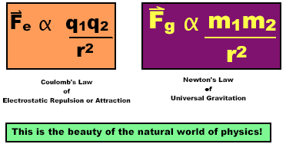
Note the similarity...

Slide 13
Any proportionality can be made into an equation by introducing a constant.
For Coulomb's Law, the constant k is used.
When substituted, we get:
where: F_{e} = electric force between charged objects (N)
k = electrostatic constant (Nm²/C²)
q₁ = charge on object 1 (C)
q₂ = charge on object 2 (C)
r = distance between charges (m)

Slide 14
Examples
ex) Determine the magnitude of the electrostatic force between each object.

Slide 15
*What is the direction of the force?
Because each charge is +ive, it is a repulsive force. Which means q₁ moves left at 26 N and q₂ moves right at 26 N.

Slide 16
Examples
ex) Determine the magnitude and direction of the electrostatic force between each object.

Slide 17
Examples
ex) The two charges below are now brought into contact with one another then separated. What is the electrostatic force between the objects?

Slide 18
Examples
ex) The electrostatic force between 2 small charged objects is 5.0 x 10⁻⁵ N. Find Fe if:
distance is doubled.
charge on one object is tripled, while the charge on the other is halved.

Slide 19
Examples
ex) In a hydrogen atom, the average separation distance between the nucleus and electron is 5.3 x 10⁻¹¹ m. Using your data sheet, compare the gravitational and electric forces at work.

Slide 20
The Coulomb (C)
Let's talk a little about the unit of C...
1 C is the amount of charge on 6.25 x 10¹⁸ individual electrons (the amount of charge passing through a 60 W light bulb in 2.0 s).
ex) What is the charge on a single electron?
This amount is called the elementary charge.

Slide 21
Examples
Ex) How many free electrons are on this charged object?

