Slide 1
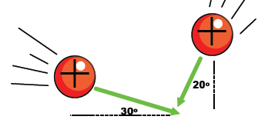
Coulomb’s Law in 2D
Lesson 3

Slide 2
Objectives
determine, quantitatively, the magnitude and direction of the electric force on a point charge due to two or more other point charges in a plane.

Slide 3
Review
ex) Two equally charged pith balls are 3.0 cm apart in air and repel each other with a force of 4.0 x 10⁻⁵ N. Find the charge on each ball.

Slide 4
Diploma Question Alert!

Slide 5
Diploma Question Alert!

Slide 6
Vector Nature of Coulomb's Law
The electric force is a vector, which means it can be added, subtracted or broken into x and y components like any other vector.
Mind your negative signs (for direction only!!!)

Slide 7
Note: Enter the test charge!
A test charge is an imaginary object of set charge and negligible mass. It is used to determine the direction of the electric force at a particular position.
This is probably not what it looks like...

Slide 8
Example:
A test charge Q₂ (q = 2.0 μC) is placed halfway between a charge Q₁ = 6.0 μC and a charge Q₃ = 4.0 μC which are 10 cm apart. Find the force on Q₂ and its direction.
Step 1: Determine each electric force.
Step 2: Determine the total force on the testy.

Slide 9
Example
Find the force on the 3rd charge:

Slide 10
Example
Find the force on the 2nd charge:

Slide 11
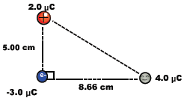
Example
Find the net force acting on the test charge.

Slide 13
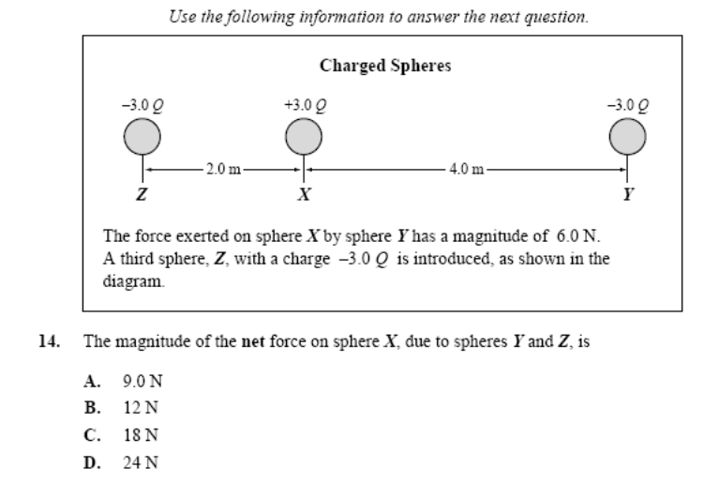
Diploma Question Alert!

