Slide 1
Collisions in 1D
Lesson 3

Slide 2
Objectives
explain, qualitatively, that momentum is conserved in an isolated system.
explain, quantitatively, that momentum is conserved in one and two-dimensional interactions in an isolated system
define, compare and contrast elastic and inelastic collisions, using quantitative examples, in terms of conservation of kinetic energy.

Slide 3
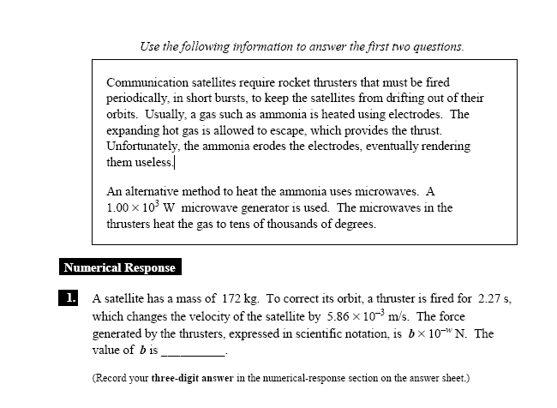
Diploma Question Alert!

Slide 4
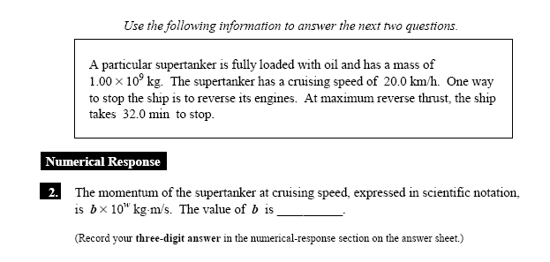
Diploma Question Alert!

Slide 5
Diploma Question Alert!

Slide 6
Momentum is Conserved in an Isolated System
Isolated System: does not allow matter or energy to pass in or out.
This means that:
This is a conservation law, just like matter, energy, charge...

Slide 7
Conservation of Momentum
Conservation of momentum can be written mathematically as:
where
Σ is the greek symbol sigma and means "the sum of".

Slide 8
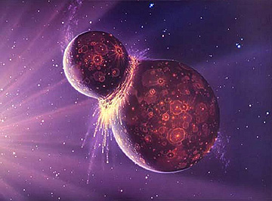
This allows us to examine a very special type of situation in physics: the collision.

Slide 9
Collisions
There are two types of collisions we study:
1. Elastic Collision: objects collide and bounce back without deforming, there is no energy lost. (ex: pool balls colliding).
2. Inelastic Collision: objects collide but deform in some way, losing energy (ex: a volleyball hitting the floor). Objects bounce back less or not at all (hit and stick).

Slide 10
1D Collision Example
A 0.25 kg volleyball is flying west at 2.0 m/s when it strikes a stationary 0.58 kg basketball dead centre. The volleyball rebounds east at 0.79 m/s. what will be the velocity of the basketball immediately after impact?
Step 1: Make a free-body diagram.
Step 2: Write the conservation statement.
Step 3: plug and chug (mind your negatives!)

Slide 11
Example
A 125 kg bighorn ram butts heads with a younger 122 kg ram during mating season. The older ram is rushing north at 8.50 m/s immediately before collision, and bounces back at 0.11 m/s [S]. If the younger ram moves at 0.22 m/s [N] immediately after collision, what was its velocity just before impact?

Slide 12
Question: was this collision elastic or inelastic?
If the collision was elastic, then there will be a conservation of energy.

Slide 13
Hit and Stick Example
A 1100 kg car traveling at 25 km/h [E] collides with a 1300 kg car traveling at 15 km/h [W]. After collision, the two cars stick together. What is the velocity of the cars after impact?

Slide 14
Explosion Example
A pizza pop of mass 250 g is initially at rest. If it is heated and explodes into two chunks, one with mass 100 g moving at 3.0 m/s left and the other with mass 150 g moving right, what is the velocity of the second chunk?

Slide 15
Example
A 0.050 kg bullet is fired from a 5.0 kg gun. If the velocity of the bullet is 275 m/s, what is the recoil velocity of the gun?

Slide 16
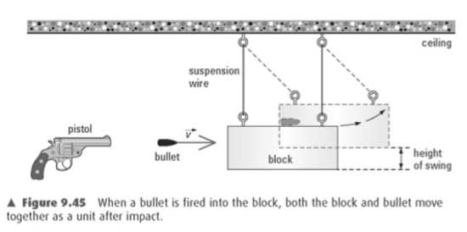
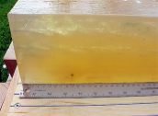
Ballistics Pendulum example:
Today, ballistics gel is used to
determine velocities of
projectiles like bullets.

Slide 17
Example con’t.
A 2.59 g bullet strikes a stationary 1.00 kg ballistic pendulum, causing the pendulum to swing up to 5.20 cm from its initial position. What was the speed of the bullet immediately before impact?
Step 1: Use conservation of energy to determine velocity of the block-bullet system.
Step 2: Use conservation of momentum to find the velocity of the bullet before impact.

Slide 18
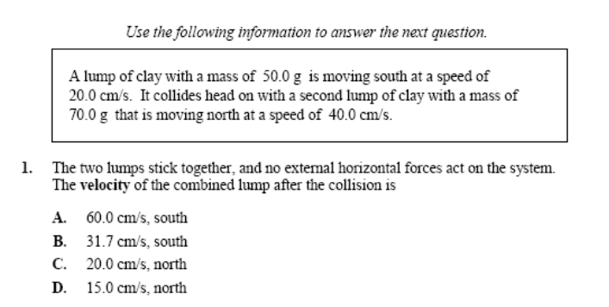
Diploma Question Alert!

Slide 19
Diploma Question Alert!

Slide 20
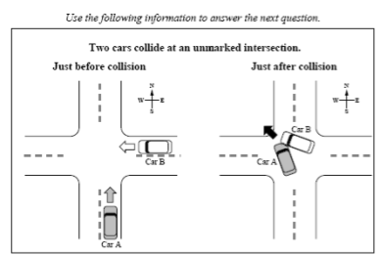
Diploma Question Alert!

