Slide 5
Standing Wave
Wave Transmission

Slide 15
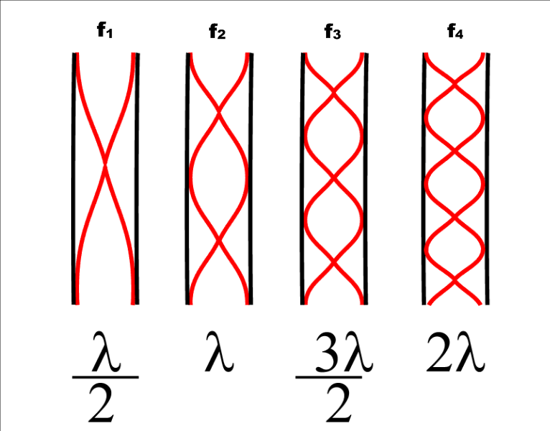

Slide 18
Loudness vs. Pitch
Pitch is a property of waves that results from the FREQUENCY of a wave.
the lower the frequency (higher wavelengths), the lower the pitch
the higher the frequency (lower wavelengths), the higher the pitch
Loudness is a property of waves that results from the AMPLITUDE of a wave.
the lower the amplitude, the quieter the sound
the higher the amplitude, the louder the sound
wavelength is independent of amplitude!!

