Slide 8
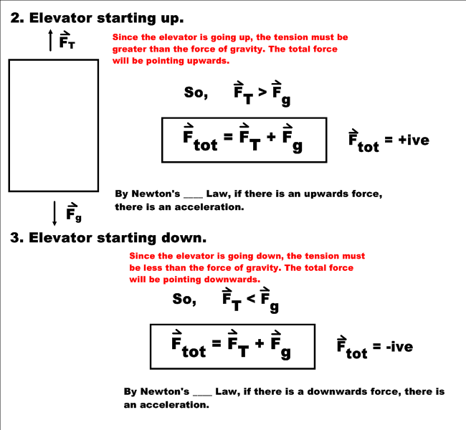

Slide 13
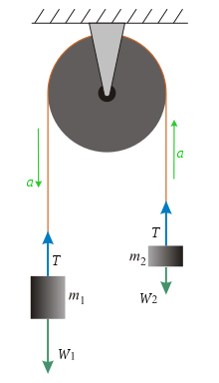
Calculating Tension
Forces affecting m₁:
Forces affecting m₂:
and adding the two previous equations we obtain
and our concluding formula for acceleration
m₁a = T – m₁g
m₂a = m₂g – T
m₁a + m₁g = m₂g – m₂a
$$a=\frac{g(m_{2}−m_{1})}{m_{1}+m_{2}}$$

Slide 14
Tension Continued
Solving for a in the previous formulas, then equating the two formulas (thus getting rid of a), and solving for T we get:

