Slide 11
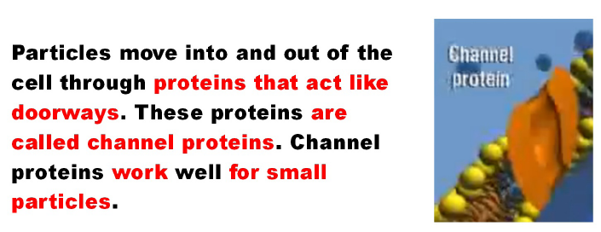

Slide 12
How facilitated diffusion works

Slide 15
How active transport works

Slide 18
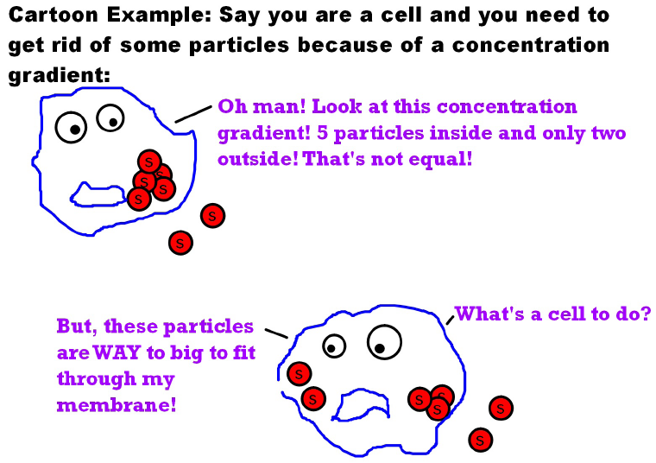

Slide 19
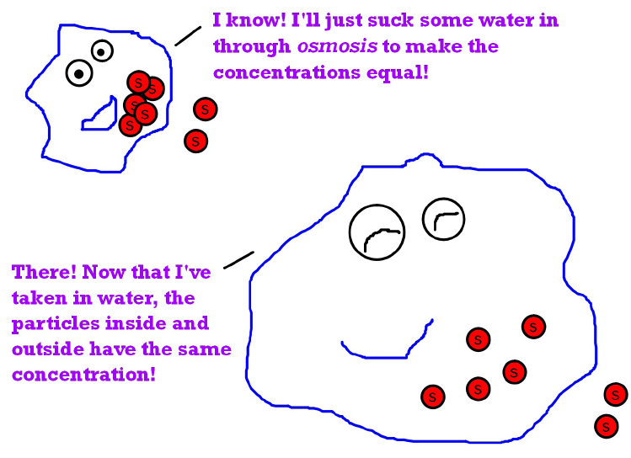

Slide 21
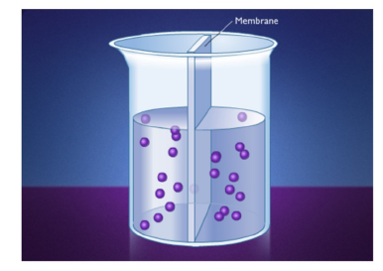
How osmosis works

Slide 22
Endocytosis

