Slide 1
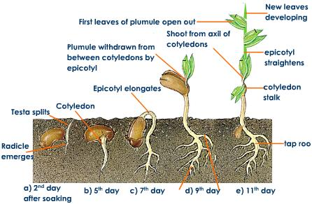
Plant Growth and Development

Slide 2
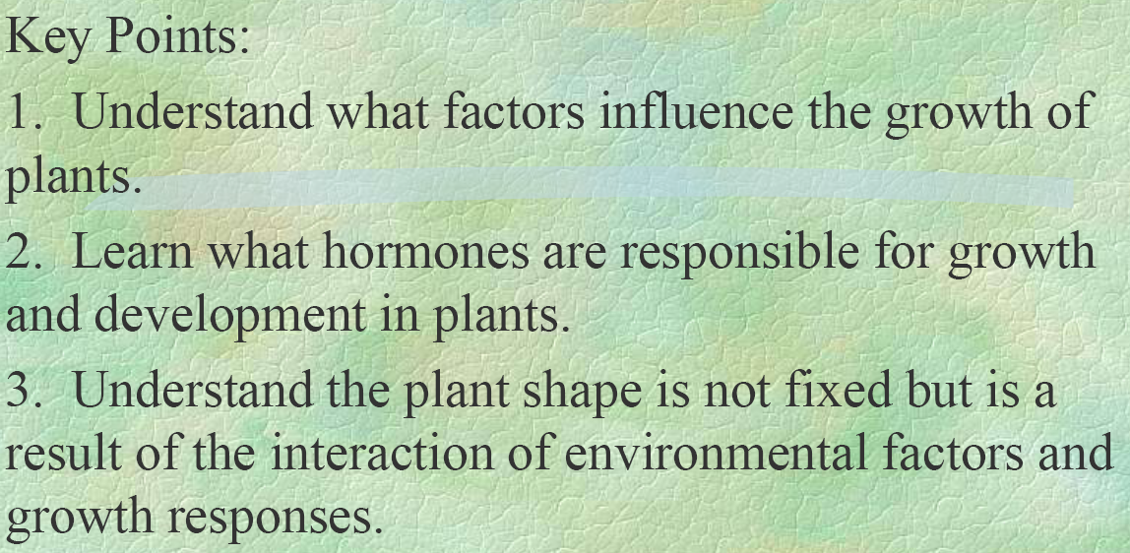

Slide 7
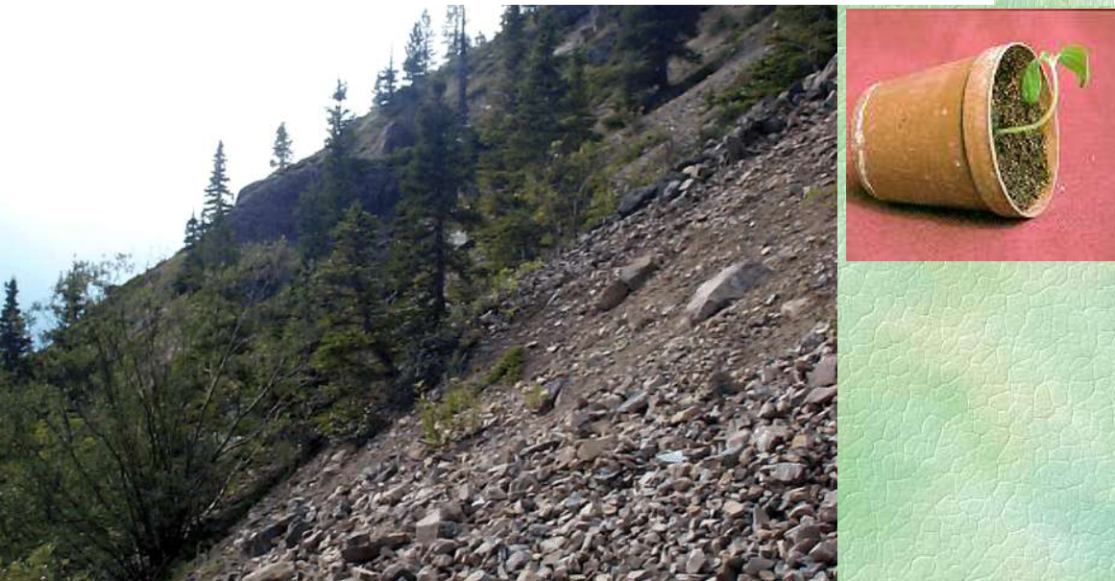
Gravitropism
Gravitropism is caused by gravity and can be seen in trees that grow on steep hillsides

