Slide 8
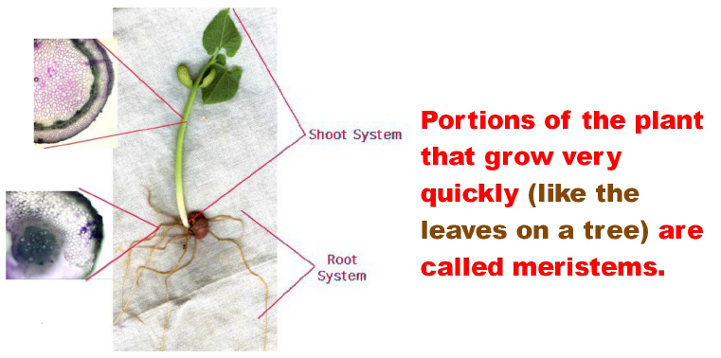

Slide 10
http://www.youtube.com/watch?v=ClynhFKMs3c

Slide 15
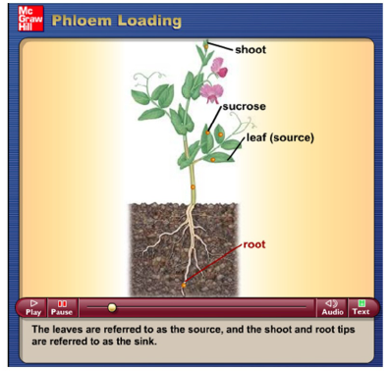
Phloem Loading

