Slide 1
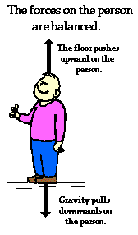
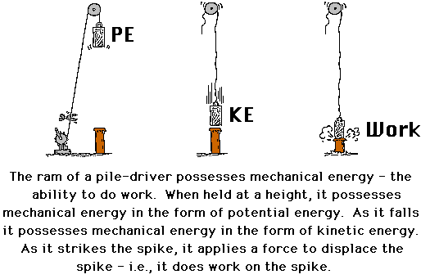
Force and Work
Force
Work

Slide 2
A. Force
Whenever an object accelerates there has to have been a force applied to the object that changed its velocity
The only way in which an object speeds up or slows down is if there is a push or pull. The amount that the object accelerates depends upon two things; its mass and the force applied to the object.
What would happen if the same object is pushed with two different forces?
Example: Suppose that you push a stopped tennis ball with a little push and then with a big push. Which time will the ball have a greater acceleration?
We can say that there is a direct relationship between force and acceleration, the greater the force, the greater the acceleration

Slide 3
What would happen if the same force (amount of push) were applied to two objects having different masses?
Example: Suppose that you push a bowling ball and a tennis ball with the same force. Which object would have a greater acceleration?
We can see that there is an inverse relationship between the mass and acceleration. The greater the mass is for a certain force, the smaller will be its acceleration
Formula F_{net} = ma
where F_{net} => force (N, Newtons)
m => mass (kg)
a => acceleration (m/s²)
The unit of force, Newton, was named after the physicist Sir Isaac Newton.

Slide 5
Example 1: A person pushes a 10 kg box and a 1.50 m/s² acceleration is noticed. What was the net force that was applied to the box?
Example 2: A 2000 kg car is decelerating at a rate of 2.3 m/s². What net force was required in order to slow the car down?
Example 3: What is the mass of a rock that hits the ground with a force of 150N?
(NOTE: the acceleration due to gravity- g – is equal to 9.81 m/s²)

Slide 6
Example 4: A small airplane with a mass of 1600kg touches down on a runway with a speed of 25m/s. It slows to a stop in 18s. Calculate the force required to stop the airplane (hint- you have to use 2 different formulas)

Slide 7
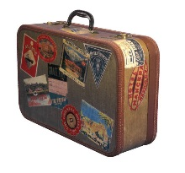
B. Work and Energy
Work is defined as a measure of the amount of energy transferred from one object to another
In order to do work a force must be applied over a certain distance.
In order for work to take place, the following conditions must be fulfilled:
There must be movement
A force is applied to the object
The force and the distance the object travels must be in the same direction (If the F_{app} and displacement are perpendicular, then the work is equal to zero)
Example: moving a suitcase – Is work being done?

Slide 8
The relationship between work and energy:
Energy is defined as the ability to do work.
If an object has energy, it can do work by transferring the energy to another object (as one object loses energy, the other gains the same amount of energy)
Therefore the change in energy = work, and therefore the units for energy is also joules (J)
Calculating work:
The formula for calculating work is:
Work = Force X distance
W = F • d
= Newton metres (N • m) Note: N = kg • m/s²
= Joules (J)
Therefore, 1 J = 1 kg • m²/s²

Slide 9
Examples:
Jonny pushes a box with a force of 200 N for a distance of 15.0 m. How much work did he do?
A log is pulled and 150 J of work is done as it moves 20.0 cm. What was the applied force?

Slide 10
A truck with a mass of 11 700 kg is traveling at 41 m/s. Suddenly, the driver slams on the brakes. The truck takes 5.00 s and 52 m to stop. Calculate the work done on the truck by the brakes (hint: you have to use 2 different formulas!)

