Slide 1
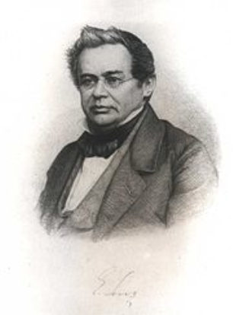
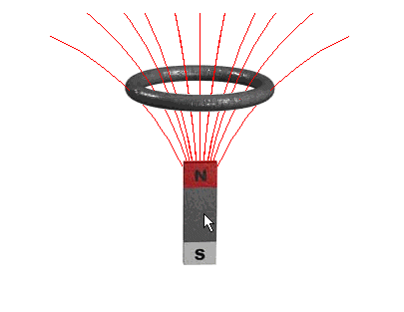
Lenz's Law
Lesson 8

Slide 2
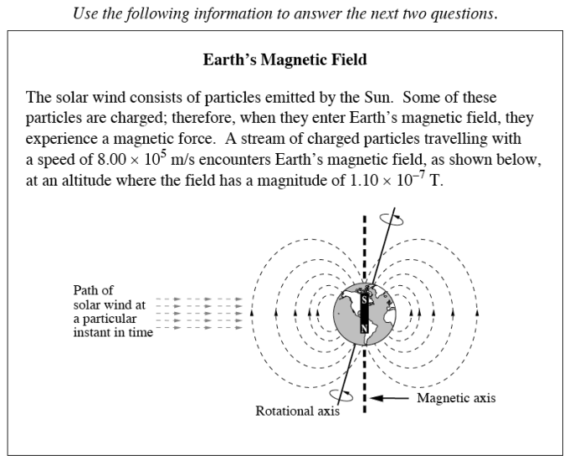
Diploma Question Alert!

Slide 3
Diploma Question Alert!

Slide 4
Diploma Question Alert!

Slide 5
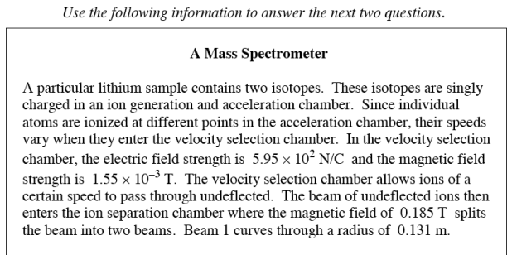
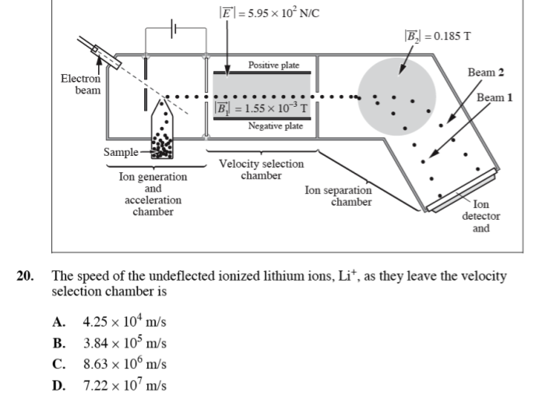

Slide 6
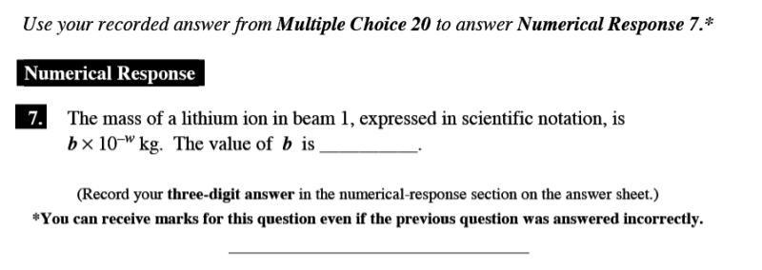
Diploma Question Alert!

Slide 7
Lenz's Law Demo

Slide 9
Henrich Lenz (1804-1865)
The conducting tube must apply some sort of force on the magnet... but where does it come from?
The answer: INDUCTION.

Slide 10
Theory…
As the magnet falls through the conductor, we have a situation just like a conductor moving through a B-field
This creates an induced current in the conductor
This induced current then produces its own magnetic field, which produces a force on the magnet
But what direction does this force go in?

Slide 11
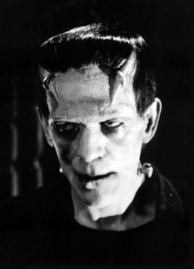
An Induction Paradox…
Imagine the force was directed downwards...
More force = more speed = more induced current
More induced current = more force = more speed = more induced current
More current = more current = more current = AH HA HA HA HA HAH HAH!!!

Slide 12
Lenz's Law
In order to obey the Law of Conservation of Energy, the force must act against the motion of the magnet
This forms Lenz's Law:
A magnet moving through a conductor induces a field such to oppose the direction of motion of the magnet.
Let's put this law to use...

Slide 14
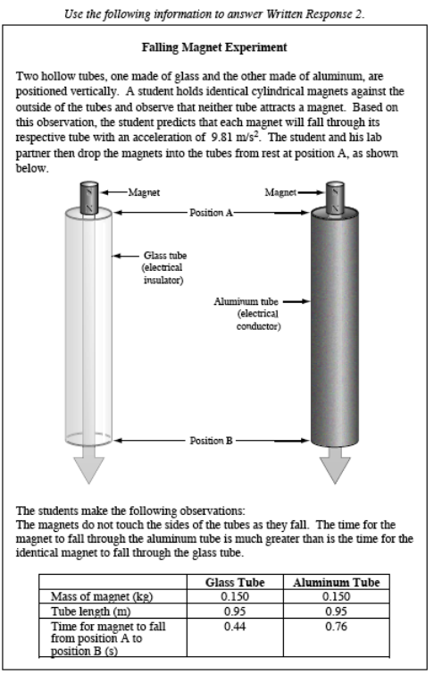
Diploma Question Alert!: Take Home Version!!

Slide 15
