Slide 1
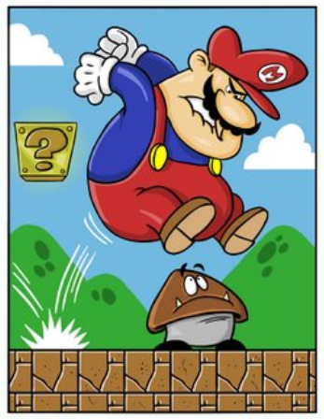
Collisions in 2D

Slide 2
Objectives
explain, quantitatively, that momentum is conserved in one and two-dimensional interactions in an isolated system

Slide 3
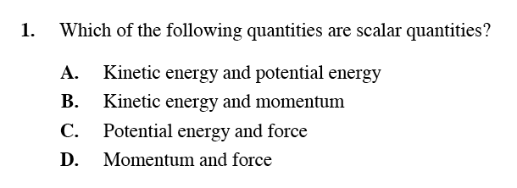
Diploma Question Alert!

Slide 4
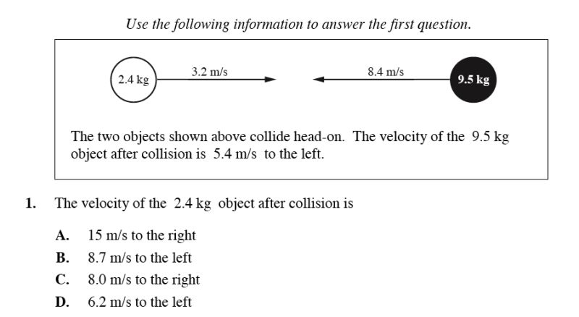
Diploma Question Alert!

Slide 5
Diploma Question Alert!

Slide 6
Nonlinear Conservation of Momentum
Just as momentum is conserved in one dimension,

Slide 7
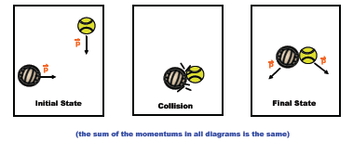
it is also conserved in other, nonlinear directions.

Slide 8
In situations where objects are moving in two dimensions (i.e. the x and y direction), we need to break the momentum vectors into components.
The components in the x direction will be conserved and the components in the y direction will be conserved.

Slide 9
Example/Steps
ex) A 4.0 kg cat is traveling South at 2.8 m/s when it collides with a 6.0 kg bat traveling East at 3.0 m/s. The objects stick together upon collision. What is the velocity of the cat-bat system?
Step 1: Draw a diagram.

Slide 10
Step 2: Write separate conservation statements for x and y directions.
x-direction y-direction
Step 3: Find final momentum in x and y direction

Slide 11
Step 4: Find the resultant momentum using vectors. Solve for velocity.

Slide 12
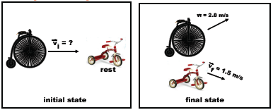
Let's take a look at a "glancing collision".
ex) A 4.0 kg bicycle is moving East at an unknown velocity when it hits a stationary 6.1 kg tricycle. After collision, the bicycle moves at 2.8 m/s 32˚ N of E and the tricycle moves at 1.5 m/s at 41˚ S of E. What is the initial velocity of the bicycle?

Slide 13
Step 1: Draw a diagram.
Step 2: Break vectors into components.

Slide 14
Step 3: Write conservation statements for the x and y.
Step 4: Solve for the unknown variable.

Slide 15
Step 5: Using the found momentum, determine the missing momentum and solve for velocity.

Slide 16
Diploma Question Alert!

Slide 17
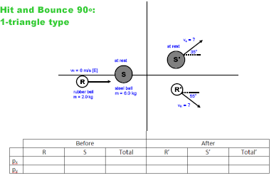
Example

Slide 18
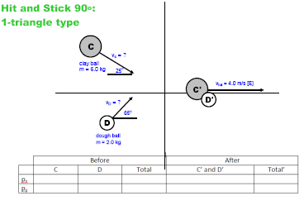

Slide 19
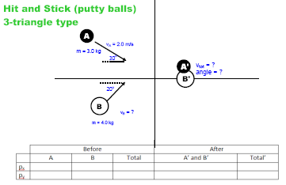

Slide 20
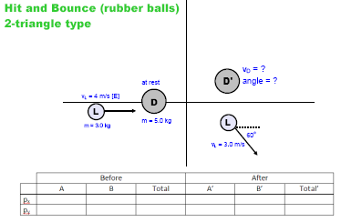

Slide 21
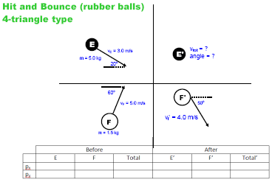

Slide 22
