Slide 1
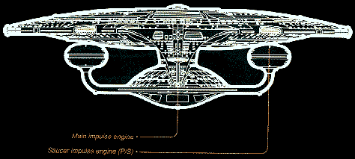
Impulse – A Change in Momentum
Lesson 2

Slide 2
Objectives
explain, quantitatively, the concepts of impulse and change in momentum, using Newton's laws of motion.
analyze graphs that illustrate the relationship between force and time during a collision

Slide 3
Review
Recall that Newton wrote his Second Law in terms of momentum. This could be arranged as:
From this, we can see that the product of force and time is momentum. Let's apply this to a real life situation.

Slide 4
Assume we have an egg with mass m and initial velocity v_{i}, dropped onto two different floors: one concrete floor and one with padding on it.

Slide 5
The p_{i} is each trial is the same as the mass and velocity of each egg is equal.
The p_{f} are both 0 as the egg comes to a stop.
This means the change in momentum is the same in each trial.

Slide 6
Now, just because the momentums are the same does not mean the force and time are the same:
eg) Δp = FΔt
12 Ns = (1 N)(12 s)
12 Ns = (2 N)(6 s)
12 Ns = (3 N)(4 s)
12 Ns = (4 N)(3 s) ...etc...
*Force and time can
vary, but as one goes up, the other goes down if momentum must be the same.

Slide 7
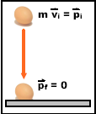
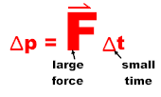
In the first trial, the time the egg takes to stop is very fast. It hits the concrete and stops immediately. This means we have a small time and a large force to make up the momentum.

Slide 8
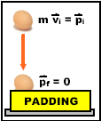
In the second trial, the egg stops over a longer period of time. This allows the same momentum change, but with a smaller force acting.

Slide 9
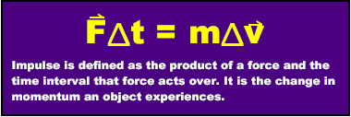
In each of these trials, the change in momentum is the same. We call the change in momentum of an object the impulse.
Impulse is a vector quantity.

Slide 10
Impulse does not receive a symbol (other than Δp), but it does receive the units of Ns or kgm/s
ex) A force of 14.0 N acts on a 6.00 kg cat for 1.00 ms. What is the change in velocity of this object?

Slide 11
Examples
A 5.00 kg dog accelerates uniformly from rest to a velocity of 15.0 m/s East. What is the impulse on the object?

Slide 12
Examples
A 1.0 kg ball hits the floor with a velocity of 2.0 m/s. If this ball bounces up with a velocity of 1.6 m/s, what is the ball’s impulse?

Slide 13
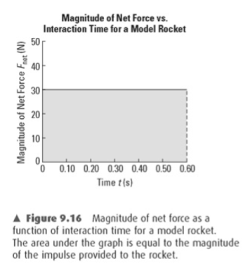
Graphs of F vs t
Another way of calculating impulse is from a force vs time graph.
The area under a graph of F vs t will give impulse:

Slide 14
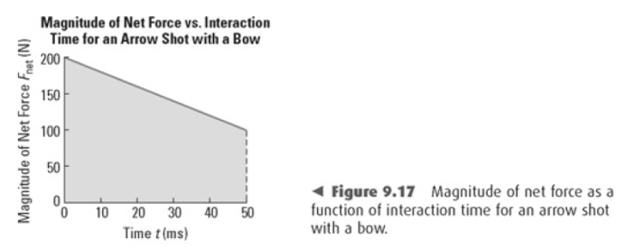
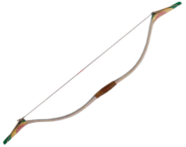
This is a particularly good method to use when the force is not constant.

Slide 15
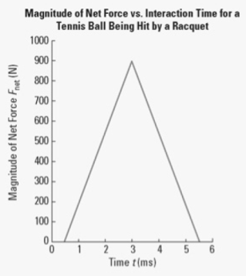
Example
a) From the graph, what is the magnitude of the impulse on the 48 g tennis ball?
b) What is the velocity of the ball when it leaves the racquet?

Slide 16
Applications of Impulse
There are a number of applications of impulse in everyday life. Be familiar with these for your diploma!
Car crashes: old rigid cars vs. new crumpling cars
Bullets fired from guns with long barrels vs short barrels
“ following through" on a throw, shot, swing
“ rolling with a punch" in boxing
Safety equipment in cars like air bags, new dashboards, steering columns
helmets
Breaking a board with your fist!
etc...

