Slide 1
Unit 1: Momentum and Impulse
Lesson 1

Slide 2
Objectives
define momentum as a vector quantity equal to the product of the mass and the velocity of an object

Slide 3
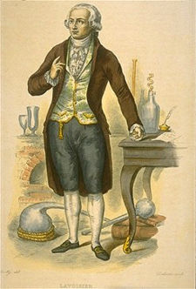
Review of Conservation Laws:
1. Conservation of Mass
Formulated by Antoine Lavoisier in the late 16th century. "
The mass of the reactants in a chemical reaction is the same as the mass of the products."

Slide 4
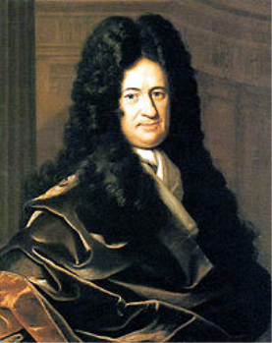
Energy
2. Conservation of Energy
Formulated by Gottfried Leibniz in the late 16th century. "
The sum of all energy in an isolated system remains the same".
Energy is never created or lost, just changed in form.

Slide 5
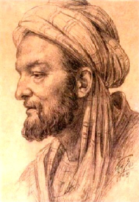
Now, mass and energy are not the only things that are conserved...there is yet another quantity!
And it has been known for thousands of years...
1000 AD, Sina describes a quantity called "impetus" which is weight multiplied by speed.
Abū Alī alusayn ibn Abd Allāh ibn Sīnā

Slide 6
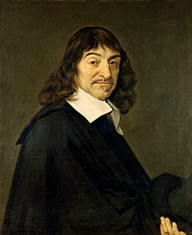
Mid 15th century, Descartes called the same mass times velocity quantity a fundamental force of motion".

Slide 7
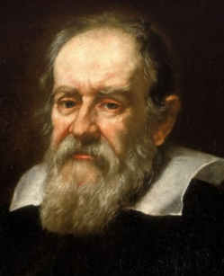
Mid 16th century, Galileo calls the quantity "impeto"

Slide 8
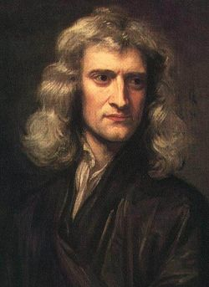
18th century, Newton calls the quantity "motus"

Slide 9
Momentum
(technically, linear momentum)

Slide 10
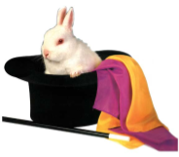
Units of momentum:
Hmm...looks like a newton (kinda)
Can you turn a kgm/s into a N?

Slide 12
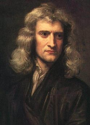
Momentum and Newton's Second Law
While he had a funny name for it, Newton had momentum figured out when he penned his famous second law:

Slide 13
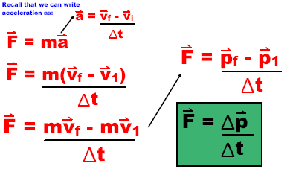
Let's have a look at that acceleration...

Slide 14
This means that any change in momentum causes a change in force, or visa versa.

Slide 15
Examples
Ex) A loaded transport truck with a mass of 38000 kg is travelling at 1.20 m/s [W]. What will be the velocity of a 1400 kg car if it has the same momentum?

Slide 16
Examples
ex) Mr. P is x-country skiing at a speed of v. If he doubles his speed, how does his momentum change?

Slide 17
Examples
A watermelon truck is driving down a road when it hits a bump and loses some water melons. The driver slows down to 1/3 of his original speed and the truck loses 1/20 of its weight in watermelons. How has the momentum of the truck changed?

