Slide 1
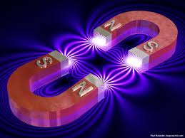
Physics 30 Unit B: Forces and Fields
Magnetism

Slide 2
Objectives
describe magnetic interactions in terms of forces and fields.
compare gravitational, electric and magnetic fields ﴾caused by permanent magnets and moving charges﴿ in terms of their sources and directions

Slide 3
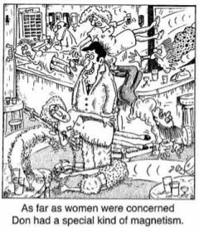
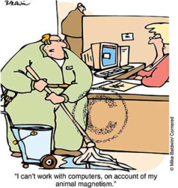
What do we already know about magnetism?

Slide 4
Early Discoveries
The Greeks knew magnets produce a force on some metals, called ferromagnetic materials.
The force was exerted without contact: they called it 'action at a distance' force.
But they couldn't explain why this force worked.

Slide 5
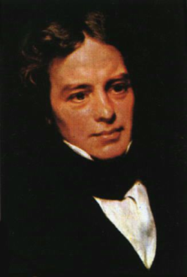
Enter: Faraday
19th Century Chemist and Physicist
Pioneer of Chemistry:
  oxidation numbers
  anode, cathode
  electrolysis
  discovered benzene
  bunsen burner
Pioneer of Physics:
  MAGNETIC FIELDS
  Electromagnetism
  Electromagnetic Induction

Slide 6

Magnetic Fields
The direction of the force can be explained through field theory.

Slide 7

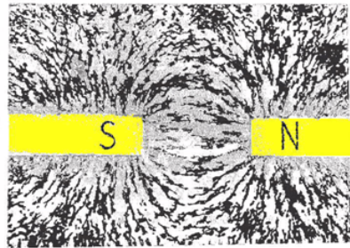
Iron filings indicate the field lines between two bar magnets.

Slide 8
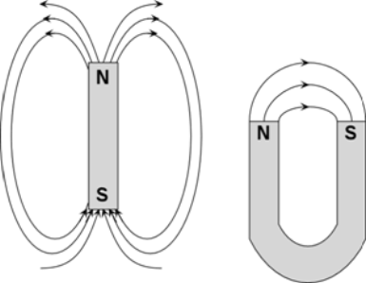
As B-fields move in the same direction a test compass would point, lines move from north to south poles.

Slide 9
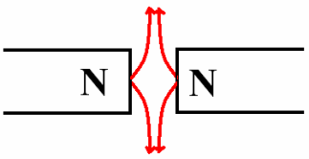
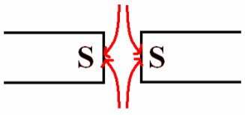

Field Lines move out from North Poles into South Poles
Like Poles Repel…
Unlike Poles Attract…

Slide 10
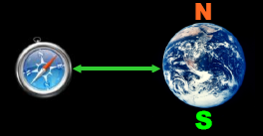
Hey, wait a second!!!
Don't compasses point towards the north pole?

Slide 11
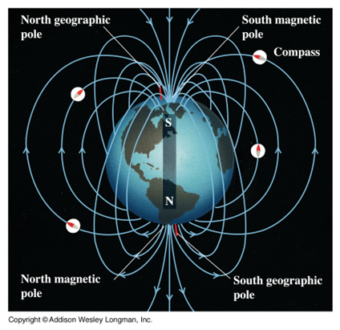
Explanation
Actually… The Earth affects compasses because it acts like a large bar magnet, producing a B-field.
However, the magnet has a south magnetic pole where we have a north geographic pole.

Slide 12
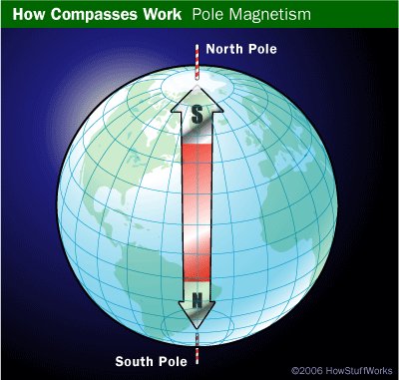
As the north poles of magnets point towards geographic north, it only makes sense that geographic north is actually magnetic south.
So, why is the Earth
a magnet anyways?

Slide 13
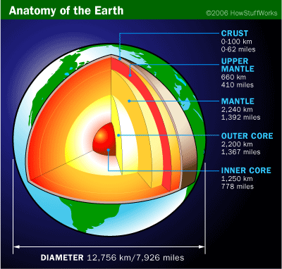
No one is certain...but it could be because of
rotating molten iron in the Earth's core.

Slide 14
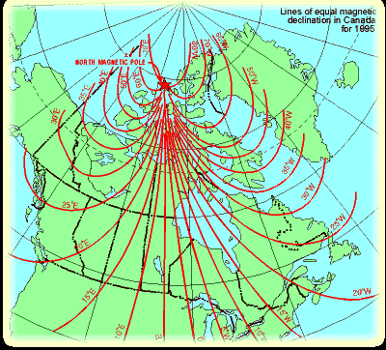
To make matters worse...
The south magnetic pole doesn't even line up with the north geographic pole.
The south magnetic pole is actually located about 1500 km S of the north geographic pole, in the Baffin Islands.
To make up for this, cartographers use angles of declination (about 12˚ W for NYC, the amount GN is from MS.)

Slide 15
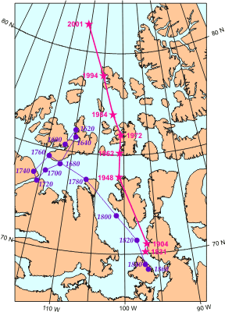
And to make things even worse...
The poles are not even fixed! They are constantly moving and flip every 10 000 years or so.
Interesting!

Slide 16

Comparing Fields
Gravitational Fields:
  Move towards the centre of objects (often the earth)
Electric Fields:
  Move in the direction a +ive test charge would go from + to - charge
Magnetic Fields:
  Move in the direction a test compass would point go from N to S poles

Slide 17
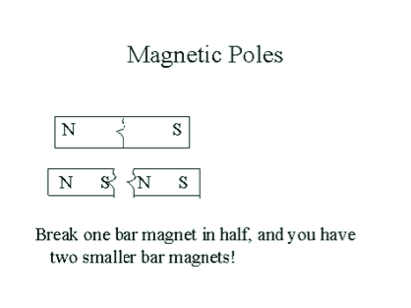
Magnetic Monopoles
Unlike electric charges (positive and negative), magnetic poles can't be separated (into a monopole).
Breaking a bar magnet in two results in two similar magnets.
Both north and south poles attract common magnetic metals.

Slide 18

European Centre for Nuclear Research (CERN) in Switzerland becomes operational in May 2008
MOEDAL (monopole and exotic object detector)
“The discovery of a monopole would be a revolution which wouldn't only affect high level physics, but would even affect basic physics and our good old Physics 101 textbooks.”
Dr. James Pinfold

Slide 19

So, what causes magnetism anyways?
On the subatomic level, it has to do with the way electrons spin.
Paired electrons spin, creating magnetic domains.

Slide 20
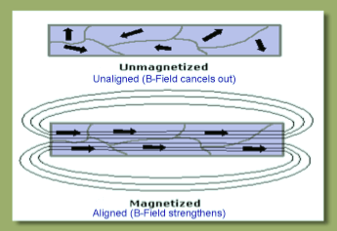
Magnetic Domains
In most materials, the domains are out of alignment.
In magnets, the domains are aligned. This causes a magnetic field to be produced.
Hmm...moving electrons produce a B-field?

Slide 21
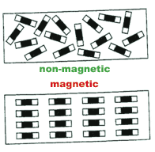
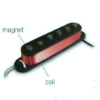
This effect is very noticeable in ferromagnetic materials such as iron, nickel or cobalt.
If another element is added to this material, the effect can be made permanent, producing a permanent magnet.
ex) ALNICO magnets.

