Slide 1
Lesson 4
(Looks pretty cool, not an electric field.)
Electric Field Theory

Slide 2
Objectives
define vector fields.
compare forces and fields.
explain, quantitatively, electric fields in terms of intensity (strength) and direction, relative to the source of the field and to the effect on an electric charge.

Slide 3
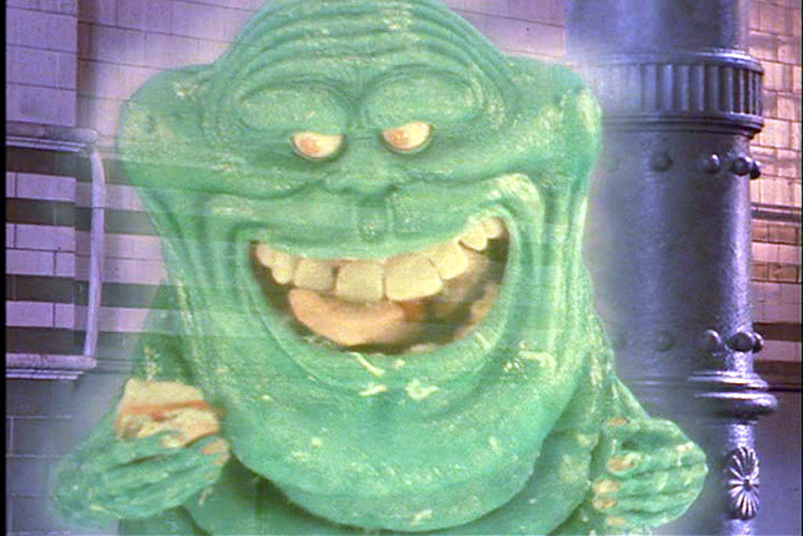
Write the parts in slimer green

Slide 4

Recall: The Gravitational Field
An imaginary field which exists around all bodies in all directions.
Shows the direction of the force of gravity.
Only exists in theory, in practice, it does not really exist (although we can calculate the magnitude).
Field lines are a vector quantity.

Slide 5
The Electric Field
All electrically charged objects (can be positive or negative) create electric fields.
The magnitude and direction of fields are represented by field lines. The greater the density of the lines, the greater the field.
The electric field is the direction a positive test charge would move when placed in the field.

Slide 6
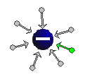
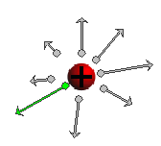
Direction of the Electric Field
Field lines move towards negative charges.
Remember: the field lines move in the same direction as a positive test charge would!
Field lines move away from positive charges.

Slide 7
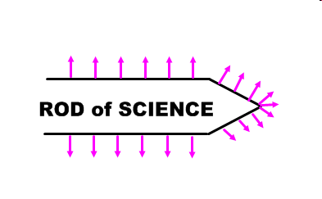
The density (number of lines) indicates the relative magnitude of the field.
Electric fields are greatest at points or sharp edges.

Slide 8
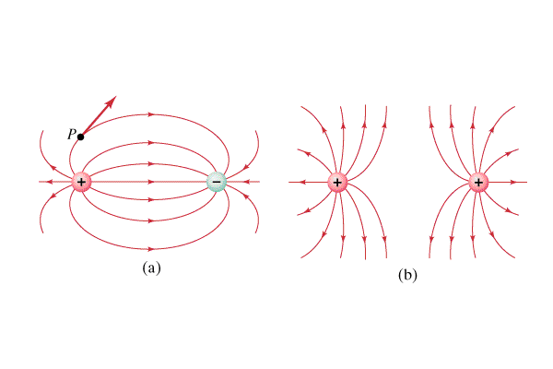
Electric Fields Applet
A Really Cool Electric Fields Applet
3-D nature of vectors

Slide 9
Field Strength
Fields are vectors, they have magnitude and direction.
Now that we know how to find the direction of the field, we need a way to find the magnitude.
We have two formulas to calculate the field strength or field intensity at any point in space.

Slide 10
1st E-field Formula
E = F_{e}
q
Where:
E = absolute value of electric field strength
F_{e} = electric force acting on the test charge
q = magnitude of test charge
This is the definition of the electric field strength: the amount of electric force per unit of charge acting on a body.

Slide 11
Look familiar?
This equation looks pretty similar to the equation for finding the gravitational field at any point…
E = F_{e} g = F_{g}
q m
All of physics is related in one way to another! Another example of the appeal of GUTs!

Slide 12
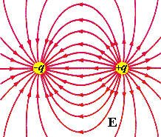
Unit of Electric Fields
The unit of the electric field is newtons per coulomb (N/C), another reminder of the first-principles definition of the term: the amount of electric force (N) per unit of charge (C).

Slide 13
Inverse Square Law
Notice from the applet that the magnitude of the E field is stronger when closer to the charge, weaker when farther away.
Electric fields obey the inverse square law.
We can manipulate the general equation for the electric force to gain a second equation for determining electric field.

Slide 14
Second Electric Field Equation
Take F_{e} = kq₁q₂ and divide by q on both sides.
r²
E = kq where: E = magnitude of the
r² electric field.
k = coulomb’s constant
q = magnitude of the charge on the charge producing object.

Slide 15
Examples
A positive test charge (q = 4.0 μC) is placed in an electric field. The force on the charge is 0.60 N left. What is the magnitude and direction of the E-field at the location of the test charge?

Slide 16
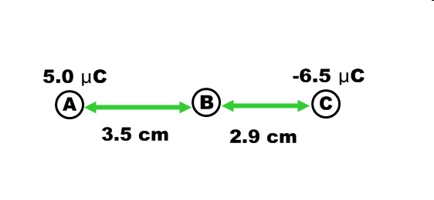
Find the electric field at point B.

Slide 17
What is the electric field at a point half-way in between a charge of -3.50 μC and a charge of 3.00 μC if the charges are 44 cm apart?

