Slide 1

Uniform Electric
Fields and Potential
Difference
Lesson 5

Slide 2
Objectives
compare, qualitatively, gravitational potential energy and electric potential energy.
define electric potential difference as a change in electric potential energy per unit of charge.
calculate the electric potential difference between two points in a uniform electric field.
explain, quantitatively, electric fields in terms of intensity ﴾strength﴿ and direction, relative to the source of the field and to the effect on an electric charge.

Slide 3
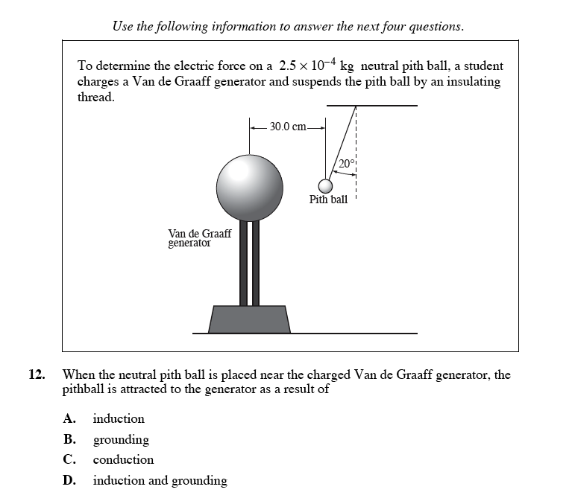
Diploma Question Alert!

Slide 4
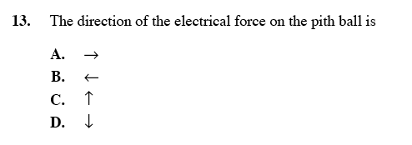
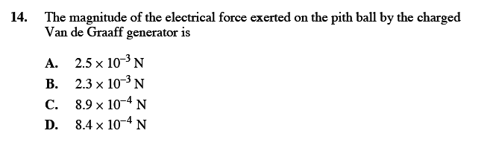

Slide 5
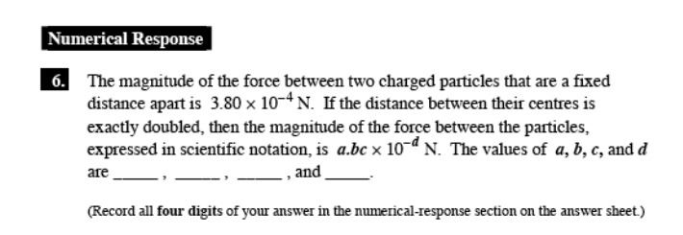
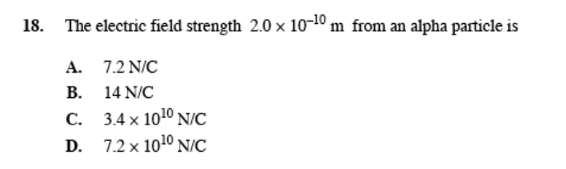

Slide 6
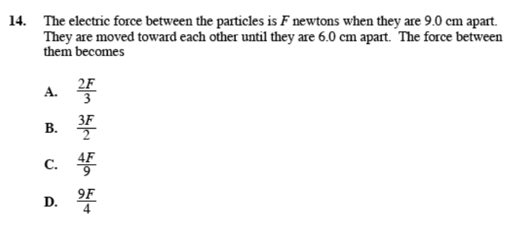

Slide 7


Review: Electric Fields
All charged objects produce electric fields
The direction of the field is the same as the direction of the electric force
The field moves in the same direction as a positive test charge would if placed in the field
Also:
E-field lines due to a positive source start from the source and extend radially away from the charge to infinity.
E-field lines due to a negative source come from infinity radially into the negative charge.
The density of the line represents the magnitude of the field.

Slide 8
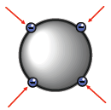
Electric Fields on Conducting Objects
Solid Conducting Spheres:
Charge spreads out uniformly on smooth surfaces like a sphere due to repulsion. The field lines act at a perpendicular to the surface of the sphere.
The Efield produced is like that of a point charge.

Slide 9
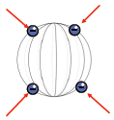
Hollow Conducting Spheres/Objects:
Like a solid sphere, the charge (+ or - ) will spread out uniformly.
However, because of the balanced vector nature of the fields, there is no E-field inside the sphere.

Slide 10
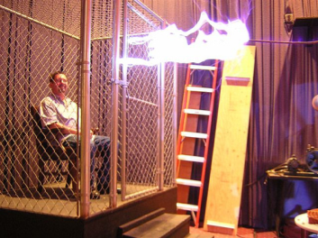
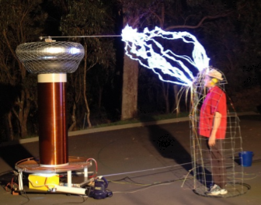
This phenomenon led to the production of Faraday Cages: hollow objects which have a E-field of zero inside of them.
No E-field means no charge acting inside the sphere/object!
YouTube 1
YouTube 2
YouTube 3

Slide 11
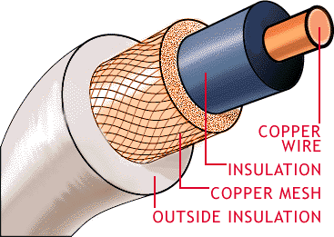
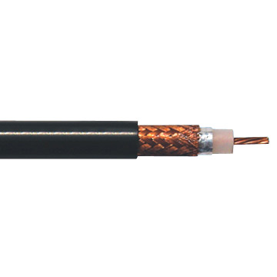
Coaxial Cable
This electric shielding is put to use in coaxial cable which is found in many electronic devices.

Slide 12
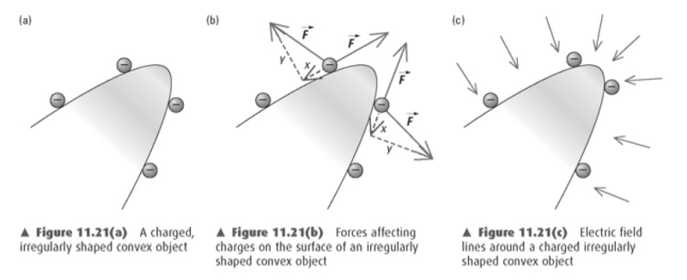
Electric Fields on Pointed Objects
Electric charge will collect on pointed objects, producing a higher density of field lines.
This can lead to some interesting effects...

Slide 13
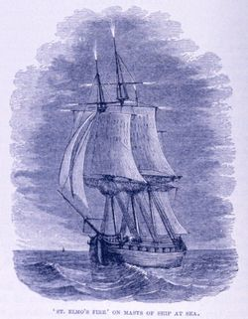
St. Elmo's Fire
If the buildup of charge is great enough, it can discharge into the air, causing it to ionize. This hot ionized air is called plasma and ranges from white to bluish in colour.
It is often observed on sailing ships or airplanes during thunderstorms.

Slide 14

Electric Fields on Parallel Plates
If two conducting plates are charged, a uniform E-field is produced between them.
The field will be of uniform strength and spacing.
Also, the field only exists between the plates (and to a small extent around the edges).
This is the basic principle behind a capacitor.

Slide 15

Let's describe what is happening between these parallel plates.
To do this, we need to take an aside and go back in time to Physics 20.
Ahh, P20! Feel‘s Nice!
We will look at the idea of Potential Energy Differences.

Slide 16
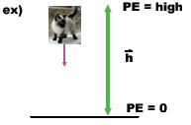
P20 Review:
When I drop an object, it moves from an area of high E_{p} to low E_{p}.
This is due to the effect of the
gravitational field.

Slide 17
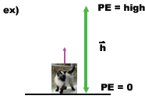

In order to lift an objects up from one area of low E_{p} to high E_{p}, we must expend energy in the form of work.
Work is a change in energy. It can also be represented by
the eqn:

Slide 18
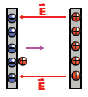
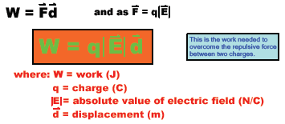
Now, back to P30...
If we move a charge against an E-field, we move it from an area of low E_{p} to high E_{p}.
This must mean we are expending work.

Slide 19

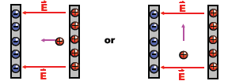
Question: Does it require any work to move the charge with the field or perpendicularly to it?

Slide 20
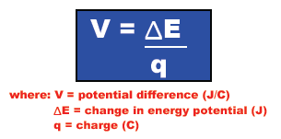
All this talk about work makes me think about energy...how do we describe energy when talking about electricity?
In electricity, we talk about energy per unit of charge. Just as we described E-fields as the amount of force per unit of charge, we can describe the Potential Difference as the energy per unit of charge.

Slide 21

Another name for potential difference is
Voltage
The units of potential difference (voltage) can be expressed as J/C or volts (V). Yes, the unit is the same as the symbol...weird.
*Note: like all energy, potential difference is a scalar!

Slide 22
Examples
Moving a small charge of 1.6 x 10⁻¹⁹ C against an electric field produced by parallel plates increases its electric potential energy by 3.2 x 10⁻¹⁶ J. What is the potential difference between the plates?

Slide 23
Examples
In moving a charge of 5.0 C from one charged parallel plate to another, a battery raises the electric potential energy of the charge by 60 J. Determine the potential difference between the battery terminals.

Slide 24




If we combine the two new equations for today, we can develop a relationship between the separation of the parallel plates and the electric field:
As work is a change in energy...
**This is only for parallel plates!

Slide 25
This equation gives the magnitude of the UNIFORM E-field between charged parallel plates.
If a charge is placed anywhere in between the plates, it will experience the same field.
**However, the voltage it experiences – and thus its energy – changes depending on its position!**

Slide 26
Two charged parallel plates are 4.0 cm apart. The magnitude of the E-field between them is 625 N/C.
What is the potential difference between the plates?
b) What work is done moving a single electron from one plate to the other?
c) What work would it take to move a proton from one plate to another?

Slide 27
A voltmeter measures the potential difference between two parallel plates to be 60.0 V. The plates are 3.00 cm apart. What is the magnitude of the E-field between them?

Slide 28

The Electron Volt
An electron volt (eV) is a very small unit of energy that is often used when dealing with individual particles. It is the amount of energy an electron gains or loses when moving through a potential difference of exactly 1.0 V.
You will often encounter this unit in your journeys. The conversion is listed on your data sheet.

