Slide 1
Earth’s Biomes and their Climate
Sc 10: Unit D
review; heating curve of water

Slide 2
1. Biomes are open systems
Biomes function as a system, a set of interconnected parts with surroundings.
They are open systems because they exchange matter and energy with the surroundings.
Earth’s hydrosphere is generally considered to be a closed system, why?

Slide 3
2. Earth’s Biomes
6 different biomes.
Defines a biotic community; characterized by the plant life. Vary because of precipitation, temperature, soil type, topography, etc.
Dividing earth into Biomes helps scientists study and understand interactions between living and non-living things.

Slide 4
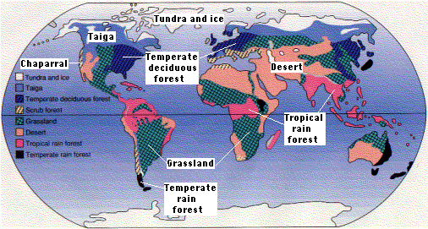

Slide 5
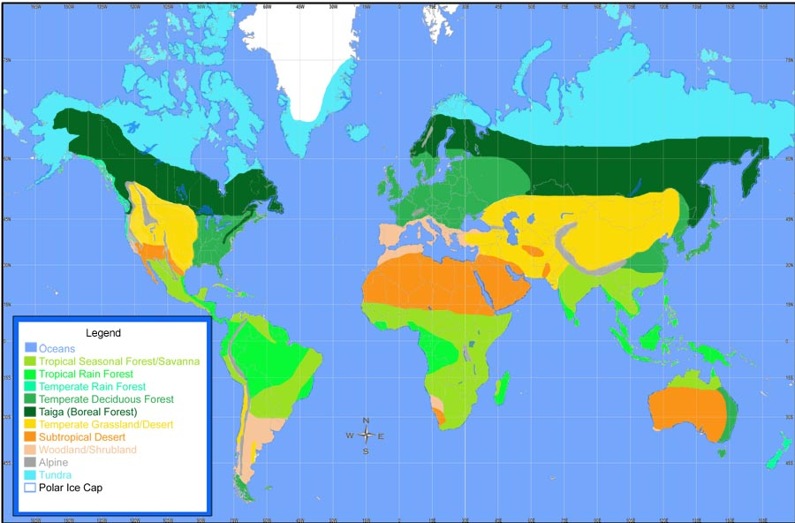

Slide 6
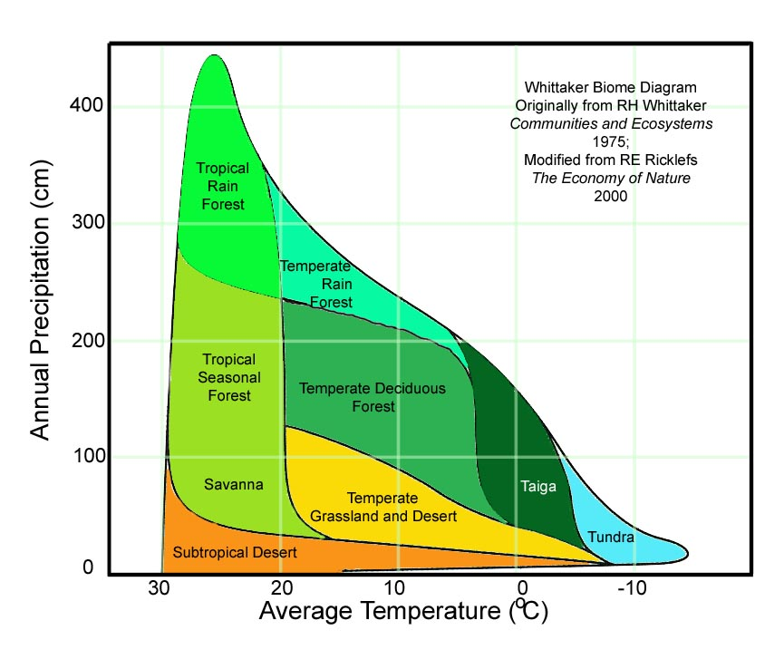

Slide 7
a. Tundra
Location: arctic regions of North America and Eurasia.
Sunlight: Varies from 24 hours (summer solstice) to 0 hours (winter solstice).
Soil: Permafrost due to low insolation.
Plants: very little precipitation so few plants---- lichens/mosses/shrubs.
Animals: Caribou, polar bear, arctic fox.

Slide 8
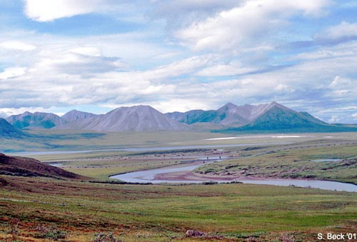
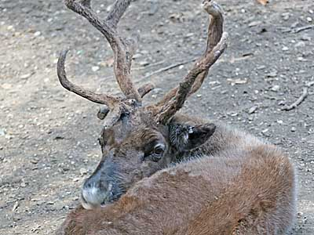
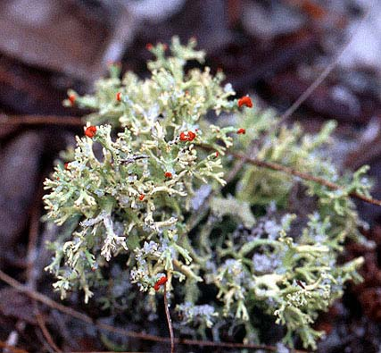
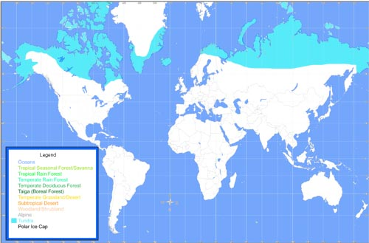

Slide 9
b. Taiga/Boreal Forest
Location: South of Tundra region.
Sunlight: more sunlight year-round = longer growing season than Tundra.
Soil: slightly acidic soil; supports lots of plants.
Plants: variety of plants/shrubs- mostly conifers (evergreens), fewer shrubs.
Animals: woodpeckers, moose, bear.

Slide 10
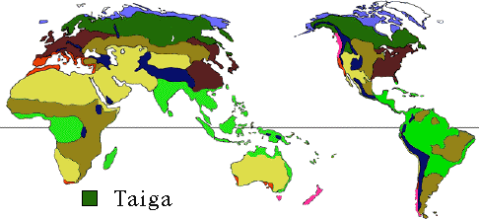
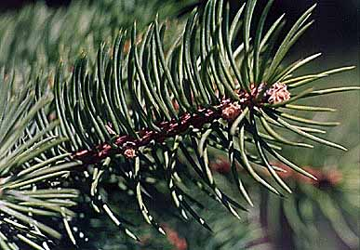
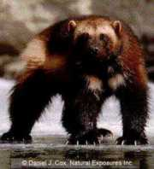
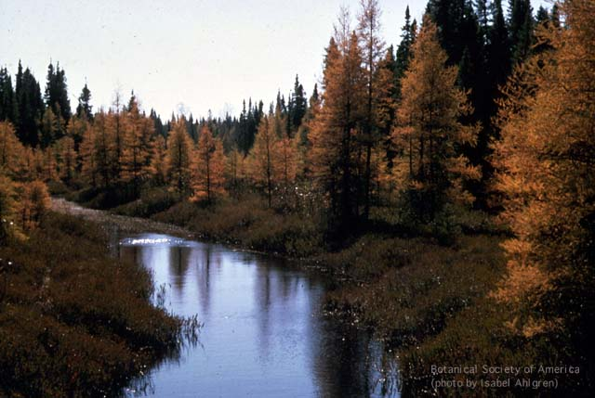
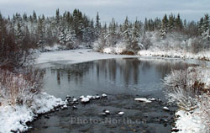

Slide 11
c. Deciduous forest/Mixed woodland
Location: between 30-60°N latitude; all over world.
Sunlight: more than Taiga; climate is more moderate.
Soil: very fertile soil, lots of precipitation.
Plants: huge variety of plants– sunlight fits floor for shrubs, flowers, deciduous trees.
Animals: insects, birds, squirrels, rabbits, deer, fox.

Slide 12
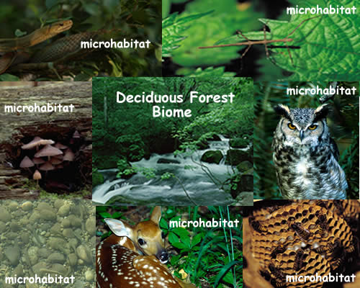

Slide 13
d. Grassland
Location: anywhere that has 20cm precipitation per year; prairies and savannah.
Sunlight: lots of sunlight; more in summer.
Soil: soil holds moisture, slightly acidic.
Plants: mostly grasses, few shrubs.
Animals: hawks, birds, insects, buffalo, deer--- savannah = cheetah, zebras.

Slide 14
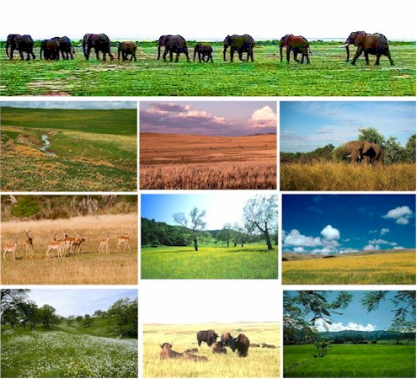
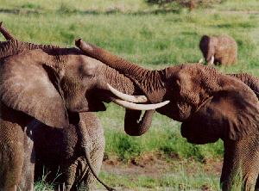
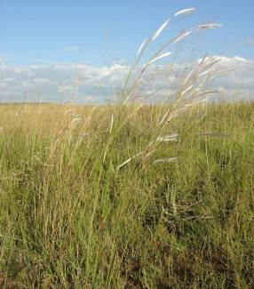
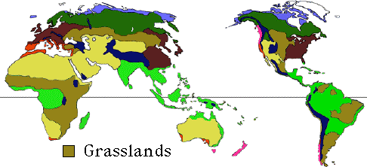

Slide 15
e. Rain forest
Location: anywhere with 200cm/year precipitation and always warm.
Sunlight: Lots of sunlight, 1 season.
Soil: very fertile, supports most life of all biomes.
Plants: Large, broad leaf trees, flowers, shrubs, vines…
Animals: snakes, lizards, hummingbirds, monkeys, gorillas, tigers.

Slide 16
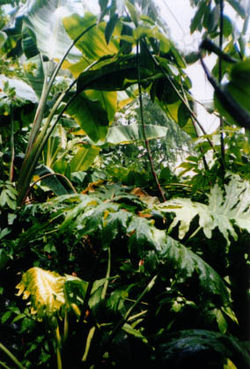
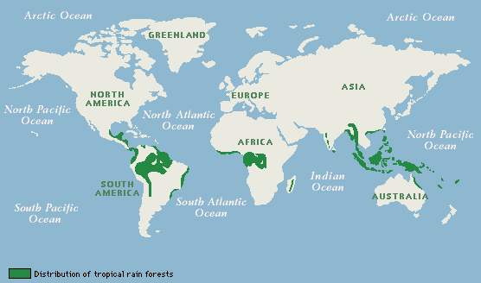
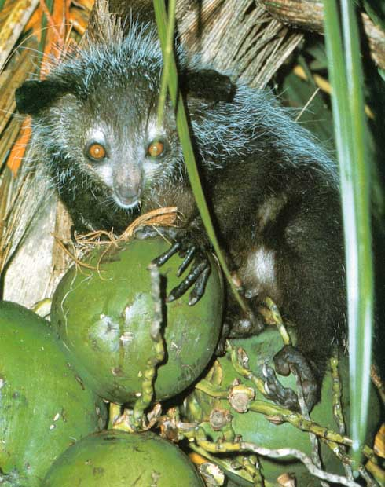
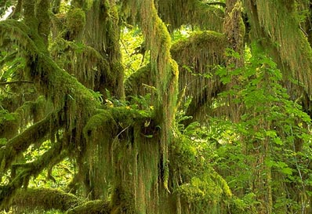
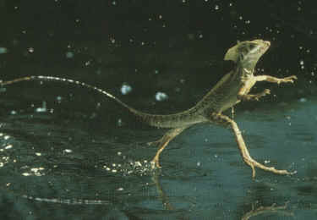

Slide 17
f. desert
Location: anywhere with less than 25cm/year precipitation.
Sunlight: hot during day due to high insolation levels.
Soil: very thin, not very fertile, doesn’t hold water.
Plants: cacti, drought tolerant plants (sagebrush).
Animals: lizards, snakes, antelope, bats, coyote.

Slide 18
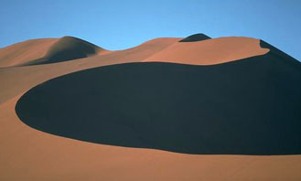
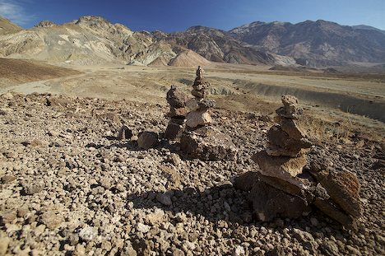
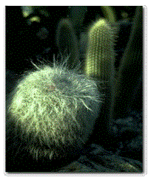
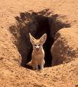
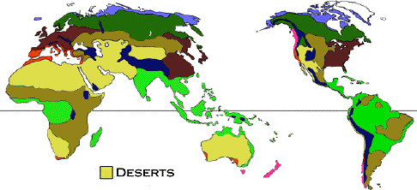

Slide 19
3. Biomes and Climate
Climate determines the plants and animals that survive in the region.
Includes: temperature and precipitation.

Slide 20
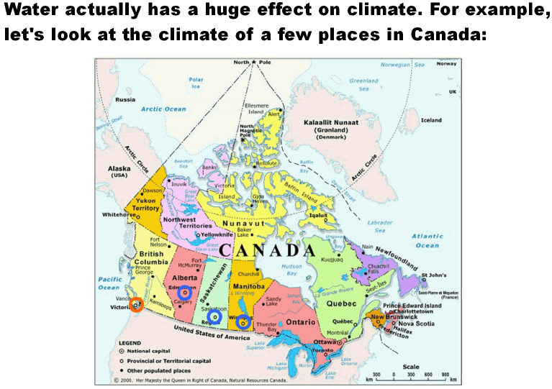

Slide 21
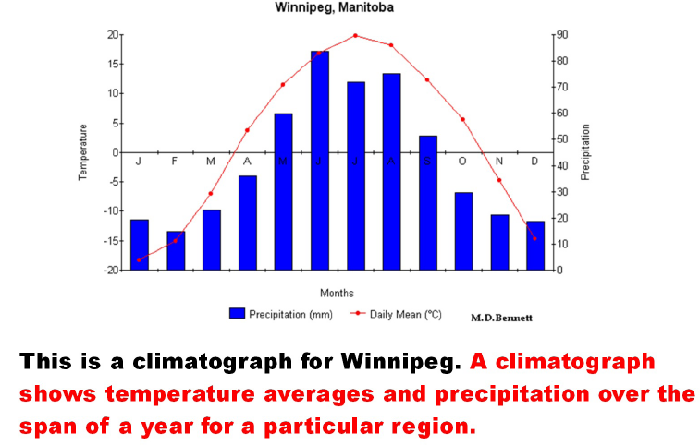

Slide 22
