Slide 1
Finishing up
Population Genetics...

Slide 2
Mitochondrial DNA & Evolution
Mitochondria → the “power plant” of the cell (production of ATP – fuel for cell activity)
Mitochondria contain their own DNA (mtDNA)
mtDNA forms in small looping chains
Since mitochondria contain DNA, can be used to study evolutionary relationships
We get our mtDNA from our mother.
The mtDNA in our cells comes from the cytoplasm of the mothers egg.
The mtDNA is less affected by mutations than nuclear DNA.

Slide 3
Mitochondrial DNA & Evolution
Proposed that mitochondria had enough DNA to exist on their own as a prokaryotic cell billions of years ago
Proposed that chloroplasts existed on their own too
Symbiotic relationship formed between chloroplasts & mitochondria
Mitochondria (aerobe) engulfed by chloroplast (anaerobe)
Chloroplast provided with efficient respiration
Mitochondria provided with protection & access to nutrients
Eventually formed nucleus and developed into today’s eukaryotic cells
Called – SYMBIOTIC HYPOTHESIS

Slide 4
mtDNA used to trace extinct maternal lineage from recovered mummies

Slide 5
Speciation
Species → a group of similar organisms that can interbreed and produce fertile offspring
Speciation → the formation of new species
Eg. Each one of Darwin’s finches is a species

Slide 6
Speciation
Speciation does not always = evolution
Eg. evolution with peppered moths (from white → black) occurred without the creation of new species
Natural selection does not always lead to speciation
Eg. natural selection for spotted Teddy Grahams occurred without formation of a new species
Speciation can arise from these processes
Geographic Isolation
Reproductive Isolation

Slide 7
1. Geographic Isolation
Physical obstacles or barriers separate a portion of an existing species which develop into a new species
Obstacles – mountain ranges, bodies of water, cities
Gene flow stops
Long time passes and groups become so different that they can’t interbreed
Examples:
Finches & turtles on Galapagos Islands
house sparrows in North America

Slide 9
PANGAEA

Slide 10
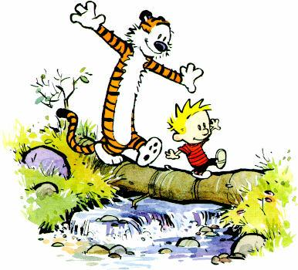
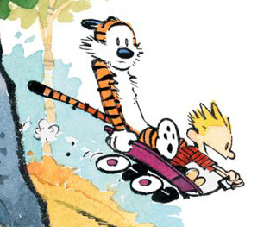
Twists to Geographic Isolation
Meet Hobbs the ‘Liger’
- cross between a male lion and a female tiger
- Hobbs is a sterile male
- challenges geographic isolation because interbreeding between species, BUT ligers are typically sterile therefore this is ‘unsuccessful breeding’

Slide 11
2. Reproductive Isolation
Organisms can no longer mate or produce offspring even after the removal of a geographic barrier
Factors contributing to reproductive isolation
Different mating habits
Different courtship behaviours
Seasonal differences in mating
Inability for the sperm to fertilize the eggs

Slide 12
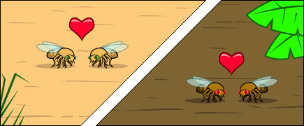
Click on picture for hyperlink
Example from website: Geographic isolation splits a population of flies
Two species evolve in two separate environments
When brought back together species are now separated by reproductive isolation
No gene flow is occurring → 2 new species have evolved

Slide 13
Speciation summary
Parts of a population become isolated and have to adapt to new environment
Selection for specific traits occurs in each environment
A new species develops
New species evolve over a long period of time
Very hard to say exact moment in time when new species formed

Slide 14
Polyploidy
Polyploidy → condition in which an organism carries more than 2 complete sets of chromosomes
Uncommon in animals but common in plants
Produces hardier and larger varieties of grains, fruits and other plants
Why might this be useful?
Polyploids can mate with each other but not with members of the parental generation
Why??
Different chromosome numbers

Slide 16
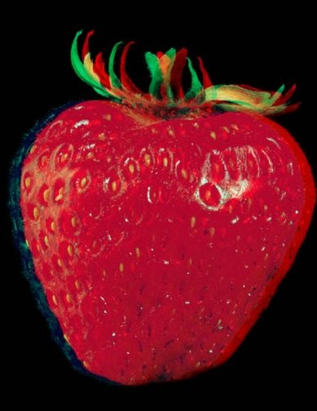

Slide 17
Adaptations
Adaptations → inherited traits that improve the chances of survival and reproduction of organisms
3 types
Physical Adaptations
Behavioural Adaptations
Physiological Adaptations

Slide 18
Physical Adaptations
Structural adaptations
In birds
Wings
Feathers
‘Opposable thumb’ in Panda Bears

Slide 19
Behavioural adaptations
Courtship
Migration
Nocturnalism
Hibernation
Aestivation (estivation)

Slide 20
Physiological adaptations
Pheromones – chemicals secreted by organisms to attract or repel other organisms
Sexual attractants
Alarms
Enzymes – control bodily functions
Eg. Secretion of venom by snakes
Eg. Production of toxins by plants (ie. poison ivy) & animals (ie. skunk)

Slide 21
Difference between Lamarck and Darwin
LAMARCK
New species form because of acquired characteristics
Giraffes have long necks b/c over the years their necks were stretched from reaching for leaves on tall branches
DARWIN
New species form because of evolution
Giraffes have long necks b/c a mutated form of neck length was selected for when only leaves on tall trees were available for food
Invalid

Slide 22
21.2 Changes in Gene Pools

Slide 23
Curricular Outcomes Discussed:
30–D1.2k
describe the factors that cause the diversity in the gene pool to change; i.e., natural selection, genetic drift, gene flow, nonrandom mating, bottleneck effect, founder effect, migration, mutation
30–D1.4k
describe the molecular basis of gene-pool change and the significance of these changes over time; i.e., mutations and natural selection

Slide 24
21.2 Changes in Gene Pools
A population gene pool is very unstable
It is constantly influenced by external factors - intentionally ignored by H - W
Factors that bring about evolutionary change include mutations, genetic drift, migration (gene flow) and natural selection
1. Mutations
Changes in the genetic makeup of an organism
An inheritable mutation has the potential to affect an entire population
Occur in a cell as it undergoes meiosis
2 types:
a.) Chromosomal mutation - resulting gamete will either lack a particular chromosome or gain an extra one
Down syndrome

Slide 25
b.) Gene mutation results from a chemical change inside an individual gene
Rearrangement of or damage to bases in DNA molecule
Sickle-cell anemia, cystic fibrosis
Mutations are a source of variation and evolution

Slide 26
2. Migration (Gene Flow)
Movement of members of a species into (immigration) or out of (emigration) a population alters its equilibrium
Immigration - new genes are added to existing gene pool
Emigration - genes are removed
Gene pool of original population changes
3. Non – random mating or Sexual selection
Non - random mating means there is a choice of which males will mate with which females, or vice versa
In animal populations, individuals choose mates based on physical or behavioral traits
Sexual Dimorphism
Blue footed boobie dance
Other examples?

Slide 27
Boobie dance

Slide 28
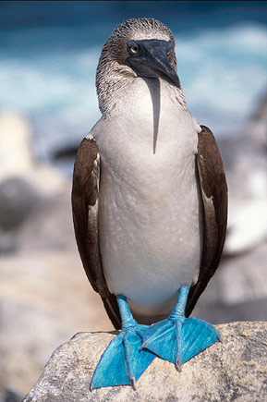
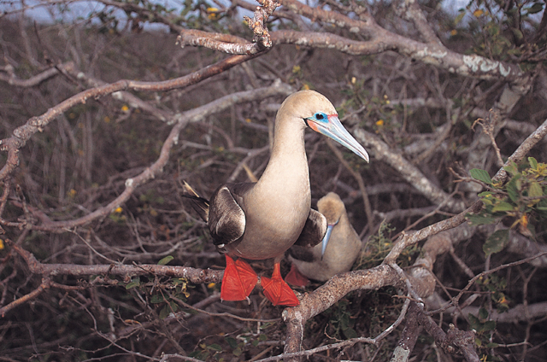
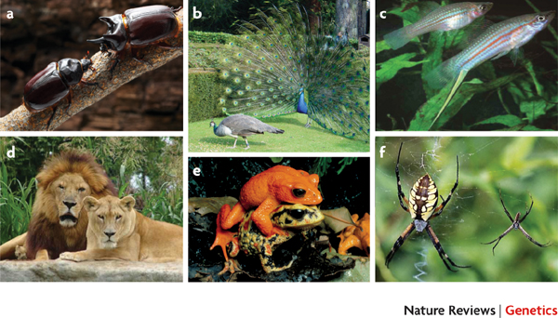
A general feature of animals is the differentiation of the two sexes both morphologically and behaviourally. Here we refer to these characteristics as sexually dimorphic traits. A common type of sexually dimorphic trait is the elaborate modification of male morphology, such as the horns of many beetle species (Strategus aloeus, a), the peacock's tail (Pavo cristatus, b), the caudal 'sword' of the swordtail fish (Xiphophorus helleri, c) and the lion's mane (Panthera leo,d). Additionally, the two sexes can differ in coloration, as shown here for the golden toad (Bufo periglenes, e). Females can be the more highly adorned sex: female garden spiders (Argiope aurantia, f) are both larger and more conspicuously marked than males. Image a © A. Wild. Image b © K. Lu. Image c © M. K. Meyer. Image d © C. Lambert (www.cmldigitaldetails.com). Image e © Science Photo Library. Image f © T. Bartlett

Slide 29
4. Genetic Drift
A.k.a. "random genetic drift" – results from chance
Disruption of genetic equilibrium in small populations
Ex. - population of 10 guinea pigs
Only one member displays allele B - black coat color
If, by chance, black individual does not mate, black allele will disappear from population

Slide 30
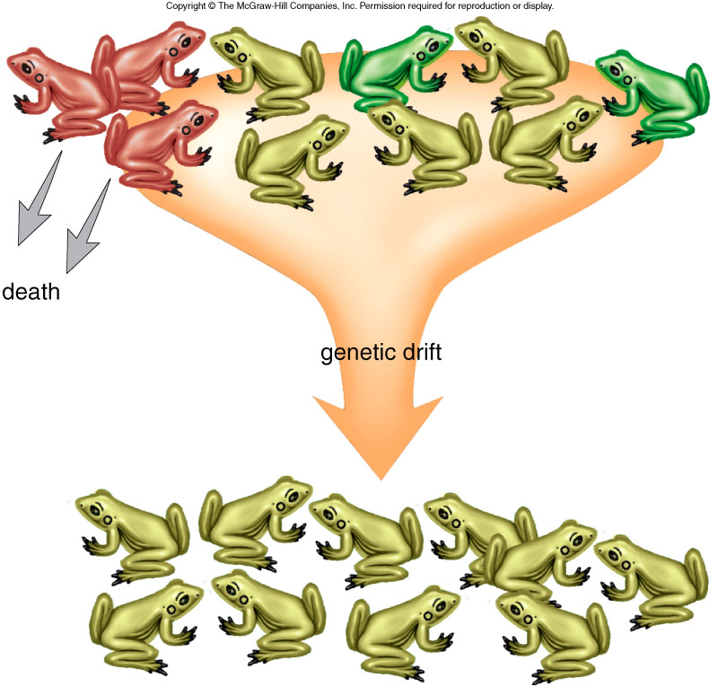
Genetic drift
Fig. 27.13

Slide 31
Simulating Genetic Drift - Animation
Amoeba Sisters Genetic Drift

Slide 32
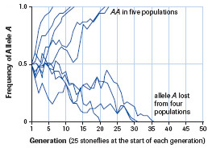
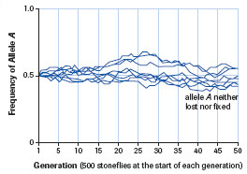
In small populations, genetic drift can lead to fixation of alleles
Thus, reduces genetic diversity – more homozygous individuals

Slide 33
Founder Effect
When few individuals from a large pop. leave to establish a new pop.
Allele frequencies of new pop. will NOT be same as those of original pop.
May deviate as pop. expands
Examples:
Few seeds carried by animal or wind to distant volcanic island
Humans
Amish community in Pennsylvania are descendants of 30 people who emigrated from Sweden in 1720

Slide 34
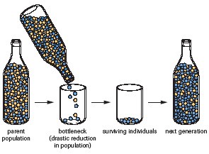
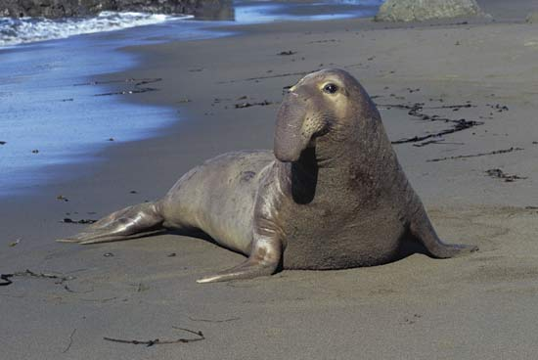
Bottleneck effect
Results from a severe, environmental event
Drastic reduction in population size
Frequency of alleles in survivors is very diff. from that of original pop.
Additional genetic drift may result in further genes in gene pool
Ex: northern elephant seal

Slide 35
Northern elephant seal population was overhunted to 20 individuals in 1890s. Population rebounded to 30 000 by 1974 but 24 gene loci were homozygous (fixed alleles)

Slide 36
5. Natural Selection
Only process that leads directly to evolution
In a given environment, some individuals are better able to survive and reproduce than others are
Those individuals with greater survival traits pass on their favorable genes to the next generation
Occurs when an individual produces a phenotype that gives a survival advantage of another
Example: antibiotic resistant tuberculosis
5 agents of evolutionary change

