Slide 1
Have you
heard
the news???
It’s
ear
time!!

Slide 2
Trivia Question
What are the smallest bones in the body?
Ossicles
Ossicles
These bones are fully developed at birth!

Slide 3
Anatomy of the Ear – A Video

Slide 4
Ear has 2 main functions
Hearing
Equilibrium
Static
Dynamic

Slide 5
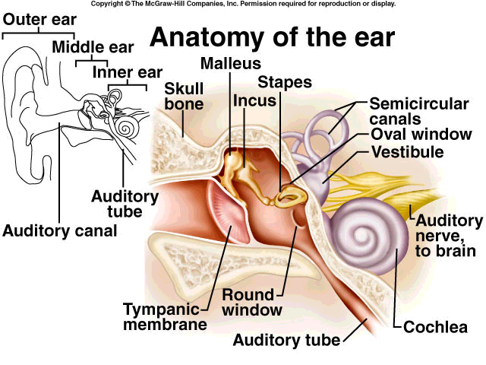
Eustachian Tube

Slide 6
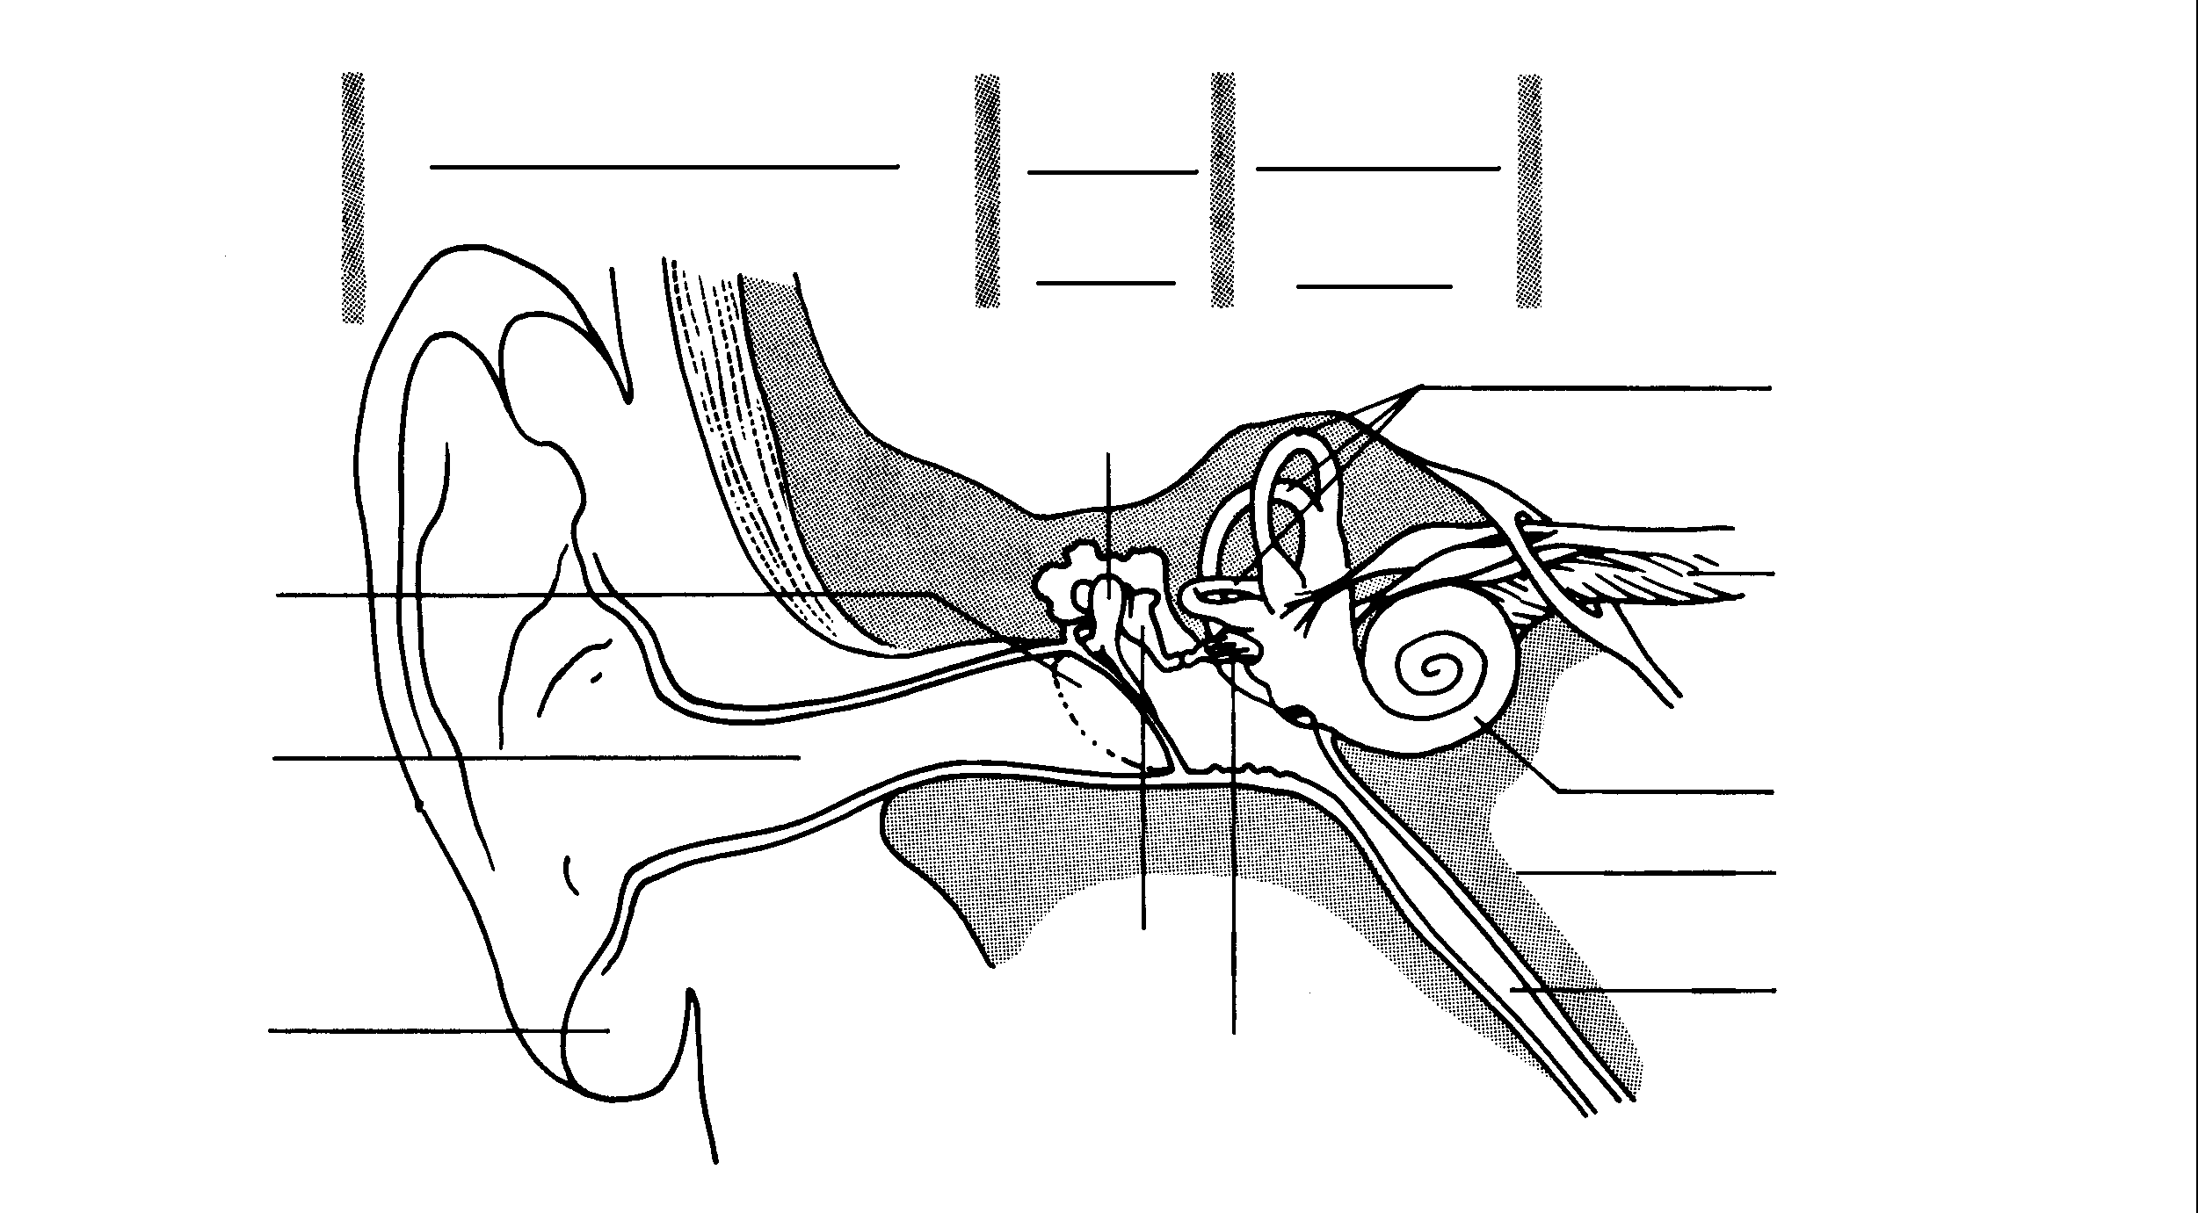
The Ear
Outer Ear
Middle
Inner
Ear
Ear
Hammer
Semicircular Canals
Tympanic
Membrane
Auditory
Nerve
Auditory Canal
Cochlea
Pinna
Eustachian Tube
Anvil & Stirrup

Slide 7
Structure
Ear has three main sections
Outer ear
Middle ear
Inner ear

Slide 8
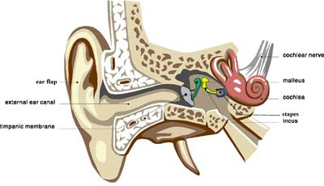
Outer Ear

Slide 9
Outer Ear
Pinna
Ear flap
Collects sound waves
Directs them to the…
Auditory canal
Carries sound to the eardrum
Protects ear
Ear wax – made by specialized sweat glands
Traps foreign particles

Slide 10
Middle Ear

Slide 11
Hammer
Anvil
Tympanic
Membrane
Stirrup

Slide 12
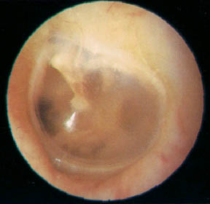
Middle Ear
Begins at ear drum (tympanic membrane)
Air filled
Contains ossicles
Hammer (malleus)
Anvil (incus)
Stirrup (stapes)
Strikes oval window
Oval window much smaller than tympanic membrane – helps amplify sound

Slide 13
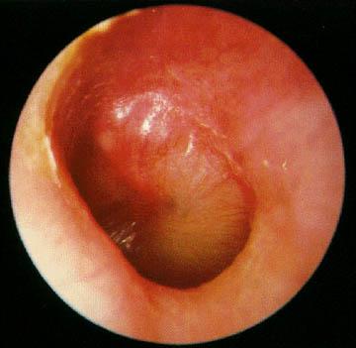
An Eardrum with Pus

Slide 14
Eustachian tube
Connects middle ear with nose and mouth
Allows for equalization of air pressure

Slide 15
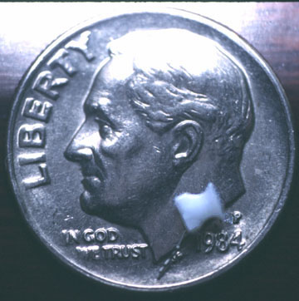
An Ear Tube
Used
To Drain
Middle Ear
Fluid

Slide 16
Inner Ear

Slide 17
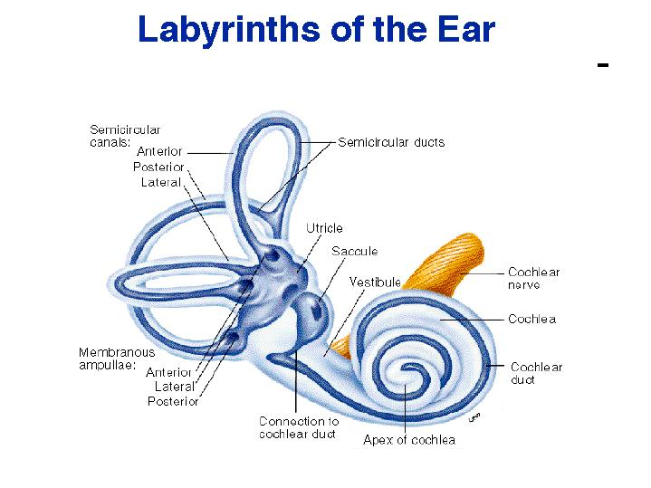
Inner Ear

Slide 18
Inner Ear
3 main structures
1. Vestibule
Contains 2 sacs – utricle and saccule
Contains fluid, hair cells, and Otoliths → CaCO₃ (s)
Stimulate nerve fibres
Detects head position
Static equilibrium

Slide 19
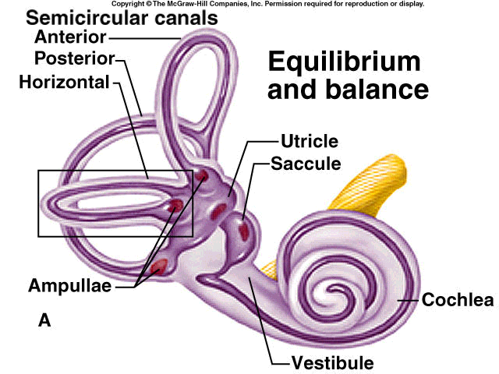

Slide 20
Semicircular Canals

Slide 21
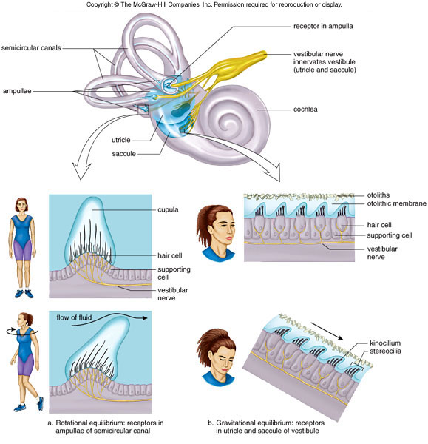
Mechanoreceptors for equilibrium
Fig 18.14

Slide 22
2. Semicircular canals
Fluid filled
3 canals
Horizontal, vertical, diagonal
movement & balance
Each canal has an ampulla
cilia → receptor cells
Dynamic equilibrium

Slide 23
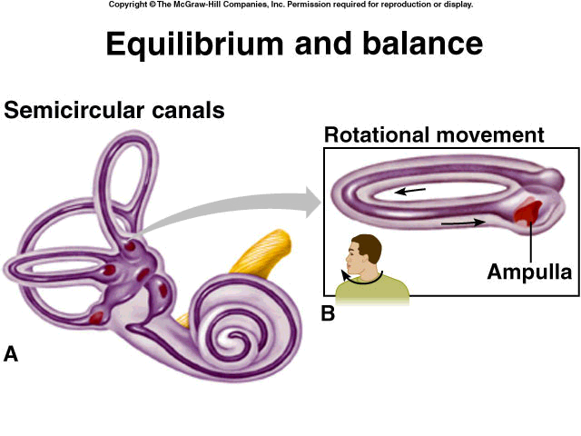
Equilibrium and Balance

Slide 24
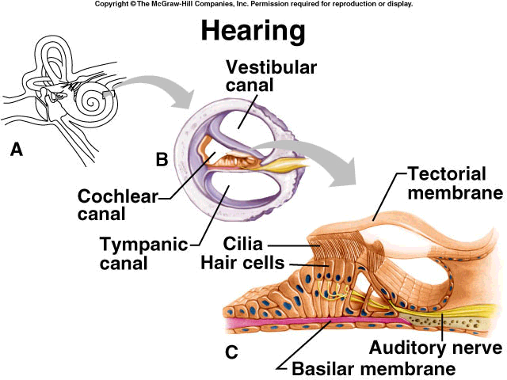
Hearing

Slide 25
Cochlea

Slide 26
3. Cochlea
Liquid filled
Vibrations → waves
Converted to nerve impulses
3 sections
Cochlear duct
contains organ of corti with cilia
Scala tympani (tympanic canal)
Scala Vestibuli (vestibular canal)
Hearing loss – tinnitus

Slide 27
Outer
Middle
Inner
An Unwound Cochlea

Slide 28
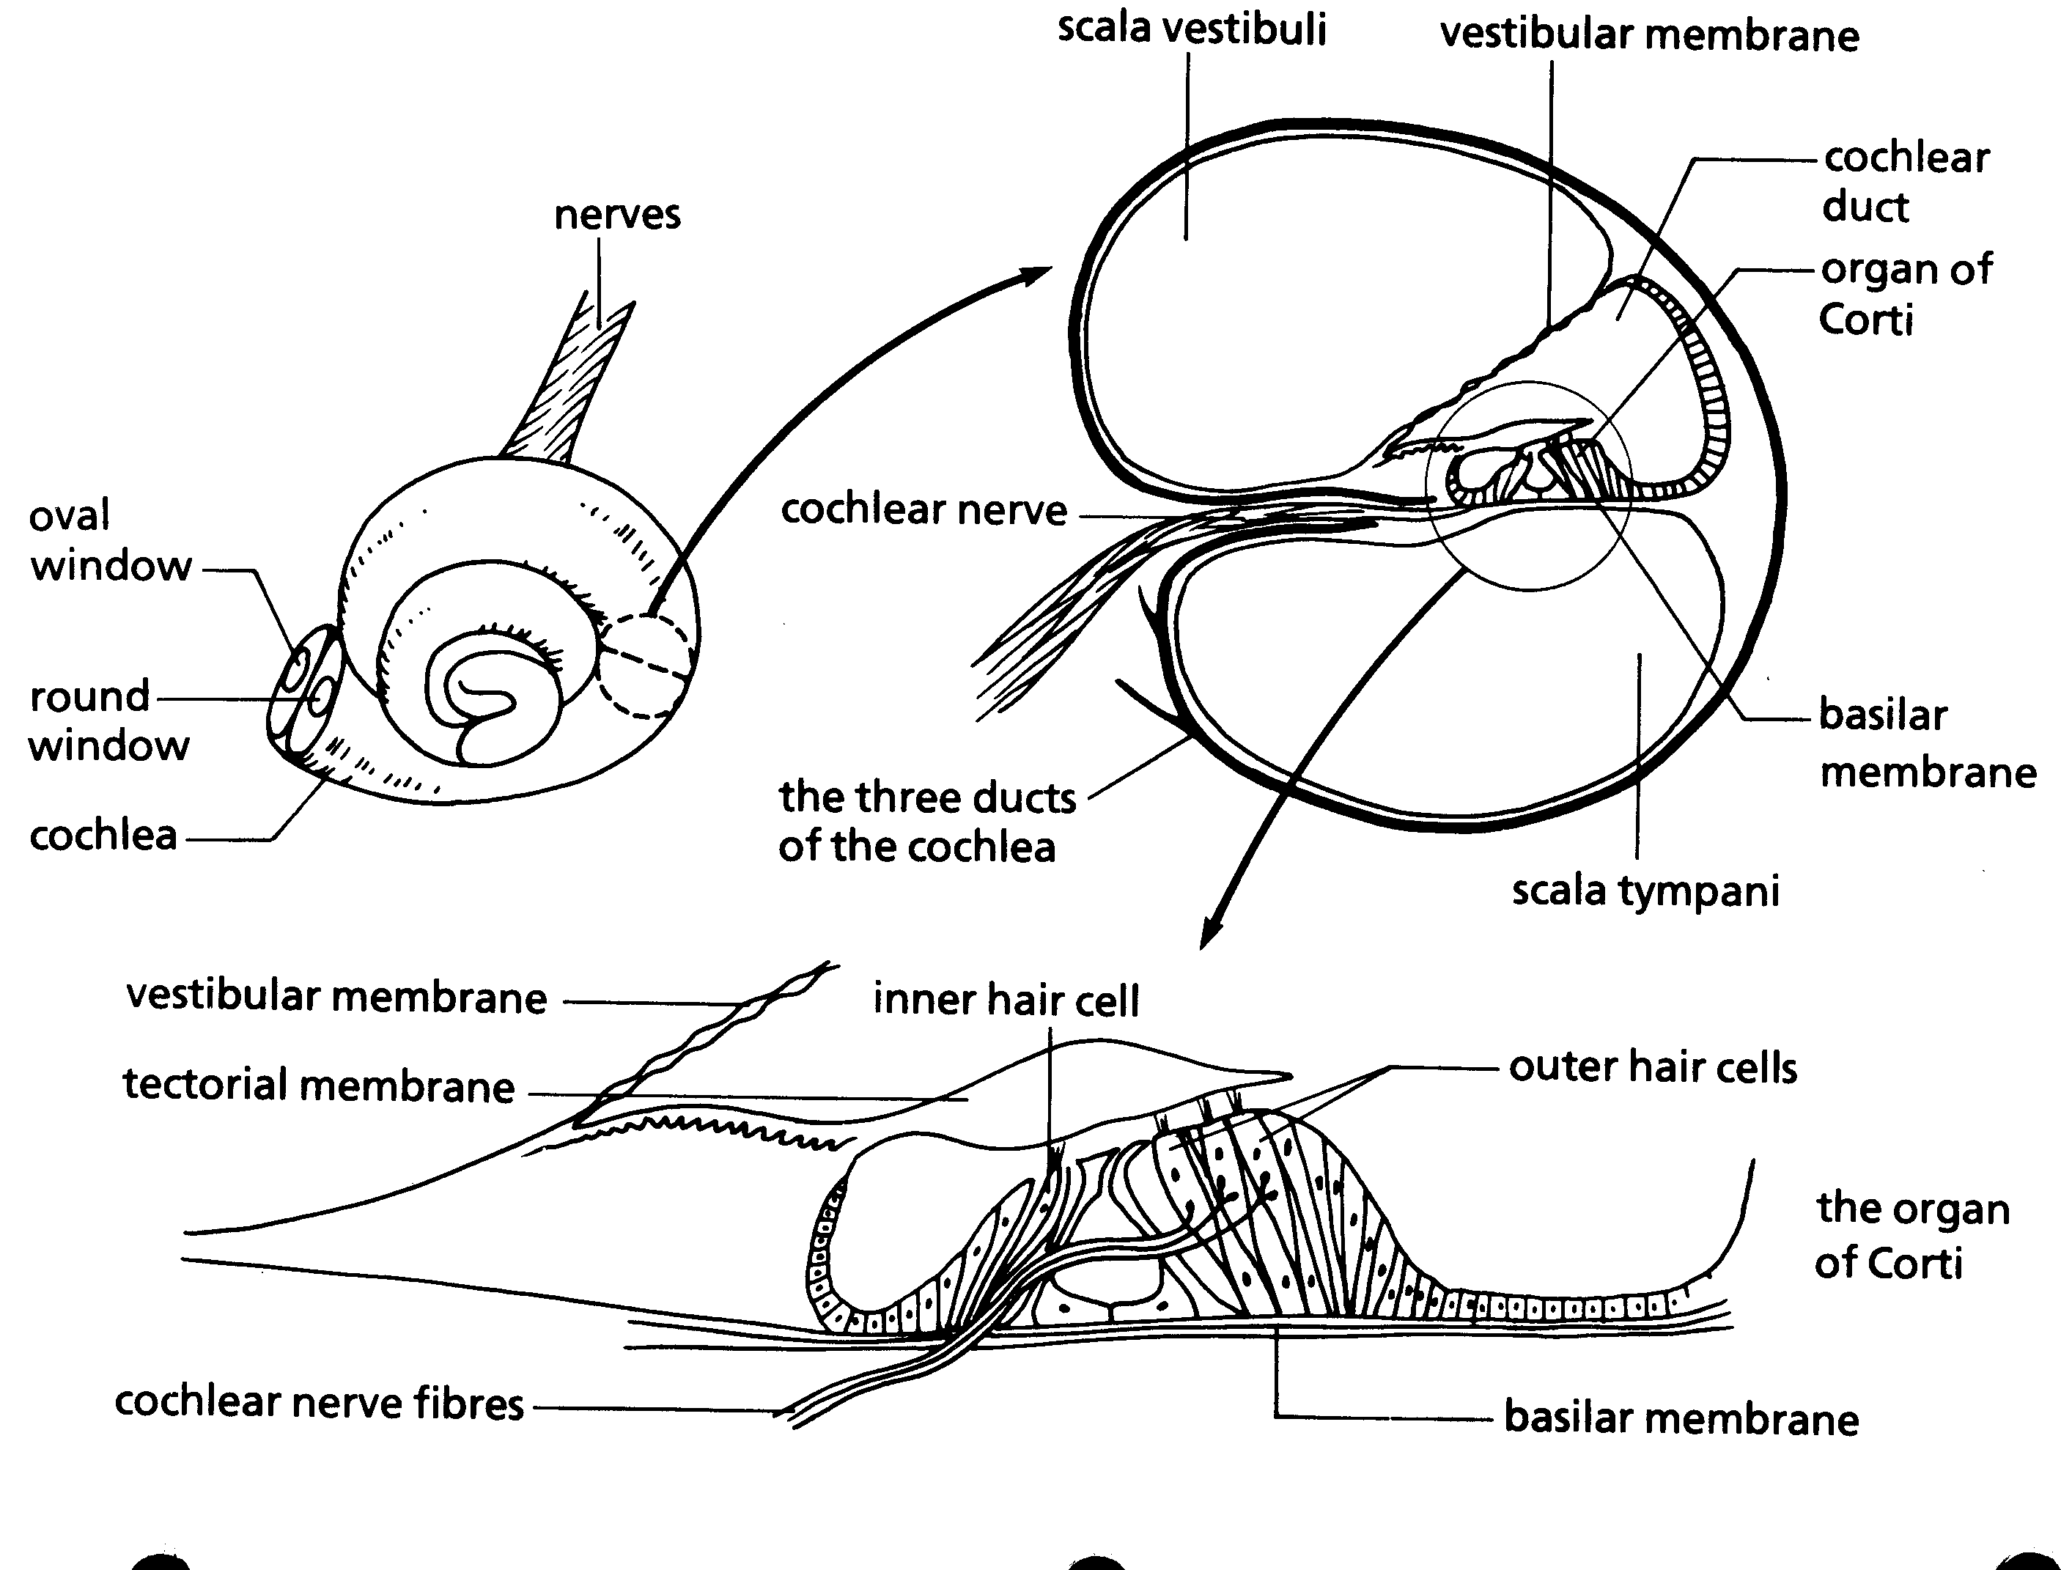
Organ Of
Corti
Scala vestibuli
Cochlear duct
Scala tympani
Tectorial mem
Basilar membrane

Slide 29
Organ of Corti
Contains cilia which stimulate nerves
Cilia attached to cells in the basilar (bottom) membrane and touch the tectorial membrane (top membrane)
Sensory Hair cells – respond to vibration of basilar membrane
An action potential develops in sensory nerves
Sending auditory info to brain (temporal lobe)

Slide 30
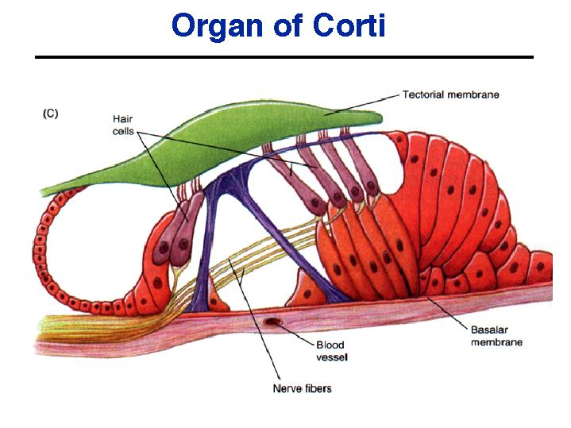
Organ of Corti
Tectorial
Membrane
Cilia
Basilar
Membrane

Slide 31
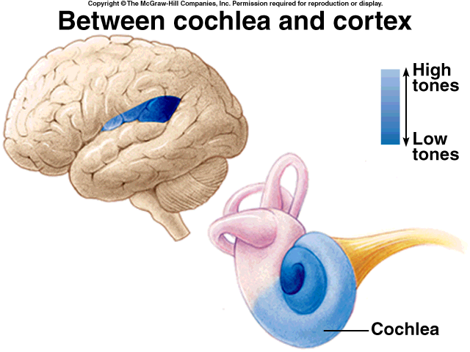
Cochlea and Cortex of Cerebrum

Slide 32
Pitch and Loudness
Stimulation of cells in different areas cause different pitches
Cochlea narrow in beginning
Hair fibers very rigid
Responding to high frequency
Basilar membrane vibrates
Sound dies fast
Cochlea eventually gets wider
Hair fibers more elastic
Responding to low freq
Sound resonates (lasts longer)

Slide 33
3 Parts of Ear
Outer | Middle | Inner
Air | Air | Fluid
Pinna | Tympanic Membrane | Semicircular Canals
Auditory Canal | Ossicles H, A, S | Vestibule
Tympanic Membrane | Eustachian Tube | Cochlea Organ of Corti

