Slide 1
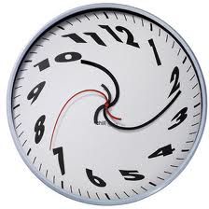
How do we measure time?

Slide 2
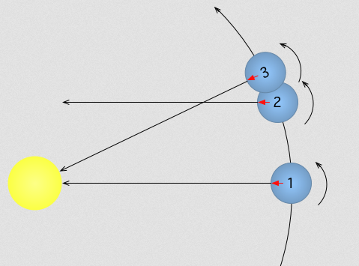
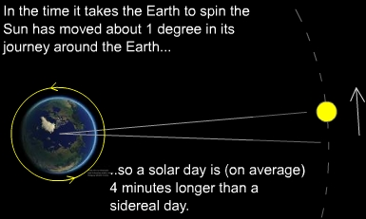
Apparent Solar Time – Time it takes for the sun to appear in the same position each day, measured by direct observation or sundial.
Mean Solar Time – 24 h between sun’s position, measured with a watch or clock (time as if the sun “traveled” at a constant speed through the sky)
Sidereal Day - the time taken by the earth to rotate on its axis relative to the stars, and is almost four minutes shorter than the solar day because of the earth's orbital motion.

Slide 4
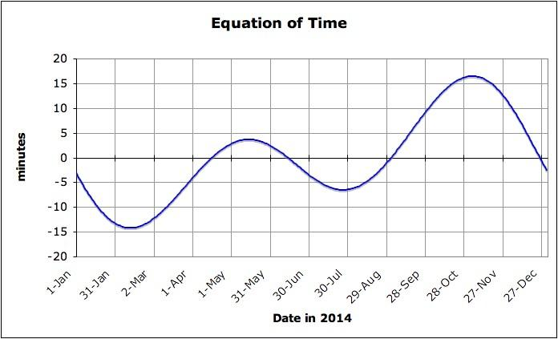

Slide 5
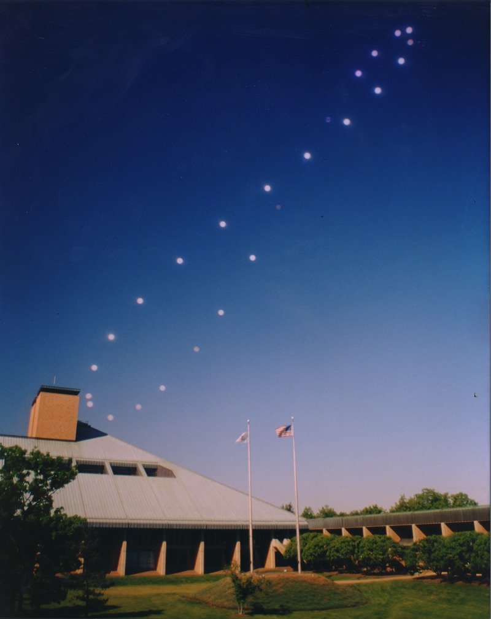
Analemma
This is a visual representation of how fast or slow a Sun Dial will be.
It can be created by photographing the sun’s position at the same clock time (24 h apart) every day.

Slide 6
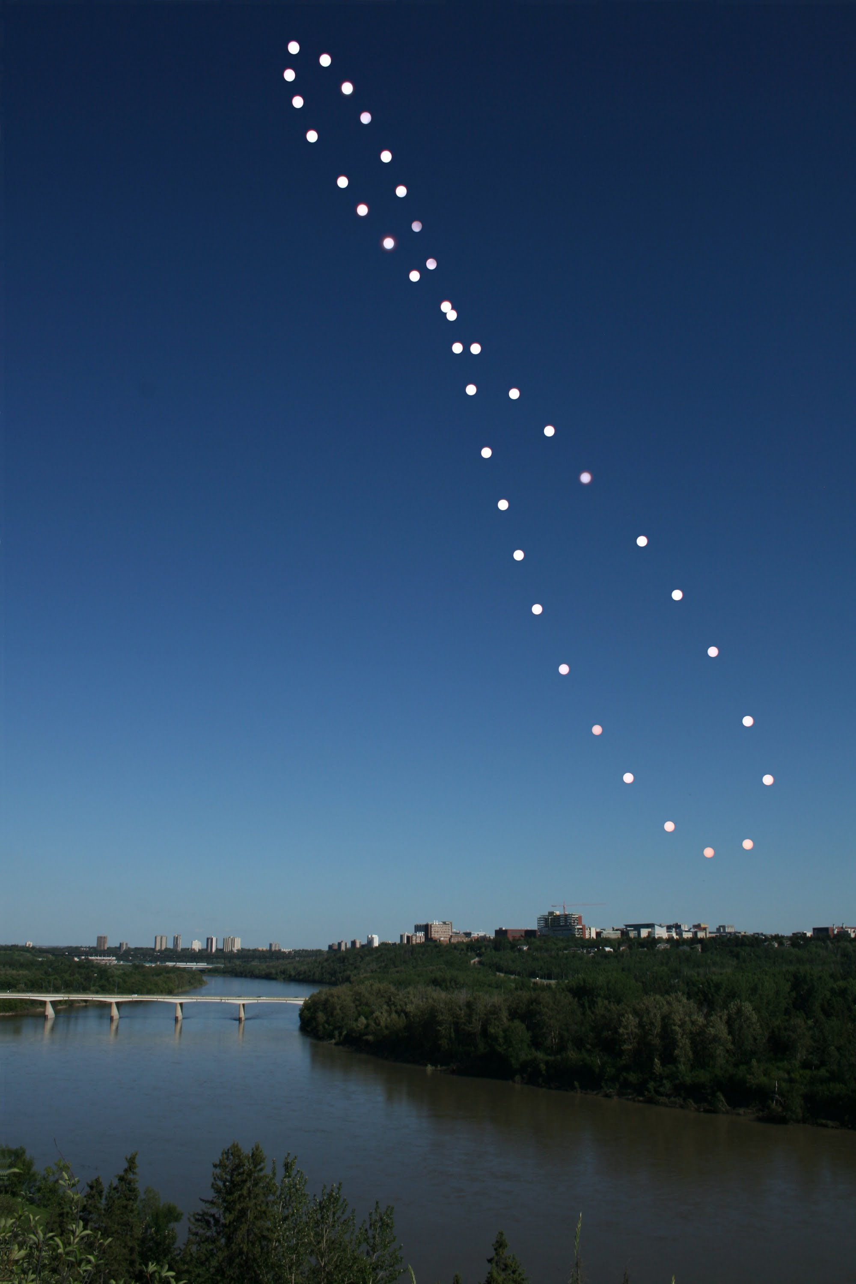
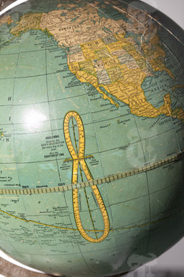

Slide 7
