Slide 1
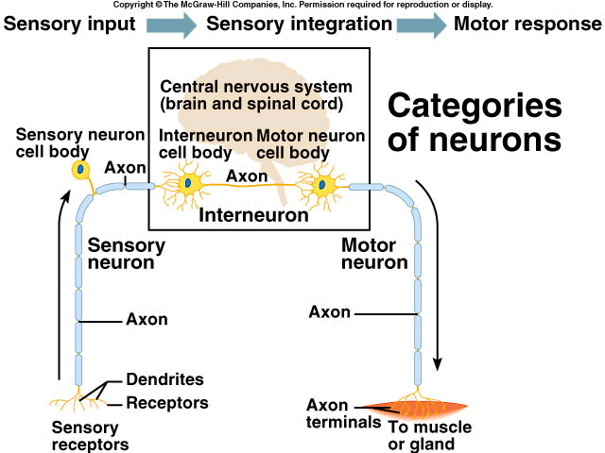
Input → Integration→ Response
Interneuron
Sensory
Neuron
Motor
Neuron
Effectors
Affectors

Slide 2
Neural Circuits Include...
1. Reception via affectors (senses)
2. Transmission along sensory neurons
3. Co-ordination & Interpretation (brain/spinal cord – interneurons)
4. Transmission along motor neurons
5. Response via effectors

Slide 3
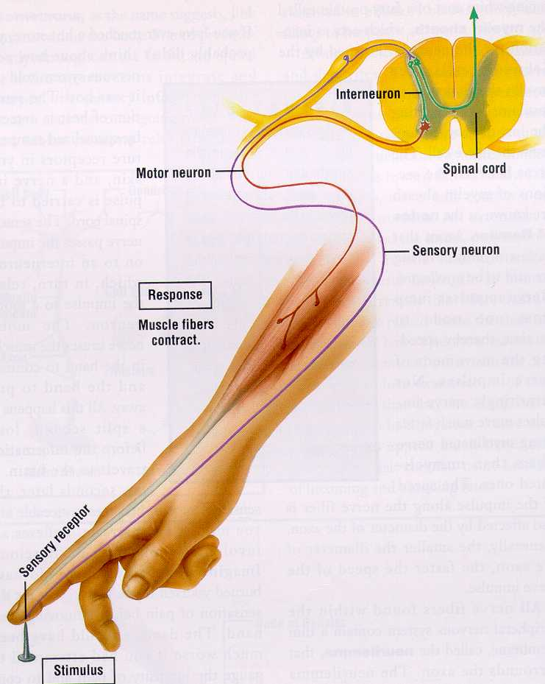
A reflex arc
(pathway)
A reflex arc contains 5 components:
1. Affector/receptor – eg. Pain receptor
2. Sensory Neuron
3. Association Neuron (interneuron)
4. Motor Neuron
5. Effector - eg. muscles

Slide 4
Neural Circuits
Automatic
Reflex pathway (reflex arc)
no brain involvement
just spinal cord
Eg. Blinking
Conscious
Involves brain & spinal
cord
eg. Making a decision
to run vs. walk

Slide 5
Neuron
Resting Neuron
Said to be at resting potential
Approx -65 to -80 mV
Active Transport pump pushes… 3Na⁺ out for every 2K⁺ in
ATP (energy) needed for this
Membrane said to be polarized because…outside more positive because there is more positive ions (Na & K) outside the neuron than inside
polarized because inside and outside are opposite charges
Excited Neuron
Said to be at action potential
Approx +40 mV
Na⁺/K⁺ pump still active
Na⁺ move in by diffusion (Na⁺ gates open, K⁺ gates close during depolarization - then opposite when at +40mV)
K⁺ gates open (when membrane is at -50mV, but with a delay – so when Na⁺ gates close), ions move out during repolarization
outside more negative than in
Many Action Potentials = nerve impulse

Slide 6
THE ACTION POTENTIAL

Slide 7
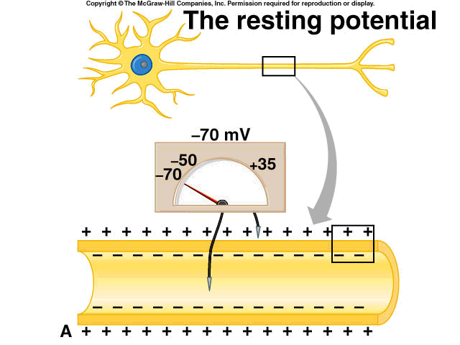
Basic Neural Processes
Membrane polarized
Outside of neuron
more positive
Inside of neuron
more negative

Slide 8
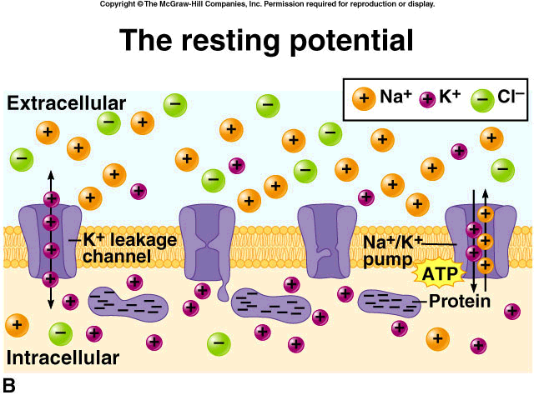
Resting Potential
(outside the cell)
3 Na⁺ out : 2 K⁺ in – this requires energy (ATP)
(inside the cell)

Slide 9
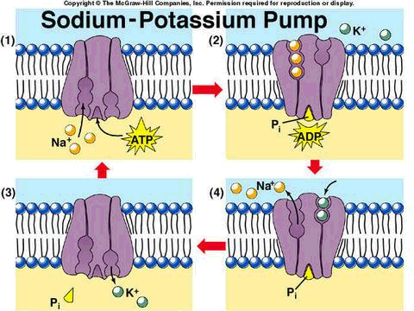
Sodium/potassium Pump
3 Na ions out
Na-K pump requires ATP.
3:2 Ratio
2 K ions in
Sodium and potassium pumps and channels are active only at each NODE OF RANVIER. This is where the axon can actually exchange ions with the extra cellular fluid.

Slide 10
The Stimulus
The Action Potential
Electrical, chemical, light, or mechanical stimulus will alter the resting potential by causing more sodium to leak back into the neuron; this changes the polarity slightly
If the stimulus is strong enough to bring the inside to about -55 mV, a THRESHOLD voltage has been reached.
Once this occurs, the sodium channels immediately open wide and potassium channels close.
This causes the inside to be more positive than the outside, due to the rushing in of positive Na ions (Depolarization of Neuron).

Slide 11
Polarized vs. Depolarized Neuron
depolarization

Slide 12
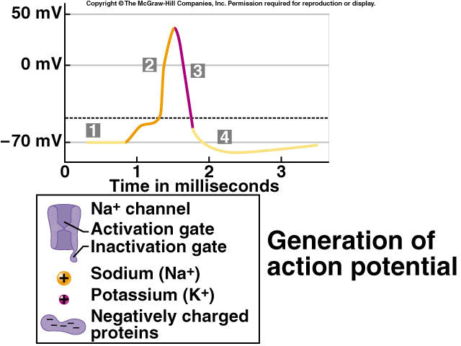
Neuron experiencing
action potential
Neuron experiencing
resting potential

Slide 13
membrane potential
shoots to about 40 mV
a spike
Generation of an
Action Potential
reversal of polarity
during action potential
(Na rushing in)
Na⁺/K⁺ pump still active -
K⁺ diffuses out -
back to resting potential
stimulus not strong enough to
reach threshold voltage

Slide 14
Summary of Impulse Transmission along Nerves
Neuron membrane initially polarized (resting potential)
Becomes depolarized (action potential)
Then repolarized as neuron recovers
Many Action Potentials sweeping along a neuron make up a nerve impulse

Slide 15
Summary cont’d.
Events of an action potential
Sodium gates open
Sodium flows down gradient into axon
Membrane potential changes from -65mV up to +40mV
Called depolarization because inside changes from negative to positive
Gates close
Potassium gates open and Na⁺/K⁺ Pump Still Active
Potassium flows down its gradient out of the axon
Brings potential back to -65mV - called repolarization
Gates close (when -50mV is reached again) with delay so membrane becomes hyperpolarized
Na⁺/K⁺ Pump brings concentrations of ions back to original levels (3 Na⁺ out / 2 K⁺ in)
These events occur in only 1 millisecond

Slide 16
Summary cont’d.
Conduction of an action potential
Nonmyelinated axons
travels down axon one small segment at a time
As soon as action potential moves on, the previous section undergoes refractory period
Sodium gates cannot reopen
Prevents retrograde transmission
During this time sodium-potassium pump restores ions to original positions
Myelinated axons
Gated ion channels concentrated in nodes of Ranvier
Action potential travels faster
“Jumps” from node to node- saltatory conduction

Slide 17
Properties of Neurons
Refractory
Period
Threshold
Stimuli
All or Nothing
Response
Once threshold
is reached
neurons either
fire at maximum
or not at all
Time needed
for neuron
to become
re-polarized
eg. 1 millisecond
(ms)
Intensity of
stimulus needed
to produce an
Action Potential
If stimulus more painful = more impulses generated, NOT a stronger impulse.
An impulse does not diminish in strength as it travels along a neuron.

Slide 18
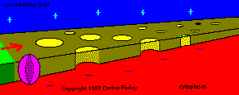
Nerve Transmission

Slide 19
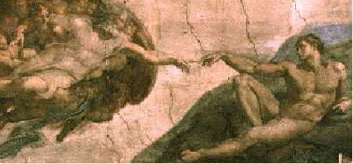
The Synapse
Pre SF
Post SF

Slide 20
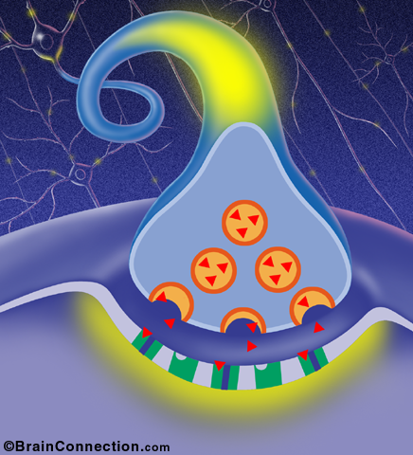
Synapse
Synapse
SYNAPTIC CLEFT

Slide 21
Synapse
Synaptic Vesicles
Neurotransmitter
Receptor Site

Slide 22
Synaptic Activities
Action potential arrives at presynaptic fiber (preSF)
Calcium ions gush into neuron
Presynaptic vesicles rupture and release Neurotransmitters (N) by exocytosis
N. travel by diffusion across synapse to post SF and
N. attach to receptor molecules on post SF
Na/K pump shuts down
Sodium gushes into post SF, membrane → depolarized
Action potential travels along post synaptic neuron
Enzyme in postSF breaks down N for re uptake by preSF
Exocytosis requires ATP

Slide 23
Cholinesterase (enzyme) breaks down acetylcholine (neurotransmitter) into acetic acid and choline
PostSF allowed to repolarize
Neuron now ready for another A.P.
Problem: If acetylcholine remains in the receptor site, the sodium channels will remain open → repeated stimulation of muscle.
Solution: Cholinesterase (an enzyme released into synaptic cleft) breaks down acetylcholine.
FYI: (1) Curare – used for poison arrow tips in S. Am. Indigenous peoples. Curare blocks excitation of muscle by binding to acetylcholine receptors in the muscle tissue → paralysis.
(2) Nerve gas inactivates cholinesterase. The amount of acetylcholine in synaptic cleft increases with each successive nerve impulse → repeated stimulation of muscle → life-threatening spasms

Slide 24
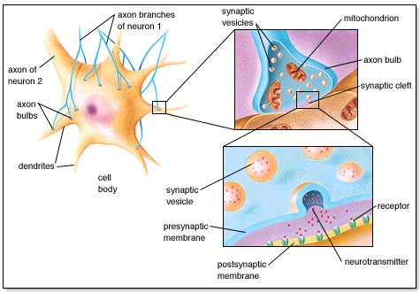
How do impulses get
from one neuron to
another?
Must jump synapse

Slide 25
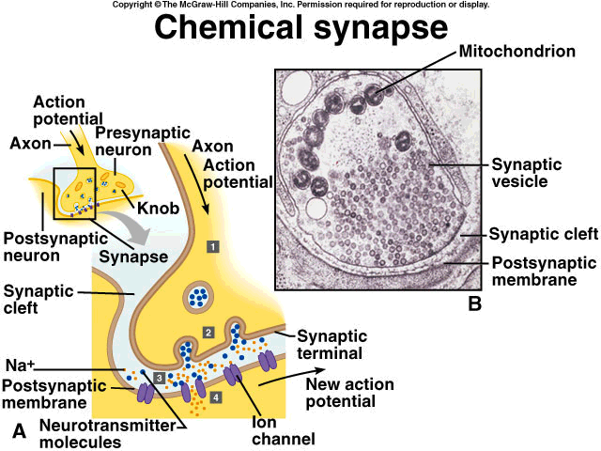
Synaptic Activities
axon of presynaptic
neuron
neurotransmitters released
by exocytosis
Receptor molecules in dendrite of postsynaptic neuron

Slide 26
Neurotransmitters
Excitatory
The purpose of neurotransmitters (ie. acetylcholine) is to partially depolarize the membrane of the post-synaptic dendrite and therefore stimulate an action potential in the
post synaptic fiber.
the post-synaptic membrane becomes permeable to Na+
Inhibitory
the post-synaptic membrane becomes resistant to depolarization. Less permeable to Na+, more permeable to K+ (K ions flow out)
resting potential even more negative than -70mV
Neuron said to be Hyperpolarized
Need higher stimulus to overcome threshold and initiate action potential

Slide 27
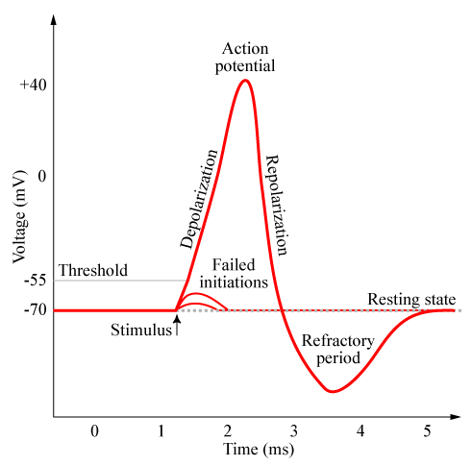
Hyperpolarization is also..
During repolarization, the rapid pumping of sodium causes a momentary hyperpolarization.
Too much positive outside - inside voltage gets below resting potential, eg. - 85mV.
Resting state is established when potassium re-enters the neuron.
Na pumped out -
K diffuses out -
back to resting
potential
hyperpolarization

Slide 28
Summation / Integration
The production of an Action Potential in one neuron often requires the sum of 2 excitatory neurons!
Stimulation of these 2 neurons is necessary to cause a sufficient amount of neurotransmitter to be released to cause depolarization of the post Synaptic Fiber.

Slide 29
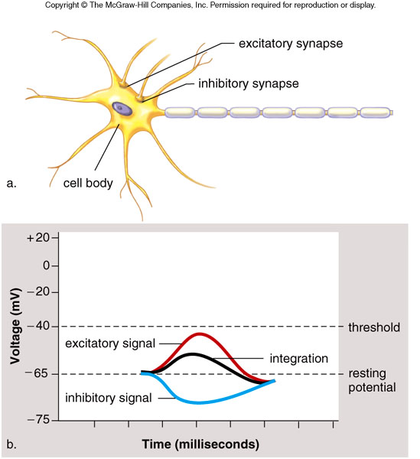
Integration
Fig. 17.6

Slide 30
Impulse only fires
when A + B are
stimulated at the
same time

Slide 31
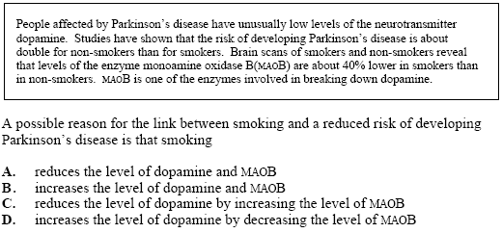

Slide 32
Chemically, there are five classes of neurotransmitters
Acetylcholine*
Most common
neuromuscular junctions, brain, internal organs
usually has an excitatory effect on post-synaptic dendrite.
2) biogenic amines
*noradrenalin = norepinephrine (same thing)
Serotonin
Histamine
3) excitatory amino acids
glutamate and aspartate
4) inhibitory amino acids
gamma-aminobutyric acid (GABA)
5) neuropeptides, over 50 are known.
*The ones to know

Slide 33
Neurotransmitter Videos
Alcohol and Neurotransmitters
Mouse Party - Drugs & NeuroTransmitters

Slide 34
Neurotransmitters
1. Acetylcholine (ACh)
In PNS and brain
Excitatory in nature
Sometimes inhibitory
Decrease production of ACh in brain is associated with Alzheimer's
2. Norepinephrine (noradrenalin)
From adrenal glands
Involved in flight or fight response, causing euphoric feelings
Amphetamines stimulate norepinephrine
Low amounts associated with depression

Slide 35
3. Dopamine
Involved in control of muscular activity
Used in brain for feelings of happiness / euphoria
Deficient (or inadequate) in people with Parkinson's
Michael J. Fox
L-Dopa is clinical form of dopamine
(remember Movie “Awakenings” with Robin Williams?)
4. Serotonin
Inhibitory
Affects brain areas associated with arousal and attention
Increased serotonin causes sleep

Slide 36
5. GABA (gamma aminobutyric acid)
Major inhibitory neurotransmitter
Low levels linked to Huntington’s disease
6. Endorphins (‘morphine-like’ substances)
generally inhibitory
Natural pain killers (and relieve stress, elevate mood)
Effects mimicked by morphine, heroin, methadone
Red heads and pain – latest research

Slide 37
FYI: Depression and Serotonin
Serotonin is lacking in the synapses of people suffering from depression
Thought to be taken back up too quickly by Pre Synaptic Fiber
Drugs can be used to prevent reuptake of Serotonin
These include Prozac and Zoloft

Slide 38
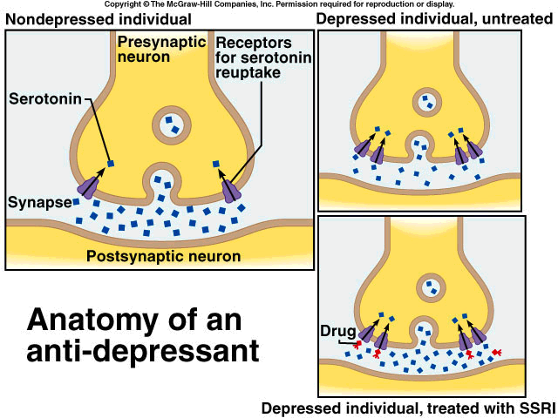
Non-depressed individuals
Depressed individuals
Depressed individuals treated with SSRI

Slide 39
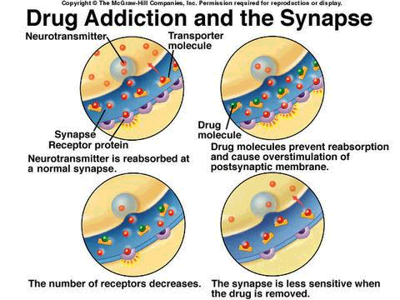
Drug Addiction and the Synapse

Slide 40
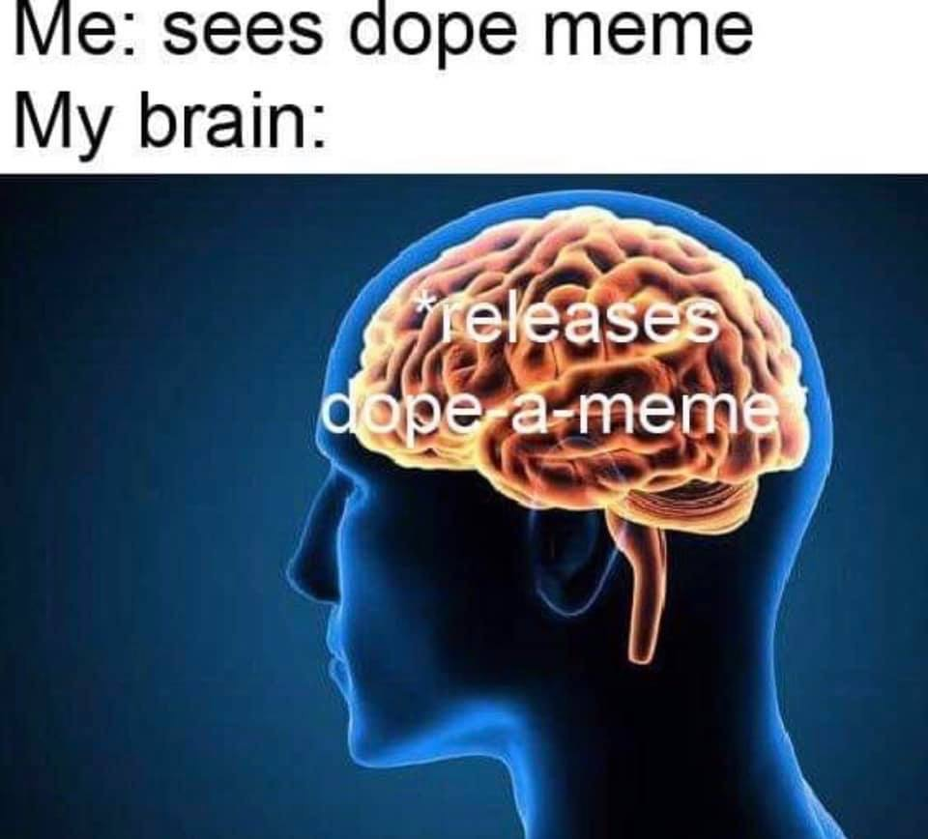

Slide 41
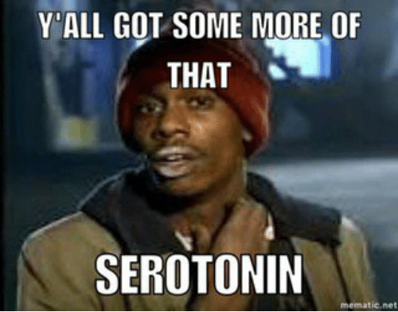

Slide 42
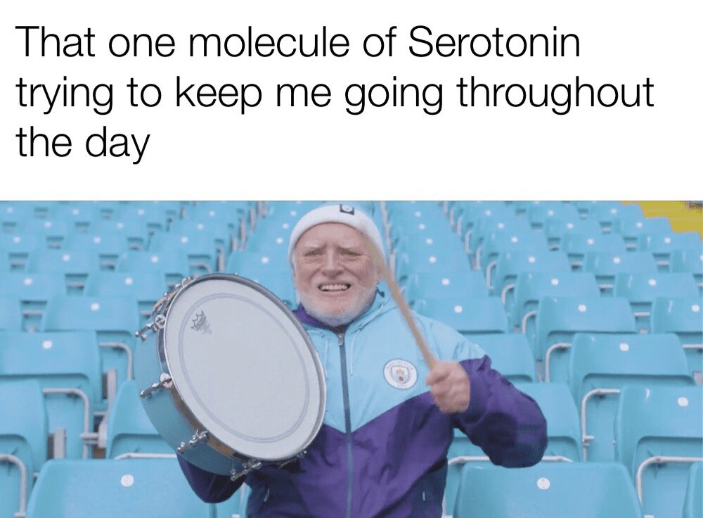

Slide 43
Nervous
System
Central
Peripheral
Brain
Spinal
Cord
Autonomic
Somatic
Sensory
Motor
Para-
Sympathetic
Sympathetic
Explore the brain and spinal cord

Slide 44
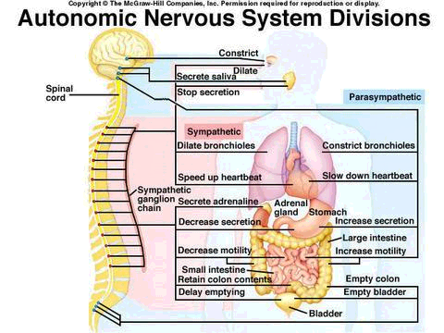
Autonomic Nervous System
Parasympathetic nervous system
Sympathetic nervous system
Parasympathetic nervous system

Slide 45
Autonomic Nervous System
Part of the Peripheral Nervous System (PNS)
Regulated without conscious control
Made of motor nerves
2 types
Sympathetic (preparing body for emergencies)
Parasympathetic (bringing body back to normal)
Use this info from the following site to answer
the questions on the ANS:
http://faculty.washington.edu/chudler/auto.html

Slide 46
Sympathetic
Parasympathetic
Heartrate
heartrate
Peristalsis
peristalsis
Glycogen to
glucose
glucose to
glycogen
Dilates pupils
constricts
pupils

