Slide 1
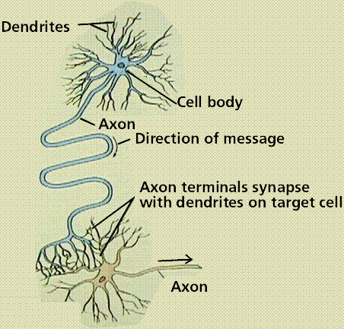
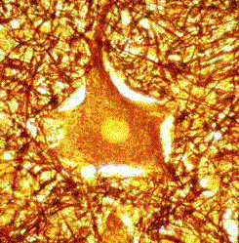
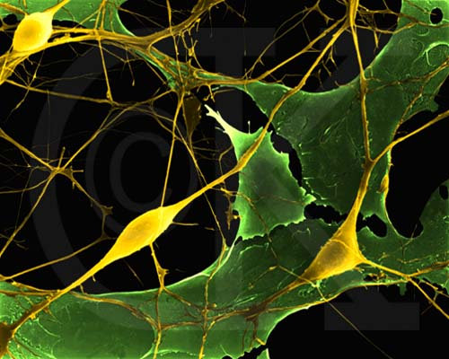
Nervous
System

Slide 2
FYI: Chocolate & the Nervous System
In 1502 Columbus seized the contents of a canoe and brought it back to Spain, including cacao beans from the tree Cacao theobroma
Chocolate causes brain to produce natural opiates
Opiates produce feelings of euphoria, dull pain
3 substances in choc act as cannabinoids (mimic cannibis (marijuana))
Active ingredient in marijuana is THC (tetrahydrocannabiol)
When THC binds to receptors, person feels high!!!
No THC in chocolate, but there are chemicals in choc that act like THC
You would have to eat 25 lbs of choc to get marijuana like effect
Choc also contains phenylethylamine, related to amphetamines
These raise blood pressure and cause blood sugar to rise causing alertness and contentment
Chocolate

Slide 3
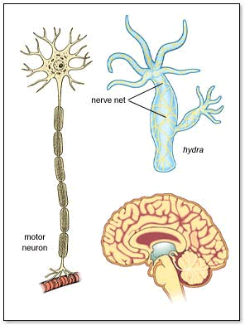
Nervous Systems
may contain
Nerve Cell
Nerve net
Human
Brain

Slide 4
Nervous System
central nervous system (CNS) and peripheral nervous system (PNS)
work together with endocrine system (hormones/glands)
Faster than endocrine
Relies on electrochemical activity in neurons (movement of ions: charged particles like sodium (Na⁺) and (potassium) (K⁺) ions )
Endocrine relies on chemicals called hormones secreted by glands into blood
Together the endocrine and nervous system
Controls, regulates & maintains internal environment
Homeostasis

Slide 5
Nervous System in Action
Via senses
Brain
&
Spinal Cord
Via muscles
or glands

Slide 6
Nervous
System
Central NS
Peripheral NS
Brain
Spinal
Cord
Autonomic
Somatic
Sensory
Motor
Para-
Sympathetic
Sympathetic
Explore the brain and spinal cord
voluntary
involuntary

Slide 7
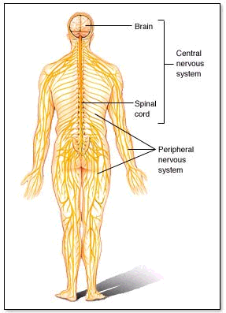
CNS
PNS

Slide 8
Cells of the
Nervous System
Conducting Cells
Neurons
These transmit nerve
impulses
Non Conducting Cells
Glial Cells
For structural support
&
Metabolism

Slide 9
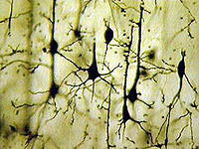
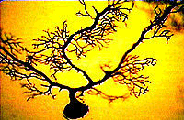
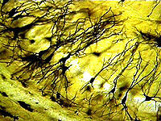
Neurons

Slide 10
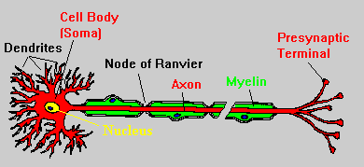
Neuron
(Axon terminal)
Direction of Nerve Impulse

Slide 11
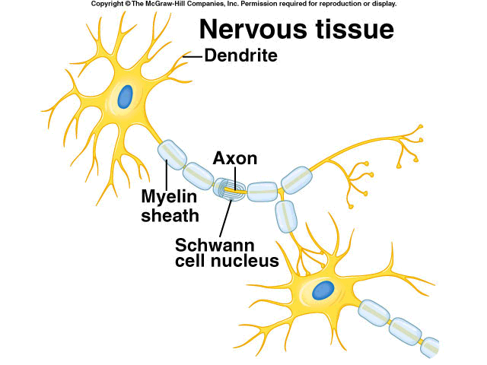
Myelin made by Schwann cells

Slide 12
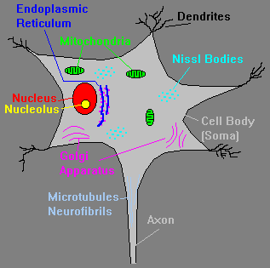
C E L L B O D Y
Filled with
Eukaryotic
organelles

Slide 13
Parts of a Neuron
1. Dendrites
Receive information from receptors or other neurons and conduct toward cell body
2. Cell Body
contains nucleus and other organelles
3. Axon
longest cytoplasmic extension from cell body
100 axons could fit into typical human hair
4. Myelin sheath
made up of fatty protein
acts as insulation & speeds up nerve impulse
Pick up info
Transport
Speed

Slide 14
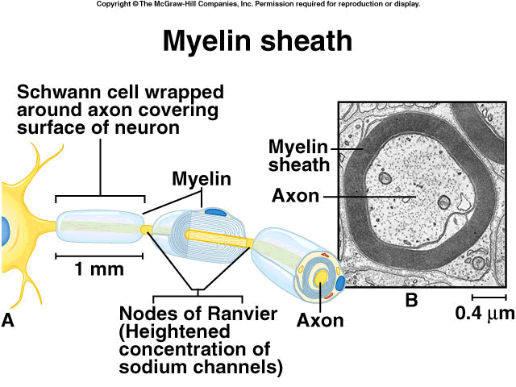
Myelin Sheath

Slide 15
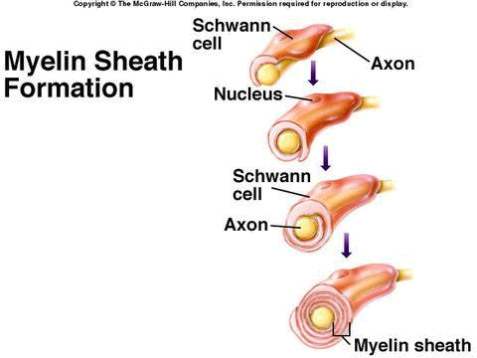
Schwann cell
wraps around
axon & produces
myelin

Slide 16
5. Schwann Cells
Wrapped around axons
produce myelin sheath
6. Nodes of Ranvier
areas between sections of myelin
impulse thought to jump from one node to another, speeding up impulse transmission
Myelin
Saltatory
Conduction

Slide 17
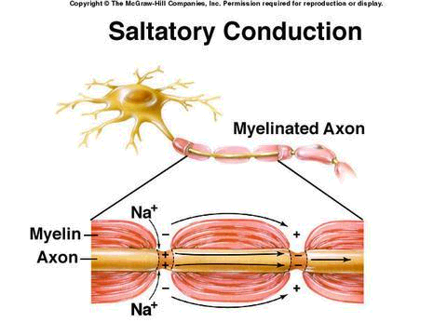
Saltatory Conduction
Impulse jumps
from node to node,
speeding transmission

Slide 18
7. Neurilemma
only present on some neurons; found on PNS neurons
allows for regeneration after damage
not on neurons in gray matter therefore damage is permanent
Healing

Slide 19
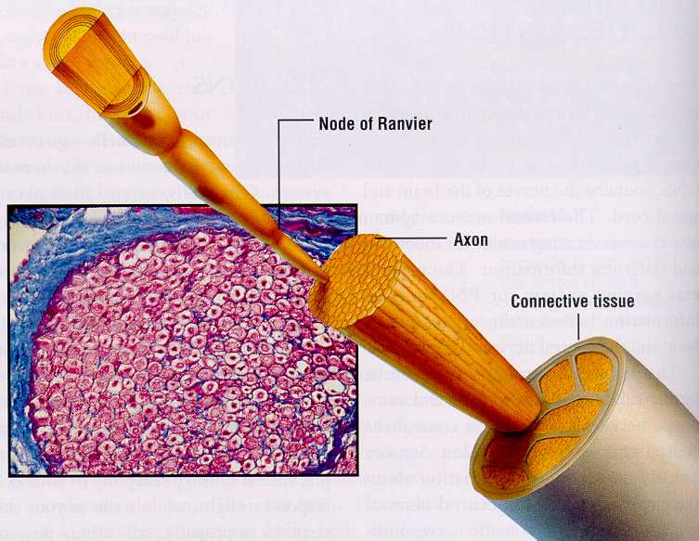

Slide 20
Types of
Neurons
Quite rare
Classified by
number of
extensions
to cell body
Sensory neurons
Common in CNS (brain & spinal cord)

Slide 21
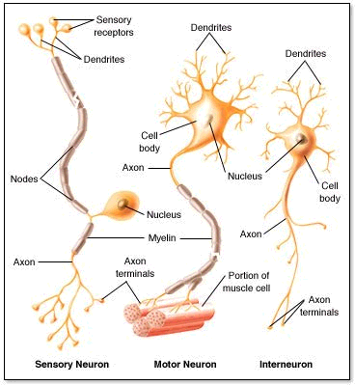
Multi-
polar
3 Types of neurons

Slide 22
Types of Neurons
1. Sensory
Relays information from sensory receptors
(affectors) to Central Nervous System(CNS)
2. Association or Interneuron
Mostly in brain and spinal cord
Integrate and interpret info.
3. Motor
Sends info. to effectors which include glands and muscles
Glands secrete
Muscles contract

Slide 23
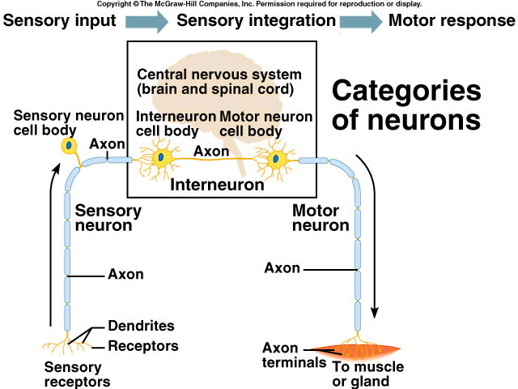
Input → Integration→ Response
Interneuron
Sensory
Neuron
Motor
Neuron
Effectors
Affectors

Slide 24
Neuron
Direction of Nerve Impulse
Can you label this without peeking at the answers earlier…?

