Slide 1
Safety In Transportation
Science 24 Unit D

Slide 2
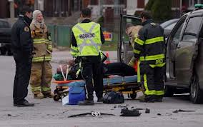
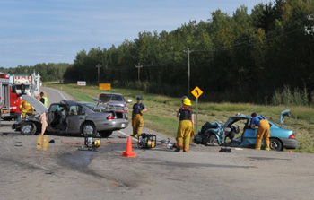
13.1 - Focus Question
How dangerous are vehicle accidents and who is most at risk?

Slide 3
Motor Vehicle Accident Injuries
Injuries People can incur are
cuts, bruises, and broken bones
whiplash
serious burns
internal injuries
head and spinal injuries that may lead to blindness paralysis, or brain damage

Slide 4
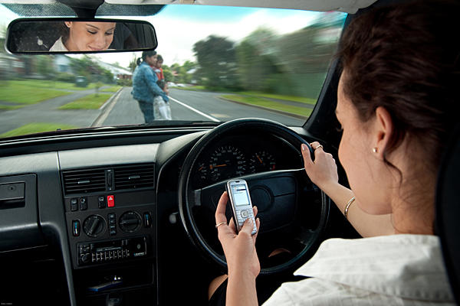
13.2 - Focus Question
What is reaction time and what factors can reduce reaction time?

Slide 5
Vocabulary
reaction time: time it takes to recognize a situation and act on it
distraction: anything that takes attention away from a task
impaired: unable to function normally
depressant: substance that slows reactions, lowers co-ordination, and increases drowsiness
BAC: Blood Alcohol Concentration; the measure of the amount of alcohol in the bloodstream. Usually measured in milligrams of alcohol per millilitre of blood
impaired driving: legal term for the offence of driving with a blood alcohol concentration of more than 0.08

Slide 6
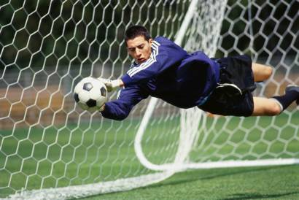
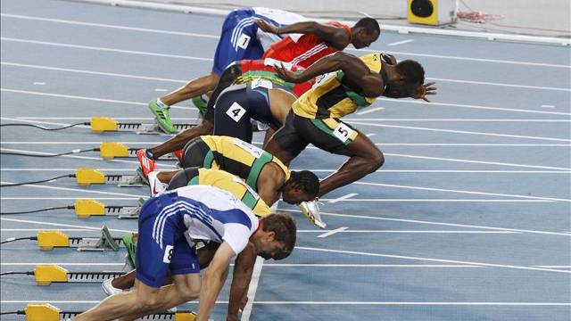
Reaction Time
What is it?
It is the time it takes you to react to a situation.
Examples:

Slide 7
Factors That Slow Reaction Time
Distractions – take your mind away from what you are supposed to be doing
Fatigue – when the body wants to sleep your mind cannot focus on the task at hand
Drugs (including stimulants and depressants) – stimulants such as coffee and cocaine speed up reaction time but cause the driver to be more aggressive; depressants slow reaction time
Blood Alcohol – alcohol affects your coordination, balance, reflexes, and the ability of your brain to focus

Slide 8
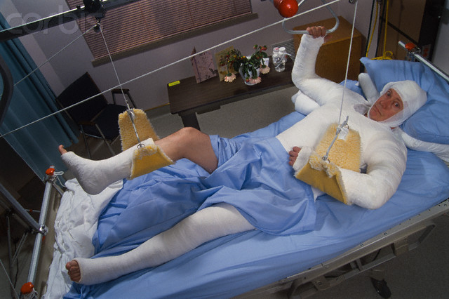
13.3 - Focus Question
What types of injuries can occur as a result of a vehicle accident?

Slide 9
Vocabulary
trauma: physical and emotional stress or injury resulting from an accident
whiplash: injury caused by muscles and ligaments of the neck being stretched or compressed too much
grief: feelings of regret, sadness, orr loss
therapy: medical treatment that does not involve surgery or drugs

Slide 10
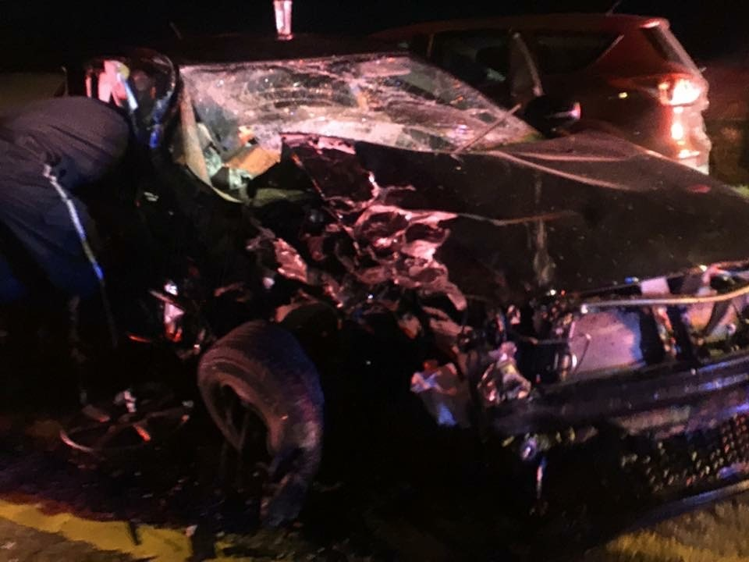

Slide 11
Trauma
Trauma refers to any physical or emotional stress acquired as a result of a motor vehicle accident.
Trauma can include:
Cuts and scrapes Fear of driving
Broken bones Grief
Whiplash Regret
Brain injuries Survivors Guilt
People who get into vehicle accidents often need hospitalization, physiotherapy, and/or counseling to bring them back to a state of health.
Many people often suffer financial difficulties as a result of a vehicle accident from the inability to go to work and, in some cases, the expenses of hospitalization and treatment.

Slide 12
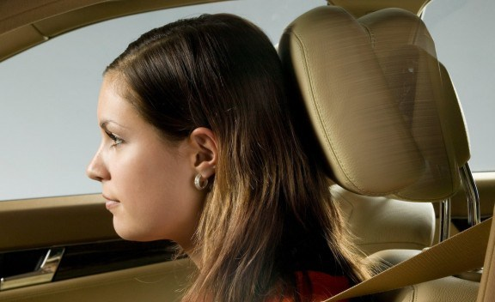
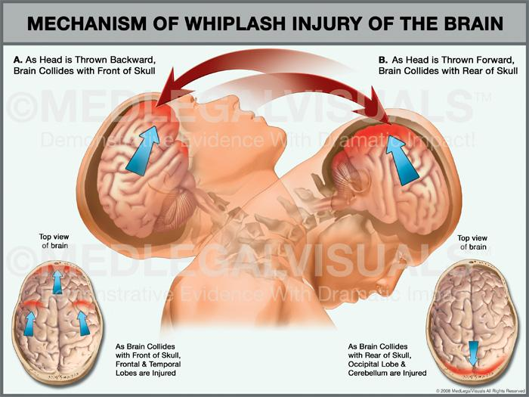
Whiplash
Occurs when a person’s muscles and ligaments of the neck are sprained.
Whiplash causes pain, stiffness and loss of movement in the neck. You may also experience headaches, muscle spasms and pain in your arms or shoulders.
A properly set headrest and the use of a seatbelt will prevent whiplash from occurring .

Slide 13
Grief Feelings of regret, sadness, or loss
Grief can be a major cause of pain after a car accident occurs
Who could grieve after a car accident:
People or persons who are injured, maybe permanently
Loved ones of people that are injured
The person who caused the accident

Slide 14
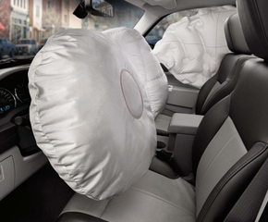
13.4 - Focus Question
How can vehicle accidents be prevented?
How can people be protected from injury if the accident cannot be prevented?

Slide 15
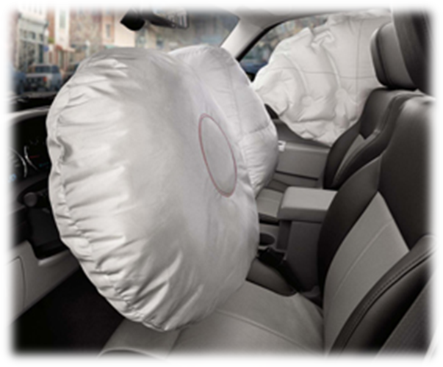
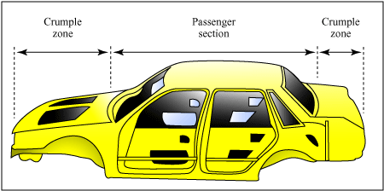
Prevention – Safe Vehicles
Safety features built into vehicles include:
Seat belts and air bags
Anti lock braking systems (ABS)
Side impact beams
Crumple zones

Slide 16
Use this information to fill in your chart – page 7 in workbook
Seat belts – Passenger restraints, there should be one available for every person in the vehicle (not in the trunk!!)
Air bags – inflate when collision occurs, cushions the driver/passenger against impact
Anti-lock braking system (ABS) – provides better stopping ability in slippery conditions
Crumple zones – outer part of the vehicle, near the bumpers. Takes energy out of collision so passengers feel less effect
Side impact beams – steel beams in the door – prevents doors from caving in

Slide 17
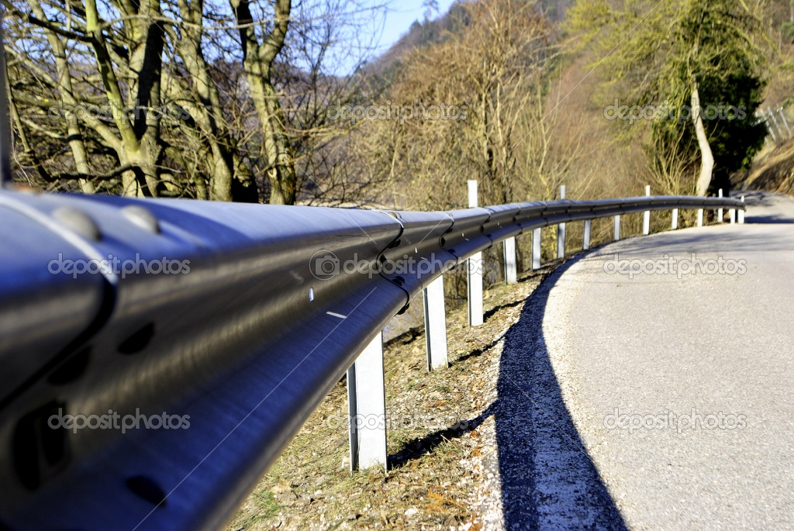
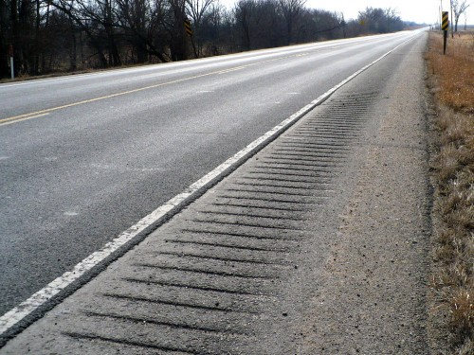
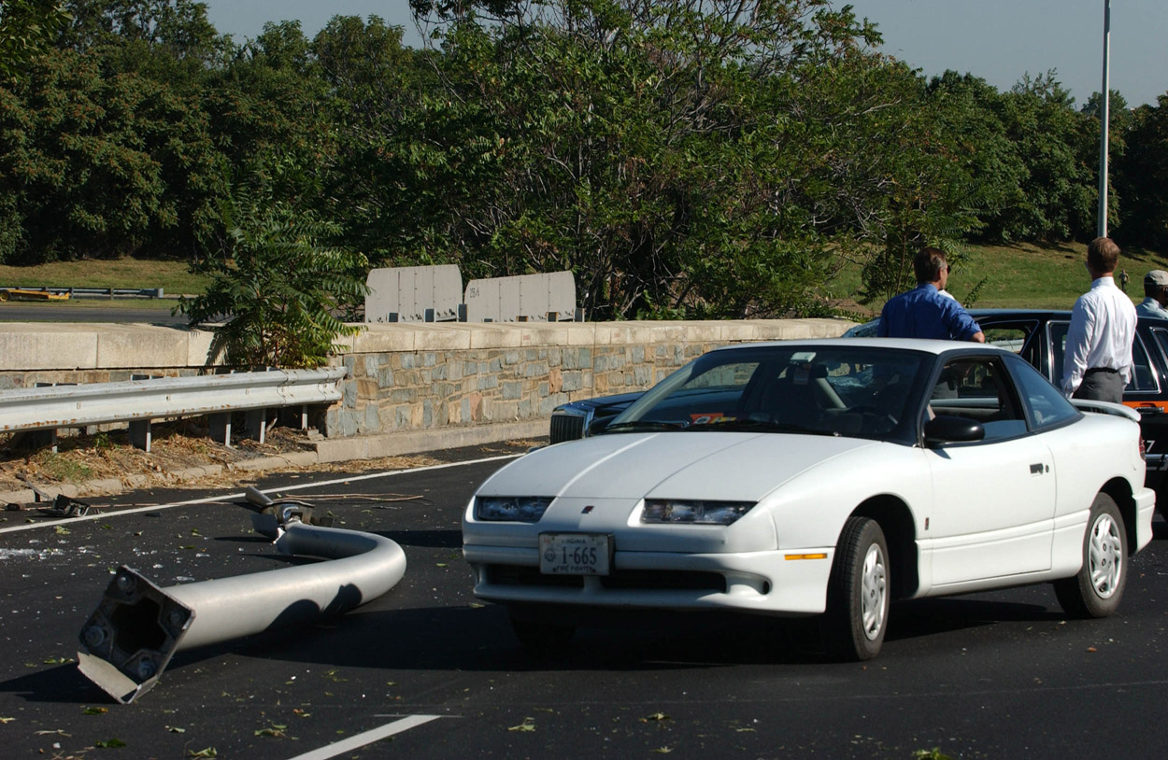
Vehicle & Roadway Maintenance
Maintaining your vehicle helps to prevent collisions from occurring. Some things to consider are:
Tires 2. Steering wheel 3. Windshield wipers
Roads can be made safer by:
1. Including rumble strips
2. Providing guard rails
3. Providing lights and signs
4. Designing roadway poles and signs to break easily on impact.

Slide 18
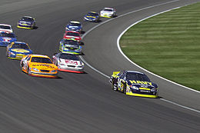
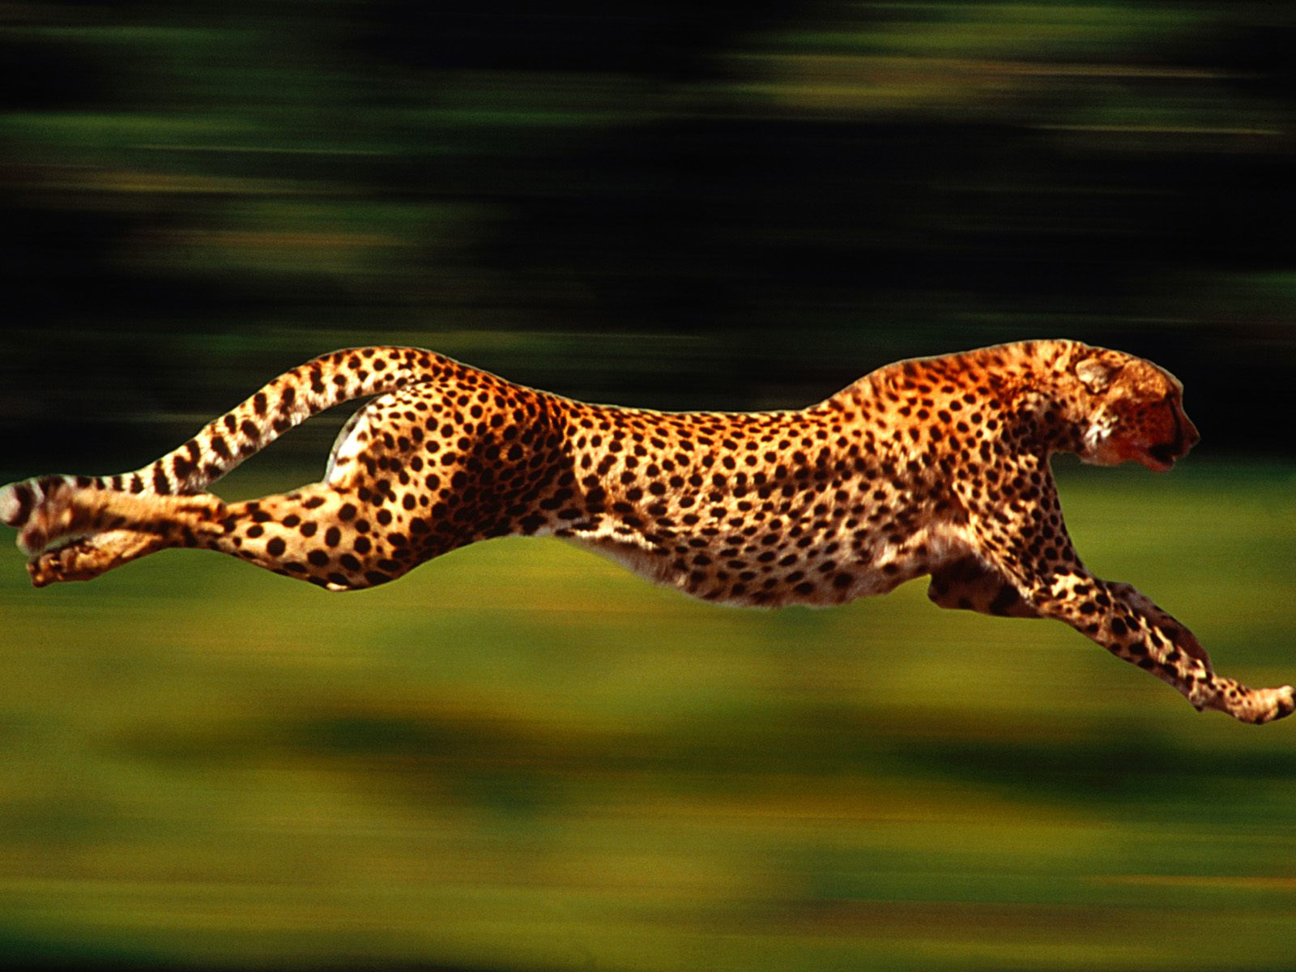
14.1 - Focus Question
How is speed, also called velocity, measured and calculated?

Slide 19
Introduction to velocity
Distance – a change in position – this change in position occurs over a period of time
Time – interval between events
Velocity – also known as speed; the distance travelled during a specific time interval

Slide 20
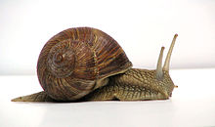
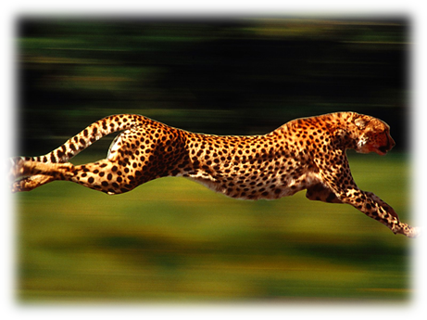
To speed or not to speed
In order to have speed you must be moving. When you are in motion you are changing position (obtaining distance) in a time period.
The more distance that you travel in a time period the faster you are going.
Think about it: Who is going faster?
A snail obtains a distance of 5 meters in 5 seconds
A cheetah obtains a distance of 1 meter in 5 seconds

Slide 21
Calculating velocity
Velocity is the distance travelled during a specific time interval.
Formula: v = d/t
v = velocity (speed) 🡪 m/s or km/h
d = distance travelled 🡪 m (meters) or km (kilometers)
t = time taken to travel a distance 🡪 s (seconds) or h (hours)
Example problem: p254 Sample Problem 1

Slide 22
Practice Problems
It is 10 meters from the back of the pool hall to the front door. If you travel that distance in 30 seconds, how fast are you traveling?
In a long shot to finish the game, the cue ball is two meters from the 8 ball. It takes half a second (0.5 seconds) for the cue ball to travel that distance. What is the speed?

Slide 23
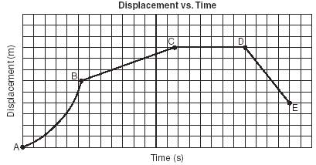
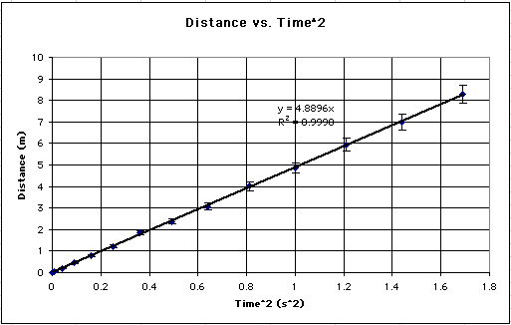
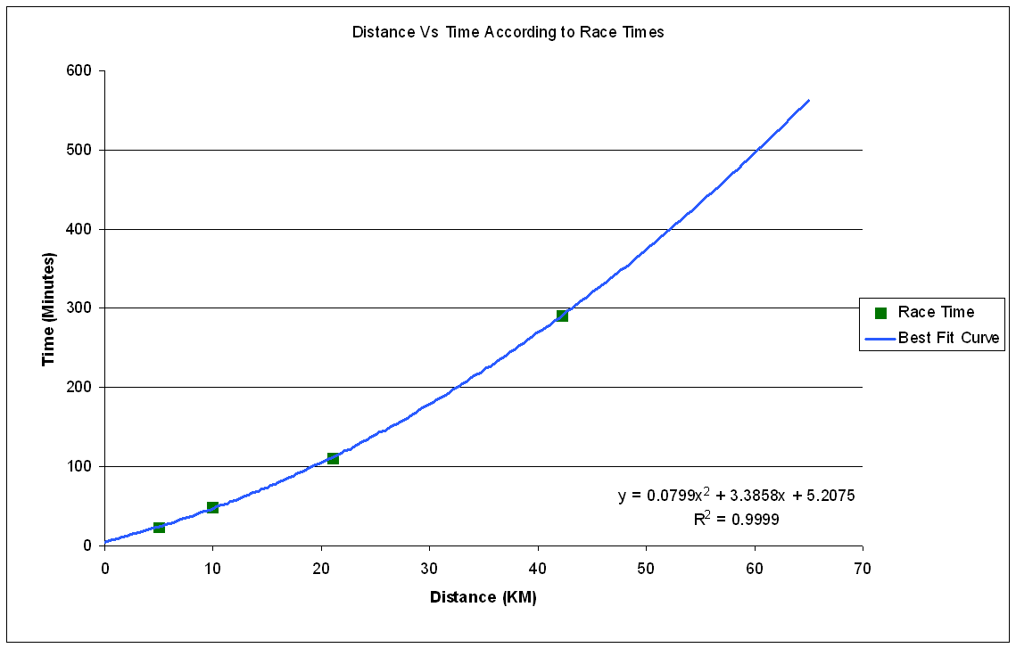
14.2 - Focus Question
How is velocity graphed?
Analyze the following graphs. What do they say about the object’s motion ?

Slide 24
Vocabulary
Variable = parts of an investigation that change because they are manipulated.
Manipulated Variable (MV) = Is the variable that is changed by the experimenter.
Is usually graphed on the X-axis
Usually “time”
Responding Variable (RV) = Is the variable that is measured by the experimenter.
Is usually graphed on the Y-axis
Usually “distance”
Y-axis
x-axis

Slide 25
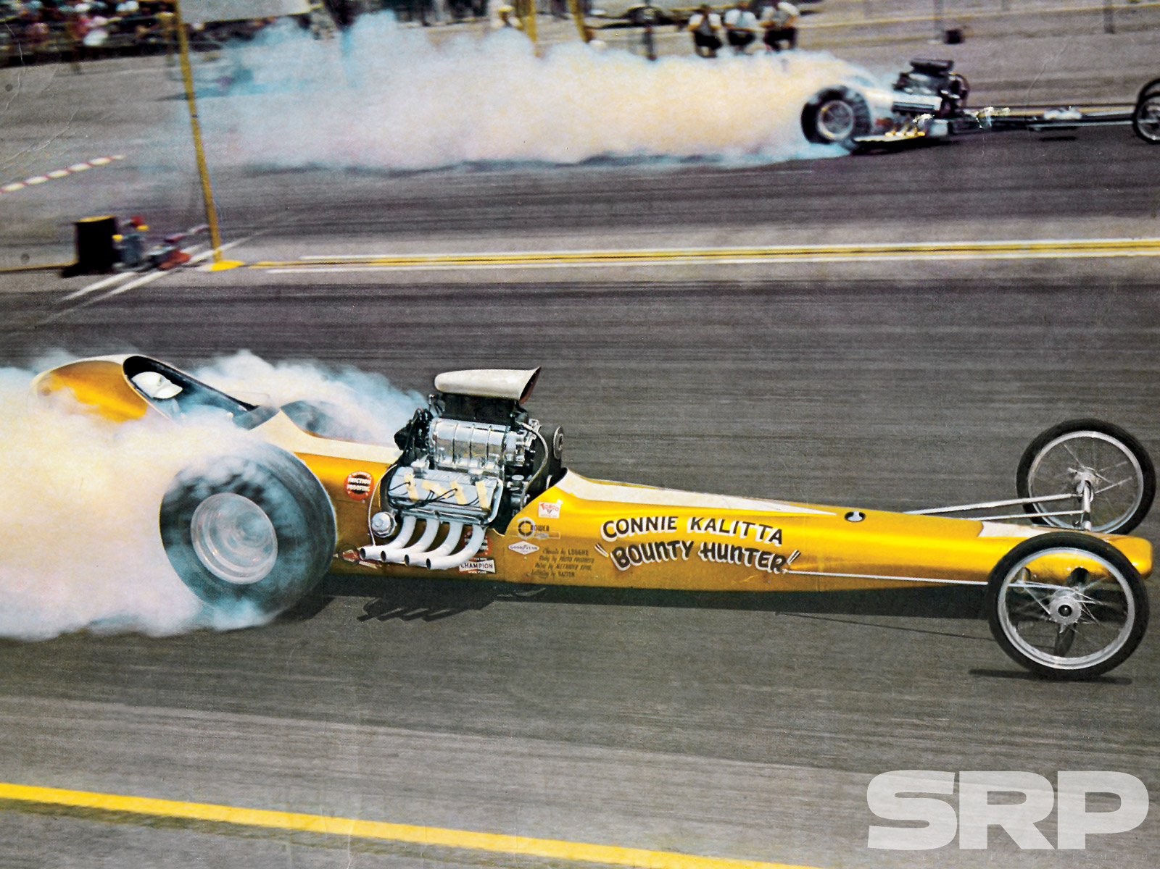
Experimental Variables
Example:
A drag racer’s speed is calculated by measuring the time that it takes to travel 100m.
What is the manipulated variable?
What is the responding variable?
**Note: Time is ALWAYS plotted on the x-axis of a graph **

Slide 26
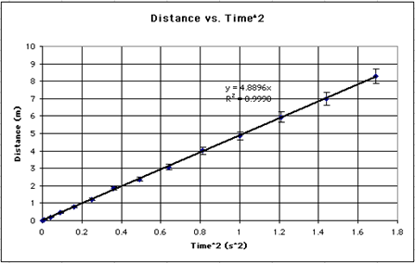
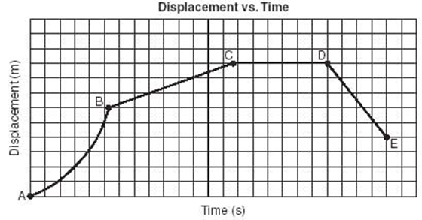
Constant vs. Changing velocity
Constant Speed
If the distance traveled in each second of the time interval is the same as the others.
Changing Speed
If the distance traveled in one second in the time interval is different than the others .

Slide 27
Example Problem

Slide 28
Using a distance-time graph to calculate velocity – page 7 (workbook)
Velocity can be obtained on a distance-time graph by calculating the slope of the graph.
Determine the rise of the y-axis
Determine the run of the x-axis
Use the formula slope=rise/run
Substitute the values obtained from steps 1&2 into the formula
Obtain an answer

Slide 29
14.3 - Focus Question
Can the distance travelled be calculated by knowing the speed of an object?

Slide 30
Solving for Distance Using the Velocity Formula – page 10 (workbook)
The distance travelled can be calculated if the velocity (speed) that an object is travelling at AND the time that it traveled at is known.
Use the following formula: d = vt
*This formula is derived from v = d/t
Example problem: p262 Sample Problem 1

Slide 31
Example problem: p262 Sample Problem 1 page 10 (workbook)
Known/unknown | Formula | Substitution | Answer
V = 15km/h T = 0.5 h D ? | V = d / t D= v*t | D = v*t D = 15km/h * 0.5 h | D = 7.5 km
Note – question must be in hours 30 minutes = 0.5 hours | Remember to rearrange the formula |  | You would have travelled 7.5km.

Slide 32
Example problem: p263 “solve these” Q 1
Known/unknown | Formula | Substitution | Answer
V = 56km/h T = 2.3 h D ? | V = d / t D= v*t | D = v*t D = 56km/h * 2.3 h | D = 128.8 km
 | Remember to rearrange the formula |  | You would have travelled 128.8 km.
So let me ask you this… what kind of roads would you be travelling 56km/h on?

Slide 33
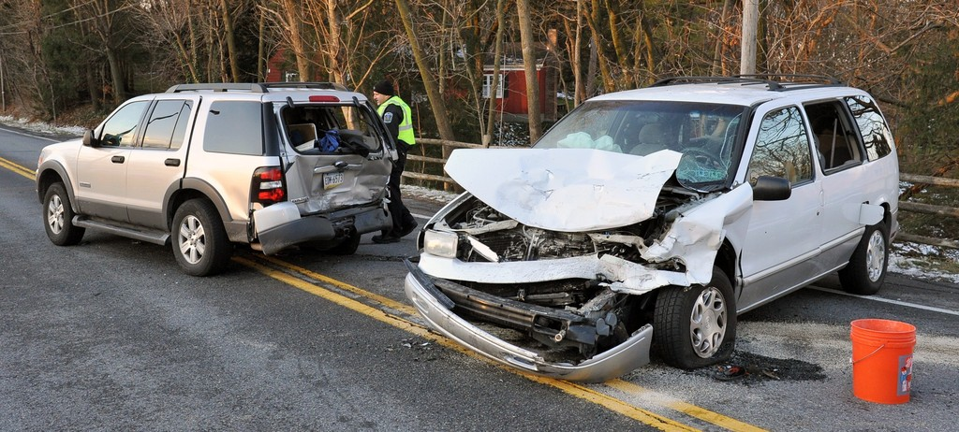
14.4 - Focus Question
How much space is really needed for safety when we are following other vehicles?

Slide 34
Vocabulary
braking distance: distance a vehicle travels between when the driver applies the brakes and when the vehicle comes to a stop
stopping distance: distance that a vehicle travels during reaction time (thinking time) + braking distance time
following distance: distance (measured in seconds) at which it is considered safe to follow another vehicle under GOOD driving conditions

Slide 35
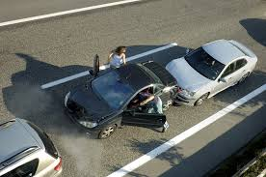
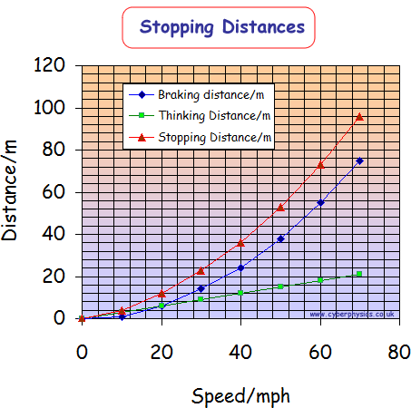
Stopping Distance
Stopping Distance = Reaction Distance (thinking) + Braking Distance
Reaction time does not usually change based on speed, BUT it will lead to differences in stopping time.

Slide 36
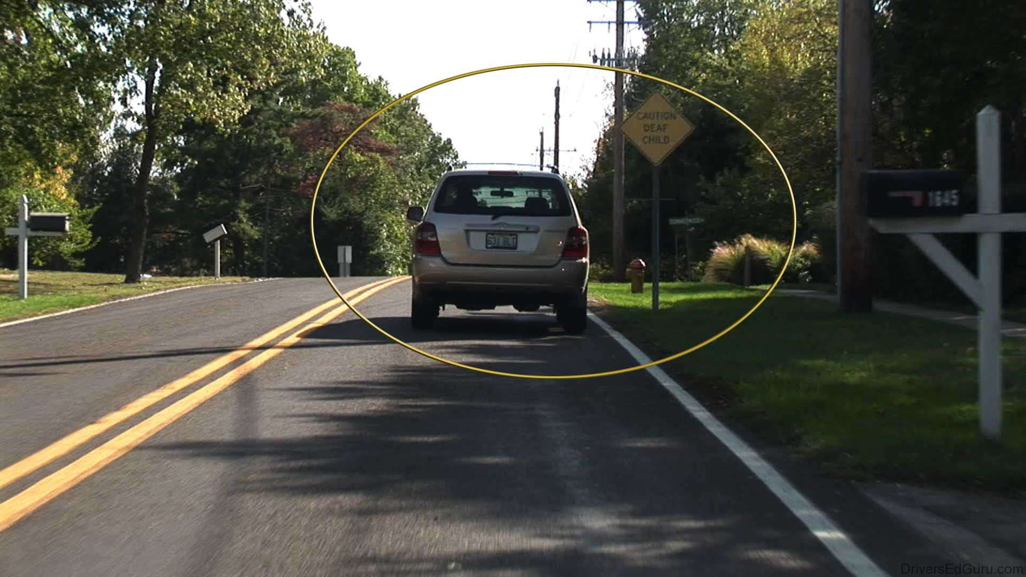
Following Distance – page 14 (workbook)
For safety, keep a following distance of 2 seconds behind the car in front of you.
Why is proper following distance important when driving a vehicle?

Slide 37
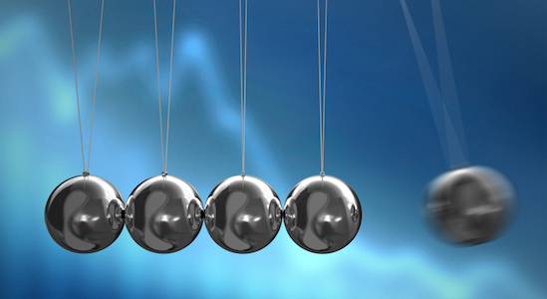
15.1 - Focus Question
What is momentum?

Slide 38
Some vocabulary to start…
Momentum – measures an object’s motion and likelihood that the object will remain in motion.
Braking – force applied by brakes to stop a vehicle
Friction – force resisting motion, caused by objects rubbing together
Force – any push or pull on an object

Slide 39
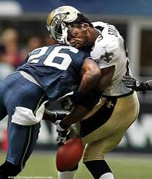
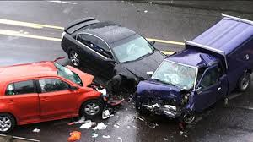
Momentum & Force
When an object is in motion it will tend to stay in motion, therefore it is said to have momentum.
An object gains momentum when a force is applied to it.
Newton’s First Law of motion
An object at rest will stay at rest unless a force acts on that object.
An object in motion will stay in motion unless an opposite force acts on that object.

Slide 40
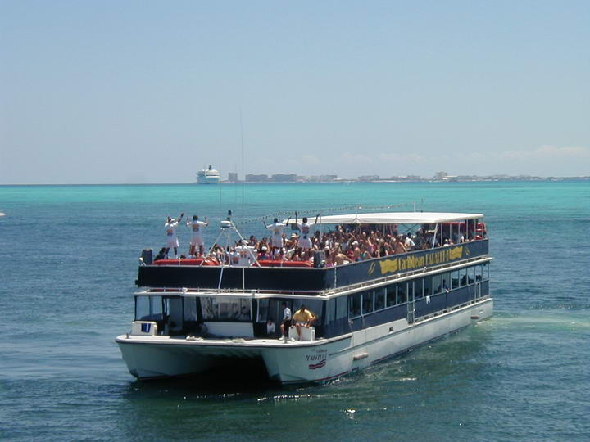
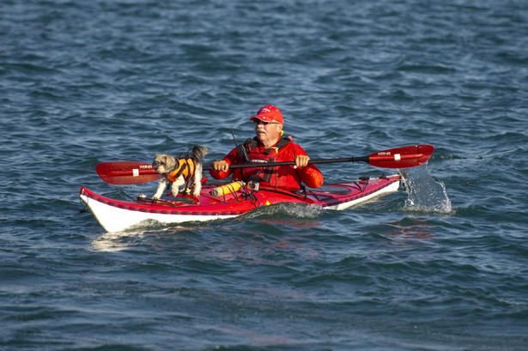
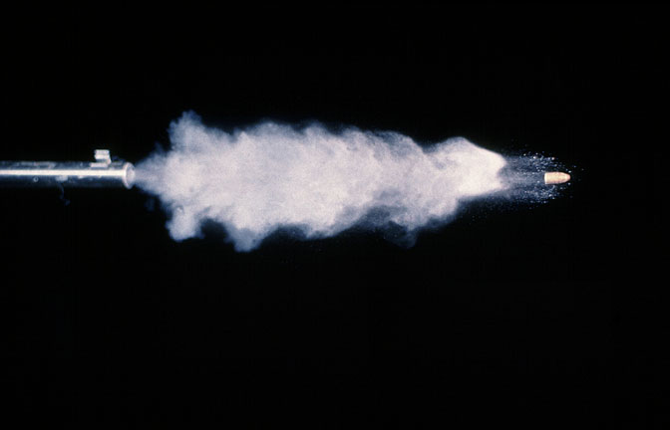
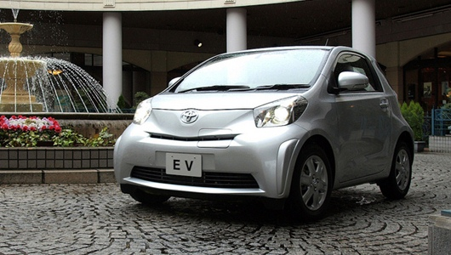
Momentum and Mass
Which object will be more difficult to stop: A large boat or a canoe moving at the same speed?
A bullet shot from a rifle or a car moving at walking speed?
Did you know? – page 270
A supertanker moving at 30km/h may take 20 minutes and 5 km to come to a stop after the engine shuts off!

Slide 41
Calculating Momentum
Since the momentum of an object depends on it’s mass and the velocity in which it is travelling:
momentum = mass x velocity
p = m v
where p = kg∙m/s m = kg v = m/s
Example problem: p271 Sample Problem 1

Slide 42
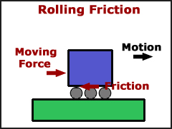
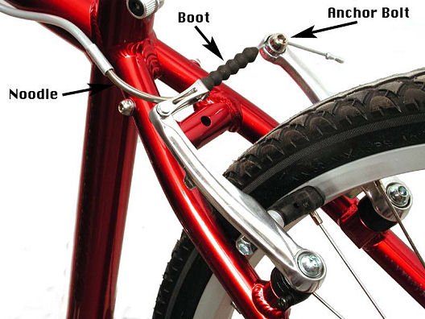
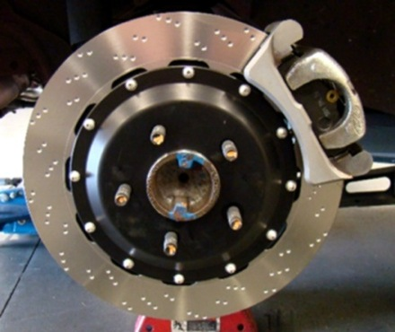
Slowing Momentum
To reduce momentum in a vehicle the brakes must be applied.
Braking slows momentum by using friction that applies a force that is opposite of the direction of momentum. This slows down the vehicle, thus reducing momentum.

Slide 43
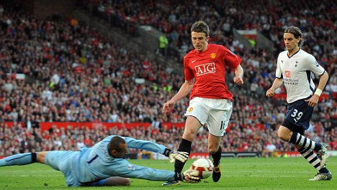
15.2 - Focus Question
How do forces affect the momentum of an object?

Slide 44
Vocabulary
impulse: force that changes momentum; force applied over time.

Slide 45
Impulse
To change the momentum of a vehicle in motion you need to apply a force opposite to that of the direction of the motion.
* A small force can be applied over a long period of time
* A large force can be applied over a short period of time
Impulses change the momentum of an object and can be calculated using:
Impulse = Force x Time
Where: I = kg ∙ m/s F = kg ∙ m/s2 or N (Newton) T = s

Slide 46
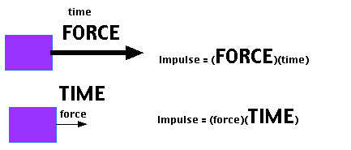
Impulse
Example problem: p275 Sample Problem
Try: Solve These p275 1-4

Slide 47
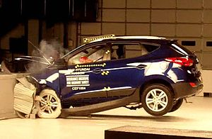
15.3 - Focus Question
How is the force of a collision related to the time it takes for a change in momentum?

Slide 48
Example
Compare the following two situations:
A. A vehicle travelling at 100km/h gradually comes to a stop in 30 seconds
B. A vehicle travelling at 100km/h comes to a sudden stop in 5 seconds
Was the change in velocity the same?
Was the change in momentum the same?
Was the impulse the same?
What then makes the two situations different?

Slide 49
Impulse is related to force
When an impulse occurs, momentum changes. The mass of the car does not change, but the velocity changes.
The amount of time it takes to change velocity is dependent on the force involved.
It takes more force to stop the car in one second than it takes to stop the car in 25 seconds
The greater the force involved, the greater the chance of being injured in a vehicle collision.

Slide 50
Calculating Force
To calculate the force involved in stopping a vehicle use the following formula:
F = m x Δv Where F = force in N (Newtons)
t m = mass in kg
Δv = change in velocity in m/s
t = time in s
Example: Sample Problem p278
Try: Solve These p278 Q 1-3

Slide 51
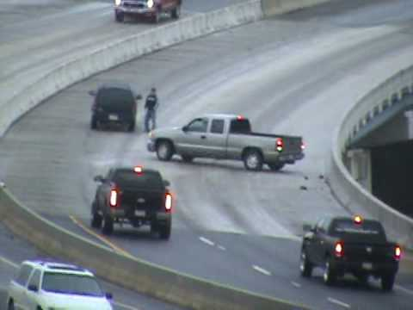
15.4 - Focus Question
When a change in momentum occurs due to a collision is the total momentum lost?

Slide 52
Vocabulary
Law of Conservation of Momentum: the total momentum of two colliding objects stays the same after their collision.
total momentum: sum of momentum of colliding objects
Note: It only stays the same if there is minimal friction between two surfaces
(like the tires and the road in icy conditions)

Slide 53
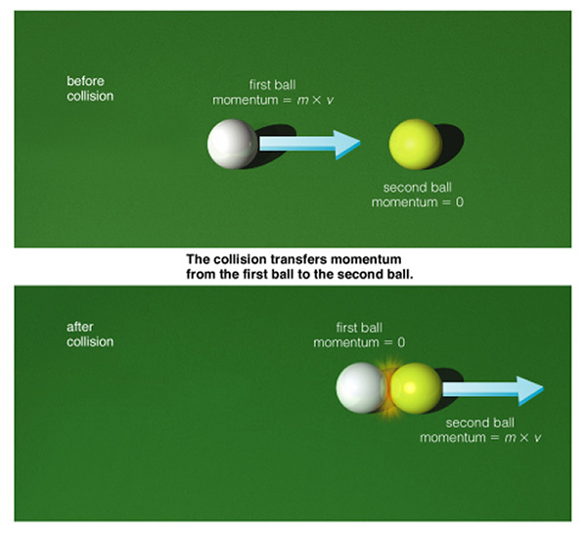

Slide 54
Explain, using diagrams, what would happen to the momentum of the vehicles during the following collisions:
Car A and Car B hit head on and have the same momentum.
B. Car A has greater momentum than Car B and they hit head on.
C. Car A and Car B have the same velocity, but Car B has more mass.

Slide 55
Conservation of Momentum
The Law of Conservation of Momentum states that the total momentum of two colliding objects stays the same after the collision.
Therefore:
Total Momentum = Momentum A + Momentum B
It is important to note that in a head on collision the object moving to the right has a positive momentum and the object moving to the left has a negative momentum
A -------🡪 🡨------- B
+ - moving East moving West

Slide 56
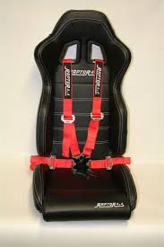
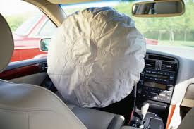
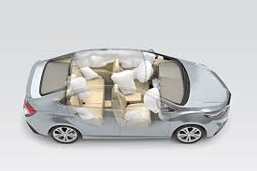
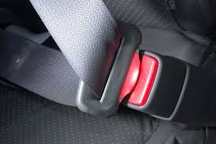
16.1 Focus Question
How does safety equipment work to make collisions safer?

Slide 57
Vocabulary
crash test dummies: mannequins designed to behave like the human body during a collision; fitted with sensors to record data.
crumple zone: parts of a vehicle designed to crush when hit, absorbing much of the energy in a collision; hood, trunk, and fenders
restraining features: hold occupant in place; prevent occupant from hitting the dashboard, windshield, sides, or roof of the car or from being thrown out of the vehicle during a collision; include air bags, seat belts, headrests and child seats.
operational features: parts of a vehicle that operate all the time to keep occupants safe; include headlights, rear-view and side-view mirrors, tail and signal lights, brakes etc.

Slide 58
Vocabulary Continued
structural features: parts of a vehicle that protect the people inside; include crumple zones and rigid features such as heavy frame, roll cage, and side-impact beams that will not crumple or break under extreme pressure.
road safety features: traits of a road that are designed to decrease the force of a collision by slowing the impulse; includes crash cushion and guardrails
crash cushion: road feature designed to decrease the force of a collision by slowing the impulse; barrels of water or sand
guardrails: road feature designed to keep vehicles on the road and to decrease the force of a collision by slowing the impulse by absorbing the force

Slide 59
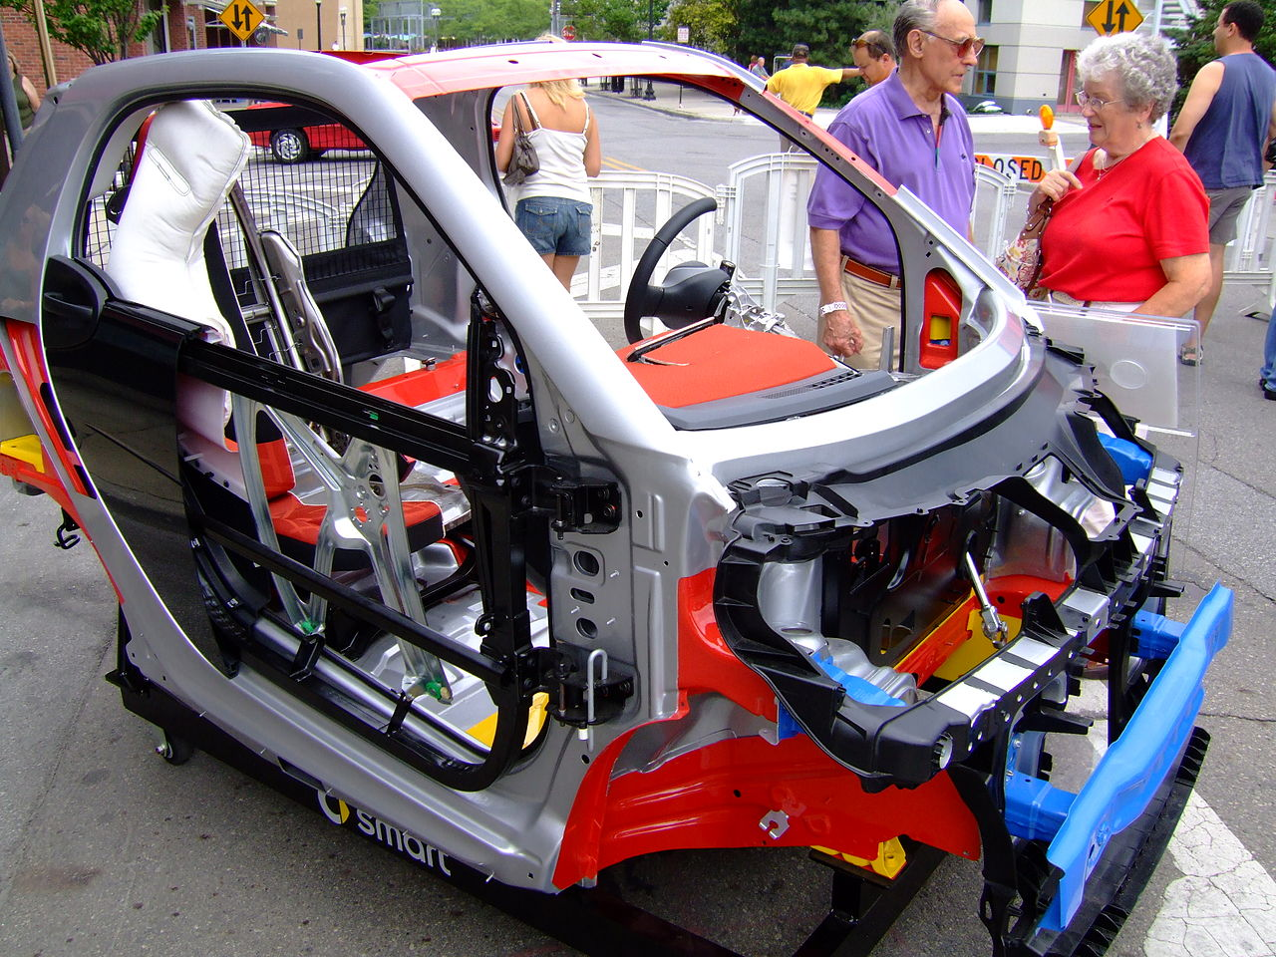
Types of Safety Features
Safety features on a vehicle work to reduce the force of a crash by slowing down the collision resulting in the occupants of the car experiencing less force resulting in fewer injuries.

Slide 60
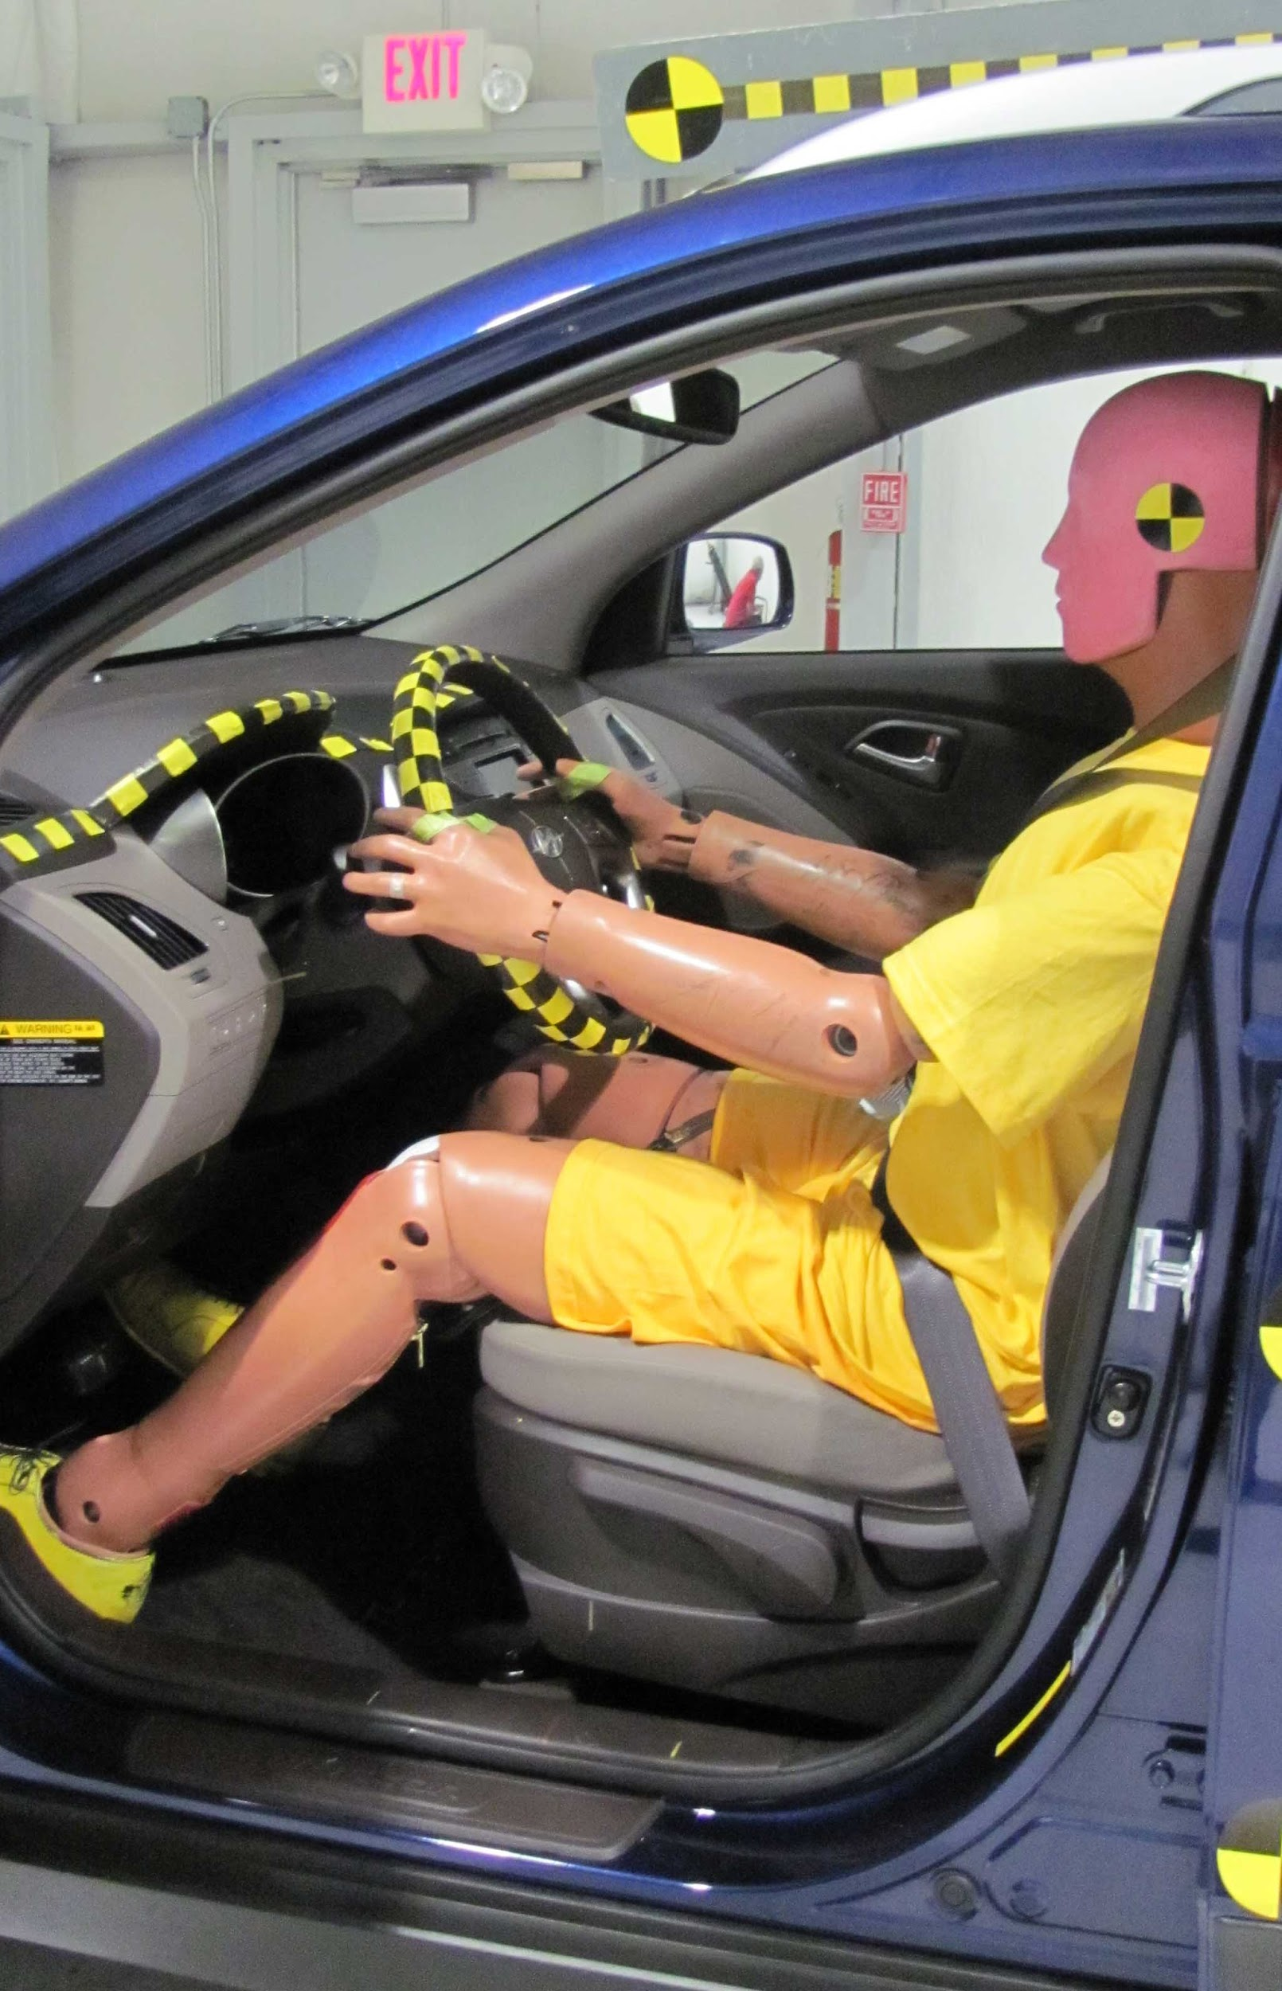
Crash Test Dummies
Engineers use crash test dummies to determine what will happen to people during a collision.
Engineers use these dummies to test how well the crumple zones in cars work.

Slide 61
Safety Features in Vehicles
Restraining:
-seat belts, air bags, headrests, child seats
Operational:
-Rear-view and side-view mirrors assist the driver in seeing all parts of the road
-Tail and signal lights warn other drivers of changes in speed or direction
-Brakes allow the vehicle to slow safely

Slide 62
Safety Features on the Road
crash cushion: - barrels filled with water
guardrails: the metal will bend but not break. In this way guardrails prevent the vehicle from rolling over or rebounding into traffic.
light poles: used to be immovable. Now they are designed to snap off under force of a collision.

Slide 63
16.2 Focus Question
How do seat belts keep you safe?

Slide 64
Vocabulary
2-point belts: also called a lap belt. vehicle seat belts designed to hold the occupant in place by securing the person to the seat with a strap placed across the pelvis
3-point belts: also called a shoulder harness. vehicle seat belt designed to hold the occupant in place by securing the person to the seat with one strap placed across the pelvis and another strap placed across the chest from pelvis to shoulder

Slide 65
Differences between 2-point and 3-point belts
Modern seat belts are designed to stop your body from being thrown forward during a collision
2-point belts are designed to hold a person across the pelvis. Unfortunately this does not stop the upper body from moving.
3-point belts are designed to help restrain the lower and upper body.

Slide 66
Seat Belts
Modern seat belts are designed to make sure they are there and working when you need them.
Webbing; the seat belt material, is made up of thousands of thin strands of polyester or nylon. The arrangement of these fibres allows the belt to stretch from 10 - 15 percent which allows the passenger to stop more gradually.
Retractor Unit ; is a clever system that involves a pendulum and a ratchet. The ratchet maintains tension in the webbing. If the vehicle experiences a sudden stop the pendulum in the ratchet system locks a bar in place preventing more webbing from coming out

Slide 67
Child Safety
Children require more protection while travelling in a vehicle because they have weaker bones, and muscles.
Children need different levels of restraint depending on age, weight and height of the child.

Slide 68
16.3 – The Evolving Air Bag
Focus Question:
How has the airbag changed over the years and how exactly do they work?

Slide 69
Vocabulary
Air bag
Inflatable bag that instantly releases from steering wheel/dashboard in a collision in order to restrain occupant and decrease the chance of serious injury.
Third-generation air bags
Furthest improvement (on the 1st and 2nd generation airbags). They can sense the mass of the occupant and force of collision to adjust inflation accordingly.

Slide 70
How do airbags work?
Air bags are rolled up inside the steering wheel and passenger-side dashboard. When activated, it performs like a parachute! They slow the velocity of the occupant.
During a collision, a chemical reaction inside the air bag causes it to inflate in 30 milliseconds.
Sensors in the vehicle send electrical signal to
ignite a canister filled with sodium azide (NaN3(s)).
This chemical decomposes to release
nitrogen gas (N2(g)) which instantly fills the air bag.
Did you know…?
The Material Safety Data Sheet (MSDS) lists sodium azide as extremely explosive! That is why you must make sure air bags are maintained regularly.

Slide 71
Comparing air bags
1st generation air bags were designed for adult males only. They often kept these people safe but injured or killed smaller adults or children.
2nd generation air bags were then designed (after many, many trial and error) to help cushion passengers softly.
3rd generation air bags are even further advanced where they can sense the mass of the occupant and inflate accordingly to properly cushion the person.

