Slide 1
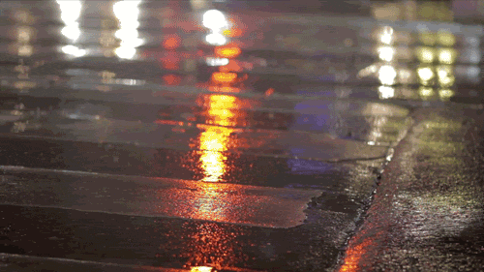
Chapter 2: Common Reactions in our Lives

Slide 2
Question results
Like☺ – labs, chemistry, experiments in gym, my moustache
Dislike☹ – periodic table, machines, certain units, difficult questions
What’s Ahead – very open minded

Slide 3
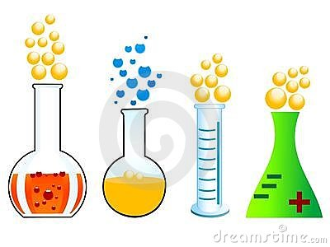
It’s all around you!
Chemistry contributes to many parts of everyday life
Some reactions form new or different substances (CO2 from video), others break down substances (cleaners with dirt)
We will continue to look at some everyday reactions and learn about what makes them useful

Slide 4
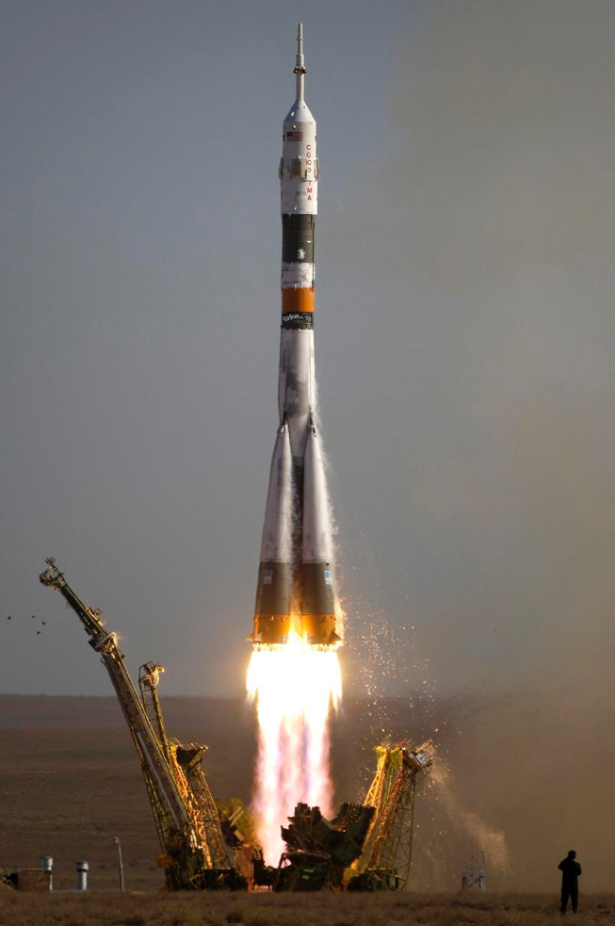
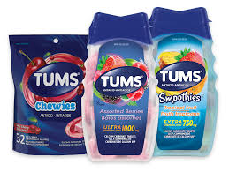
Useful reactions
During a chemical reaction substances react to form new substances with different properties
Can be simple or very complex
Such as hydrogen and oxygen reacting to power a space shuttle or simply taking an antacid
Antacids contains a basic chemical called magnesium hydroxide which reacts with your stomach acid (hydrochloric acid) to produce neutral magnesium and chloride

Slide 5
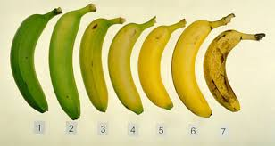
Bananas
Every notice how bananas change green → yellow → brown
Bananas give off a gas known as ethylene which triggers the release of enzymes
Enzymes – speed up chemical reactions
1.Enzyme (amylase) breaks down starches into sugar (glucose)
2. Other enzymes trigger colour change
3. Enzymes break down large molecules into smaller ones that may evaporate into the air which creates the lovely banana smell

Slide 6
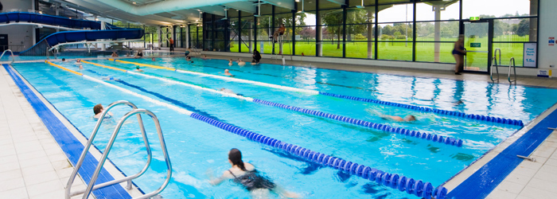
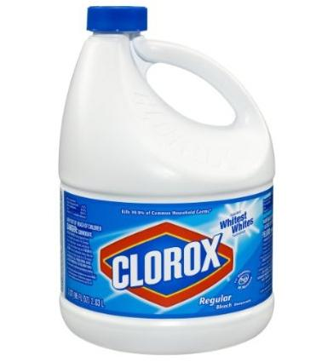
Other reactions
Bleach – make white fabrics look white and clean. Use hydrogen peroxide or sodium hypochlorite. Both contain oxygen (O2)
Swimming Pool – Have the distinct smell – caused by adding chlorine to water which produces hypochlorous acid
Hypochlorous acid kills micro-organisms that may contaminate the pool
Pure chlorine can be dangerous as it may produce chlorine gas. So protective gloves and eyewear should be worn when handling chlorine.

Slide 7
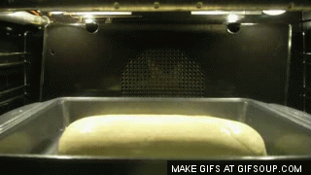
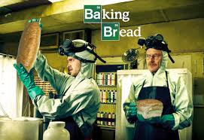
Other reactions
Baking Bread – combination of flour, yeast, liquid, salt, and other flavourings → dough
When the flour is mixed with water and yeast, enzymes from the yeast break down the starches into sugar/glucose. Other enzymes then react and create carbon dioxide (CO2) and ethanol (type of alcohol)
The CO2 bubbles up and makes the dough rise. Heat then causes these of gas to expand and give bread it’s air texture
The ethanol burns away and gives bread it’s taste

Slide 8
The changes that occur
Some reactions require energy, while others release energy
In a reaction the substances you begin with will be different from the substances you end with
Reactants – substances before the reaction
Products – substances after the reaction
Arrow – indicates a reaction is happening and the direction
Reactants
Products

Slide 9
Photosynthesis and Cellular Respiration
Photosynthesis – used in plants only
Carbon Dioxide
Water
Energy
Glucose/Sugar
Oxygen
Products
Reactants
Cellular Respiration
– used by both plants and animals
Glucose/Sugar
Oxygen
Carbon Dioxide
Water
Energy
Reactants
Products

Slide 10
Combustion
A reaction where a fuel burns in oxygen and produces carbon dioxide and water
Much of Alberta's industry depends upon combustion reactions with fossil fuels such as oil and natural gas
Fuel
O2
CO2
H2O

Slide 11
Neutralization
During these reactions an acid is added to a base to a new compound and water
The ph of the product will be closer to 7 than either of the reactants
Often involved in cooking
Acid
Base
Comp
H2O

Slide 12
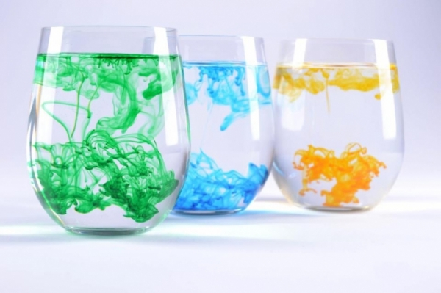
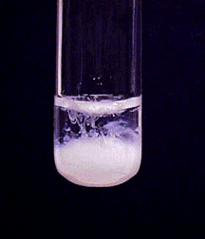
Change has occurred
In most situations we’ve looked at our contribution causes the change, but sometimes chemicals change all on their own
Evidence of Chemical Change
A different colour is produced
An odour can be detected
Bubbles appear or gas forms
A solid forms – called a precipitate
Energy is given off (exothermic) or absorbed (endothermic) – fire or icepacks

Slide 13
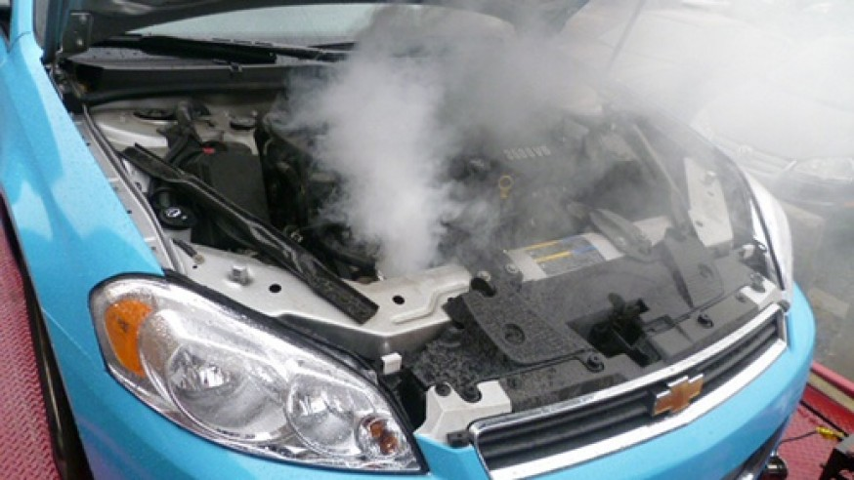
Energy and chemical reactions
Chemical changes always involve energy changes
They can be obvious or very hard to notice
Knowing how much energy is being released allows us to plan for it – radiators in cars
Gasoline is used in an exothermic reaction
Digestion and metabolism are exothermic
Photosynthesis needs suns energy to begin and is endothermic

Slide 14
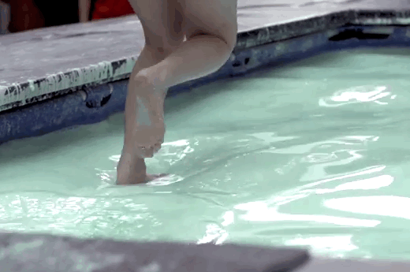
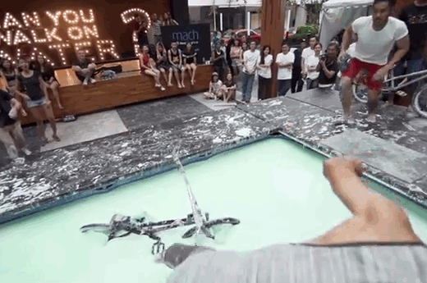
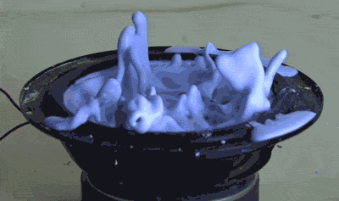
Non-Newtonian Liquid
Cornstarch and water
Is it a solid or a liquid?

Slide 15
The end

