Slide 1
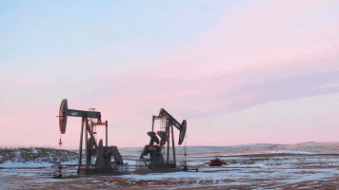
Chapter 8: Fossil Fuels

Slide 2
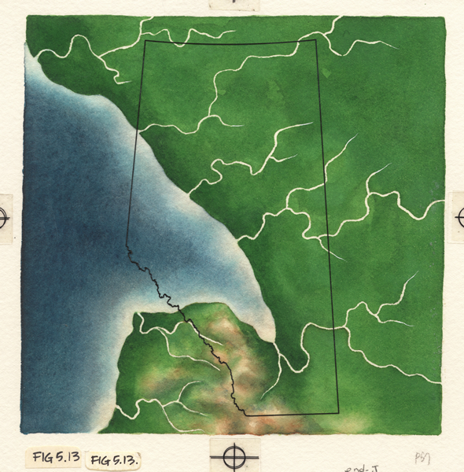
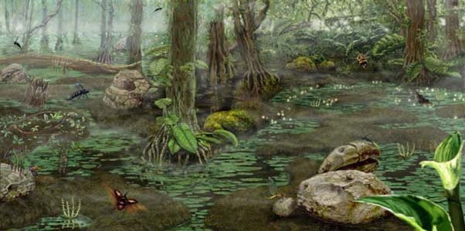
A long time ago, in a province not so far away…
Millions of years ago Alberta had a much warmer climate
Lots of swamps and bogs, with a wide variety of vegetation
This lead to the large amount of oil reserves we hold

Slide 3
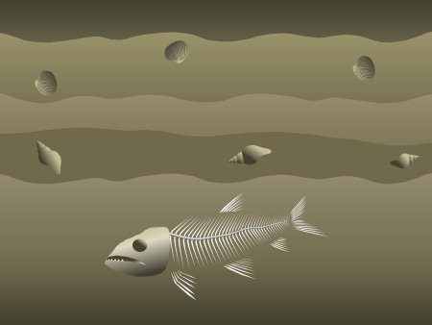
How Fossil Fuels Came To Be
When plant and animals died in the swamp their remains decompose more slowly → Remains cumulated
Over time the swamps will be covered in sediment to form a rocky layer
Pressure of building layers turn the energy remaining into fossil fuels
Living organisms that were not turned into fossils

Slide 5
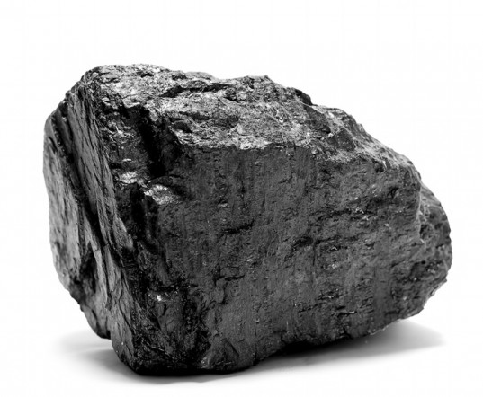
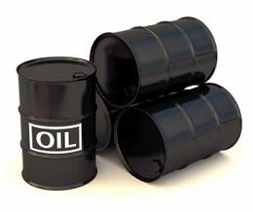
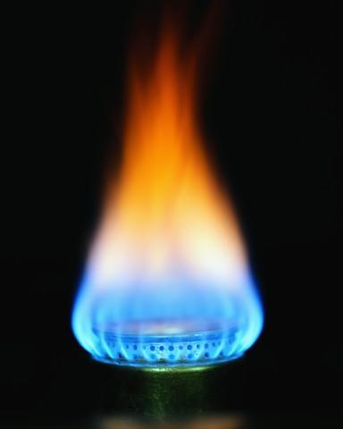
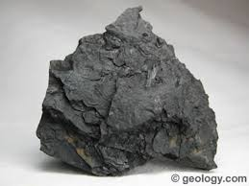
Fossil Fuels
Includes: coal, crude oil, natural gas
Take a long time to develop (non-renewable)
1. Forms in ancient swamps around 300 mya
2. Plants died and fell into the swamp. Remains could not decompose without oxygen. Formed a layer of lignite (soft coal)

Slide 6
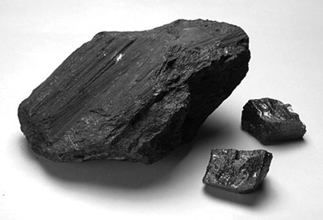
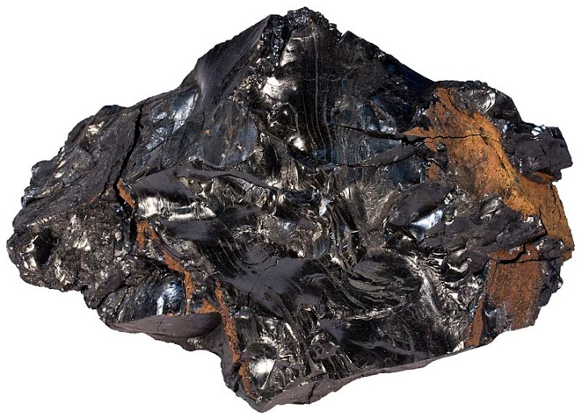
Fossil Fuels
3. More layers of sediment piled on top and increased the compression force. As it got deeper heat also increased and formed bitumous coal
4. Some areas had increased heat and pressure and turned this bitumous coal into anthracite (hard coal)

Slide 8
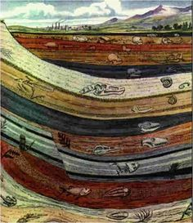
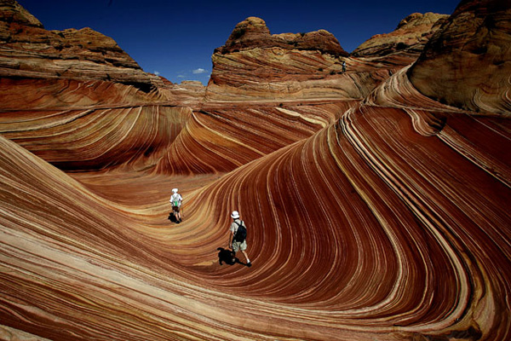
The Process
Layers of sediment are often several kilometers thick
Heat and pressure change the decaying matter into coal, oil, and natural gas – all have similar processes

Slide 9
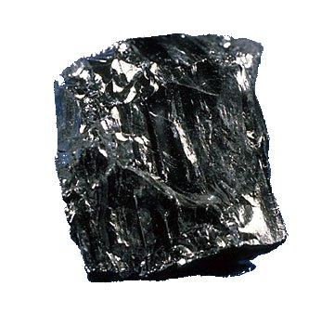
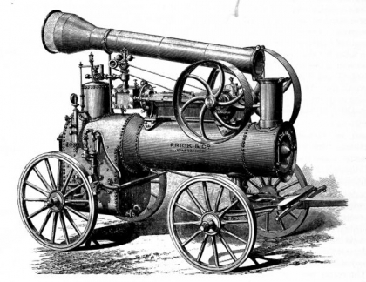
Coal
Has been used as a fuel for over 300 years
Present in most parts of the world, but not utilized until the steam engine was created
Still popular because it’s inexpensive, easy to mine, and easy to transport

Slide 10
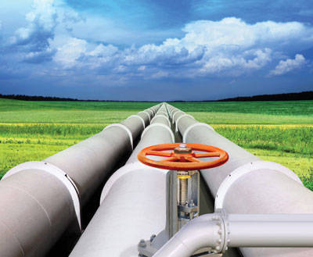
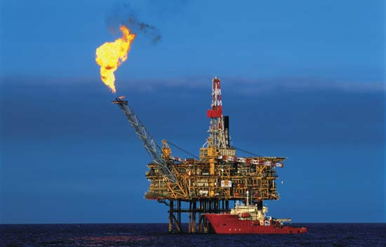
Natural Gas
Have not been used as long as coal
Natural gas is difficult and dangerous to control and transport. This is why it has only recently been used

Slide 11
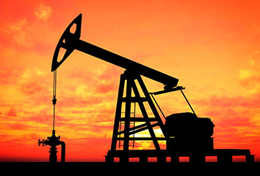
Oil
Crude oil or petroleum is found as a liquid.
It is extracted by drilling a hole into the ground
Sometimes the pressure on the fuel will cause it to come to the surface on its own, other times it will need to be pumped out

Slide 13
Extraction
Fossil fuels have been an important part of Alberta since the late 1800s
For more than a century coal was the main energy source of Canadian Pacific Railway and most industries in Alberta
Previously talked about how coal used to power electricity production (Ch.6)
Most of the iron and steel in Alberta has been produced in other parts of the world, but many of them use coal from Alberta to get the energy they need

Slide 14
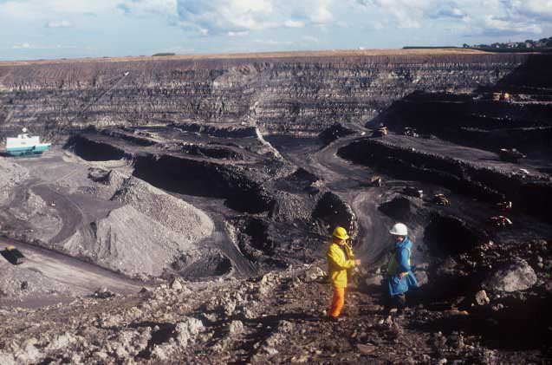
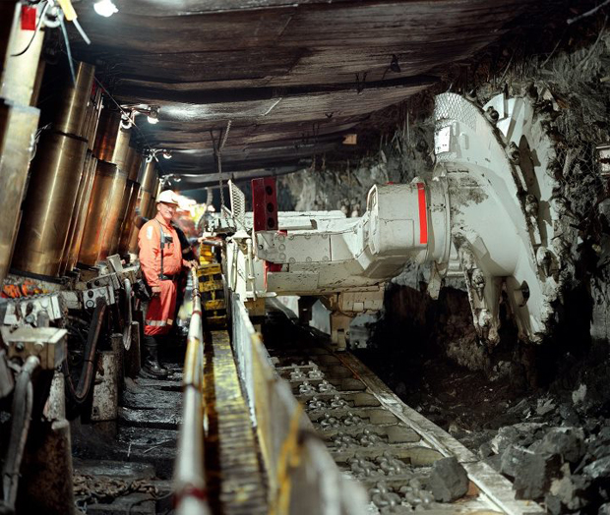
Mining Coal
Look for a layer or seam of coal
Deposits quarried similarly to sand or gravel
Called open-pit mines
Deeper deposits are dug out using a series of underground tunnels
Machines play a large part in extraction

Slide 15
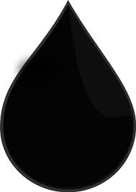
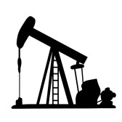
Oil
In the past oil was only used to make kerosene, which was a fuel for lamps and stoves
Today it is the most important source of energy in the world
One problem with mining crude oil is knowing where to drill

Slide 16
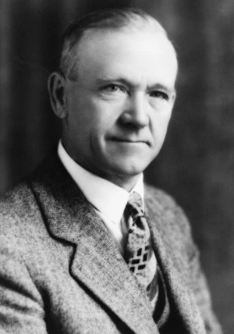
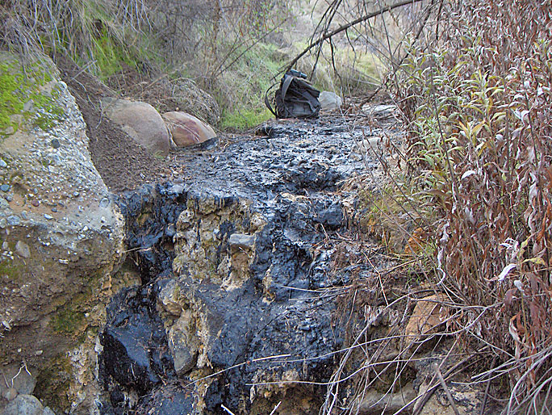
W.S. Heron
In 1914 noticed oil seeping from the ground on a farm near Turner Valley
He purchased the farm and mining rights and started drilling
He discovered oil in Turner Valley, Woodbend, Leduc, and Redwater
Helped turn Alberta into the oil powerhouse it is today!

Slide 17
Redwater
Woodbend
Leduc
Turner Valley

Slide 18
Oil Extraction
Often thought that oil forms in large pools underground
Actually forms in tiny pores between the particles that make up rocks
As earth’s crust changes and causes great amounts of pressure to shift and forces the oil droplets into porous rocks called reservoir rocks
Further Earth movement can trap these reserves between impermeable rocks

Slide 19
Reservoir Rocks

Slide 20
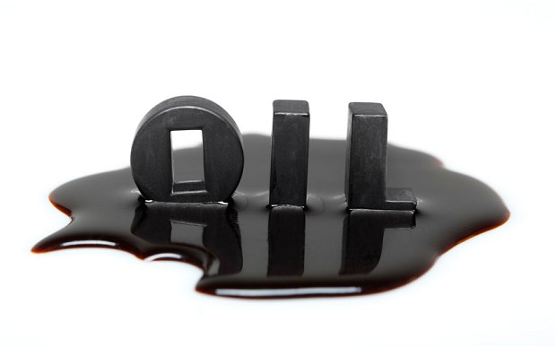
Finding Oil
Geologists use a number of technologies to determine the location of potential reservoirs
One of the more common methods is the seismic survey
Shock waves are sent through the Earth’s crust. The returning soundwaves reflect off of rock and detected by sensitive equipment
Geologists then interpret these images looking for certain patterns or structures

Slide 21
Reservoir Rocks

Slide 23
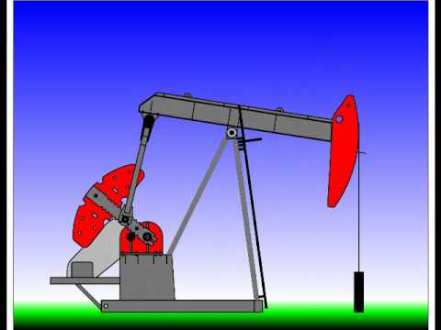
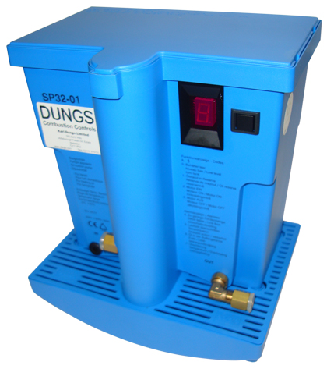
Drilling
Once location is identified they start to drill
At the beginning the pressure may cause oil to rise to the surface on it’s own
After the pressure decreases a pump may be needed to extract the rest of the oil
In most cases a pump jack is installed, but in some areas a lift pump may be used

Slide 24
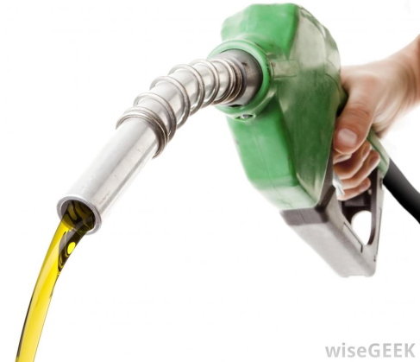
Refining Oil
Once it is taken from the ground it can be turned into many useful products through a process called distillation
Allows for separation of materials with low boiling points from those with high boiling points
Heavy lubricants (motor oil, kerosene) are separated from lighter liquids (gasoline, naphtha)

Slide 25
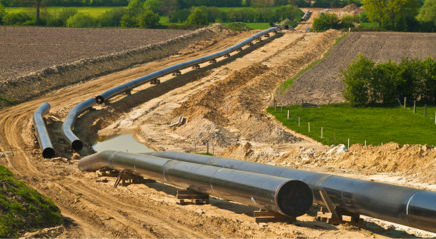
Natural Gas
Along with oil is created in a similar way to coal but often a product of marine organic matter
Until a few decades ago was seen as waste and burned off as it was difficult to control
Today it is primarily pumped across Canada through pipelines and also through train, truck, and ship

Slide 26
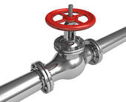
Pipelines
Transport natural gas from source to towns and cities
Natural gas is popular because it causes less pollution than either coal or gasoline and provides immediate heat
Like other fossil fuels when natural gas is burned the stored energy is transformed to thermal energy for heating and cooking

Slide 27
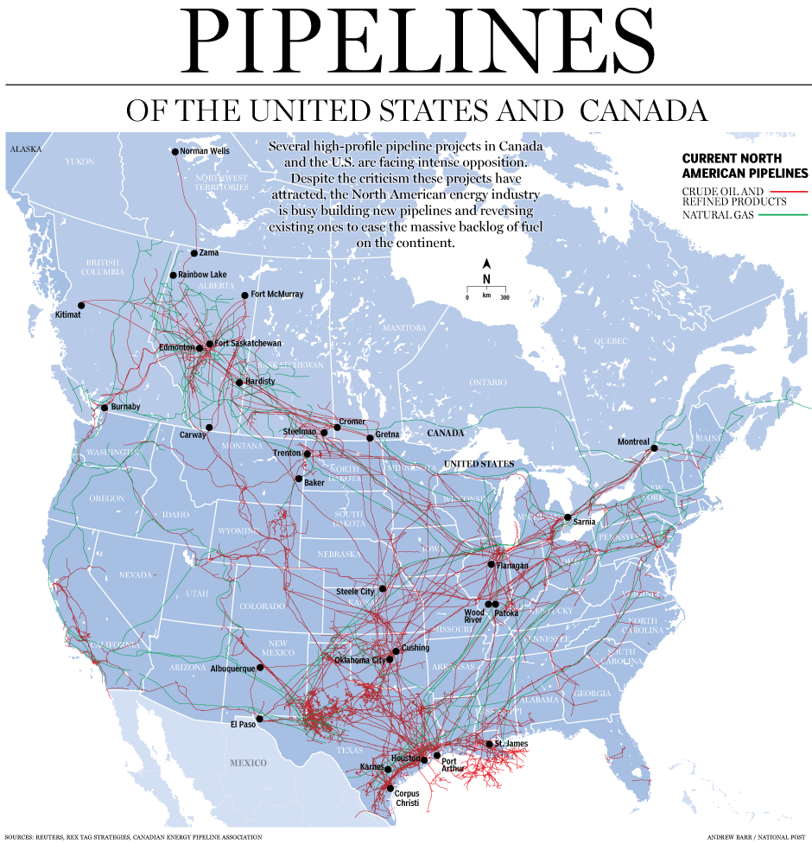

Slide 28
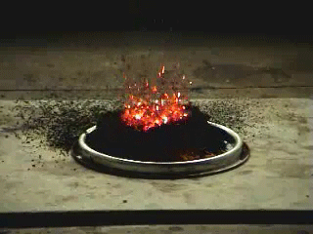
Combustion
A fuel is burned in the presence of oxygen to produce carbon dioxide, water, and energy
All fossil fuels made of carbon and hydrogen – hydrocarbons

Slide 29
Similar to Cellular Respiration
Combustion
Cellular Respiration

Slide 30
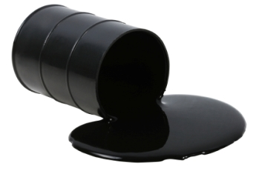
Other Side of the Coin
Although we seem pretty dependant on these fuels as they integrate into our everyday life, they can also cause problems
The are non-renewable
Demand is increasing, supply is decreasing

Slide 31
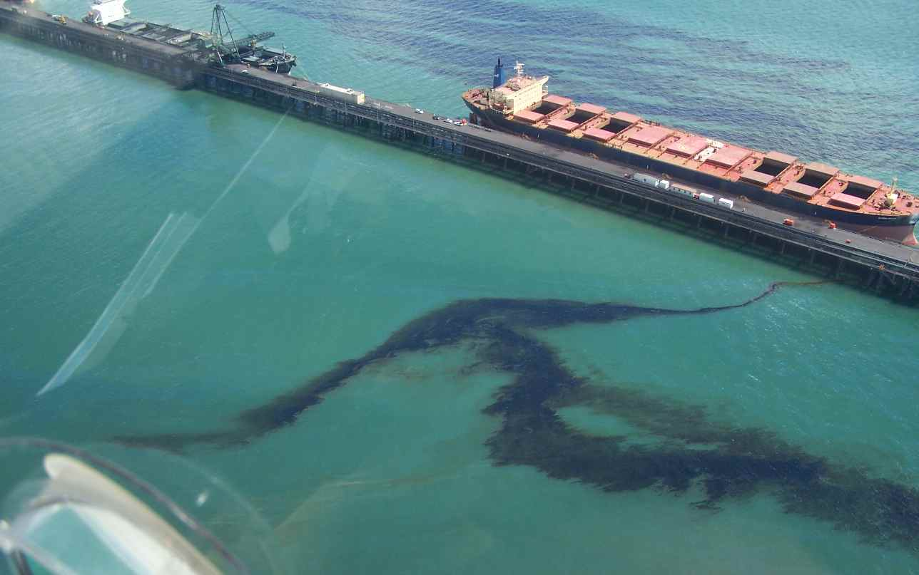
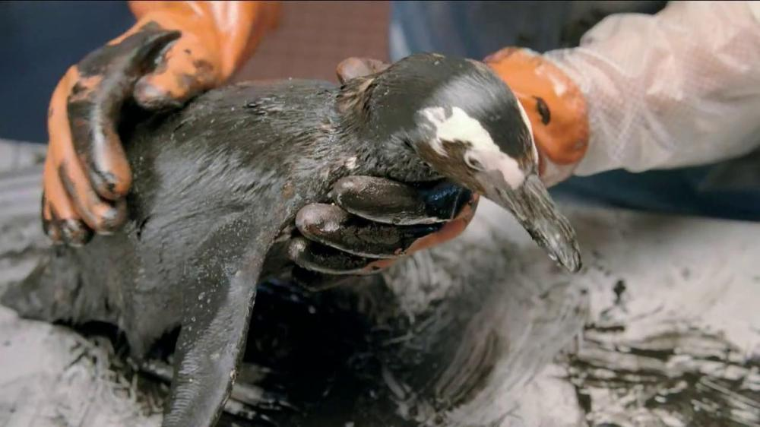
Oil Spills
Damage to tankers or pipelines can cause oil to leak into the surrounding environment
Toxic if consumed, and if it coats the animal can destroy natural insulation or water proofing

Slide 32
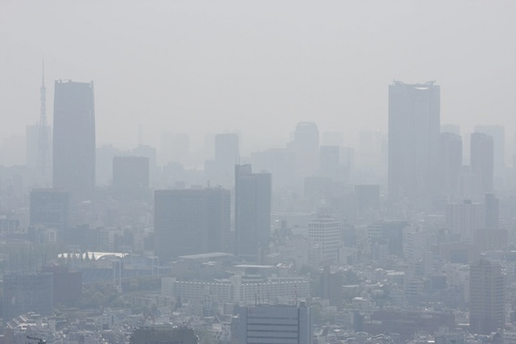
Air Pollution
Considered as any chemical in that air that can cause harm to living things or the environment
Can combine with each other to produce acid rain
Also known as acid deposition since the acid isn’t always in the form of rain, can be fog or mist, as well as rain

Slide 33
Formation

Slide 34
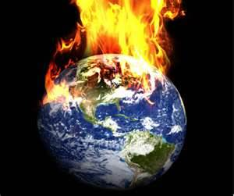
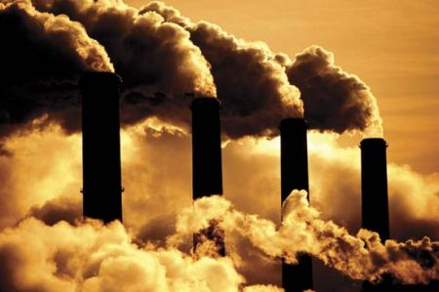
Greenhouse Gases
Humanity burns millions of litres of gasoline daily – heating, vehicles, generate energy
All these combustion reactions release millions of tonnes of CO2 into the atmosphere
Causes a process known as Global Warming

