Slide 1
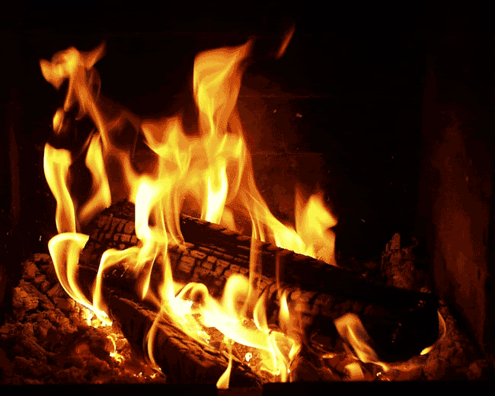
Chapter 5: Energy Conversions
Unit B: Energy Transformations

Slide 2
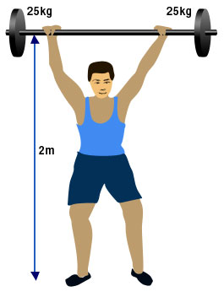
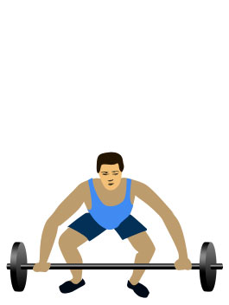
Energy
Energy is the ability to do work
Work is done when a force that is applied to an object moves that object.
Energy can cause changes to the temperature, shape, speed, or direction of an object

Slide 3
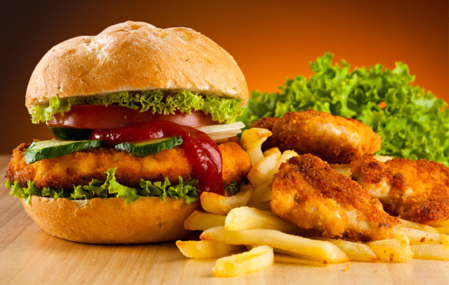
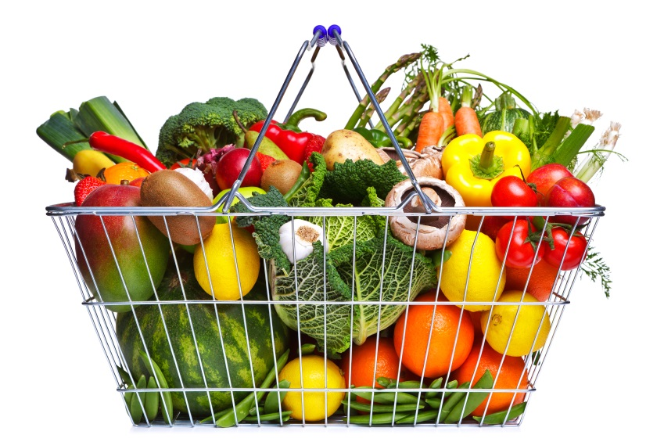
Energy
Where do we get our energy?
Our main source of energy is food, and if we don’t use all the energy it is stored
Stored energy that has the potential to do work is called Potential Energy
Potential Energy is then converted to kinetic energy

Slide 4
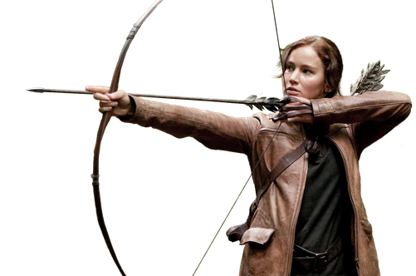
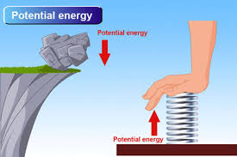
Potential Energy
In physics, potential energy is the energy that an object has due to its position
Often the higher off the ground the object is the higher it’s potential energy is

Slide 5
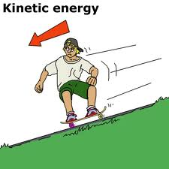


Kinetic Energy
In physics, the kinetic energy of an object is the energy that it possesses due to its motion.
The body maintains this kinetic energy unless its speed changes.

Slide 6
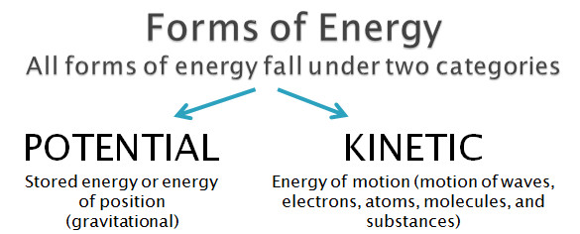
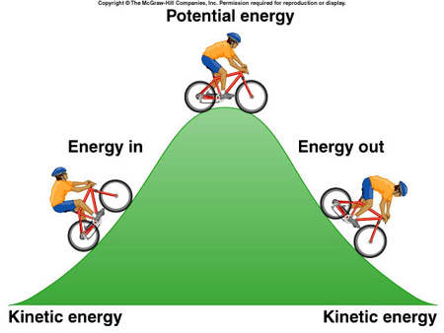
As Kinetic Energy increases Potential Energy decreases
So as Kinetic Energy decreases, Potential Energy increases!

Slide 7


Many Forms of Energy
Energy Conversions – turning one form of energy into another
We probably wouldn’t be able to survive without certain energy conversions
Without energy from the sun, life wouldn’t exist on earth
As with food webs most energy will start with plants

Slide 8
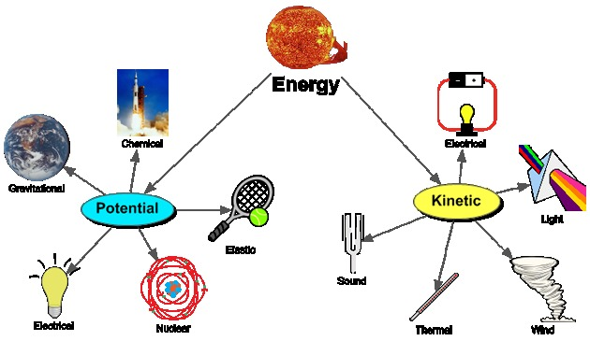
Forms of Energy

Slide 9
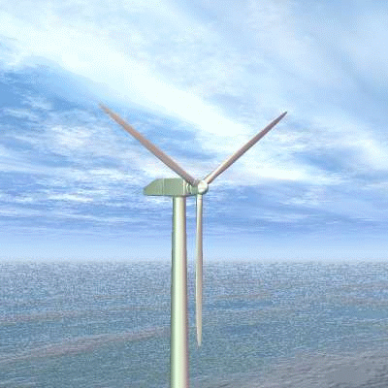

Examples
Eating food
Light bulbs
Dropping a beet
Gasoline in a car
Wind Turbine
Chemical → Potential
Electrical → Light
Potential → Kinetic
Chemical → Kinetic
Kinetic → Electrical

Slide 10

SCIENCE!

Slide 11

2 B Continued

Slide 12
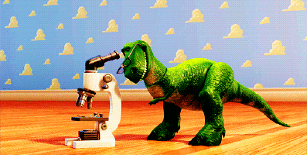
Chapter 5 continued

Slide 13
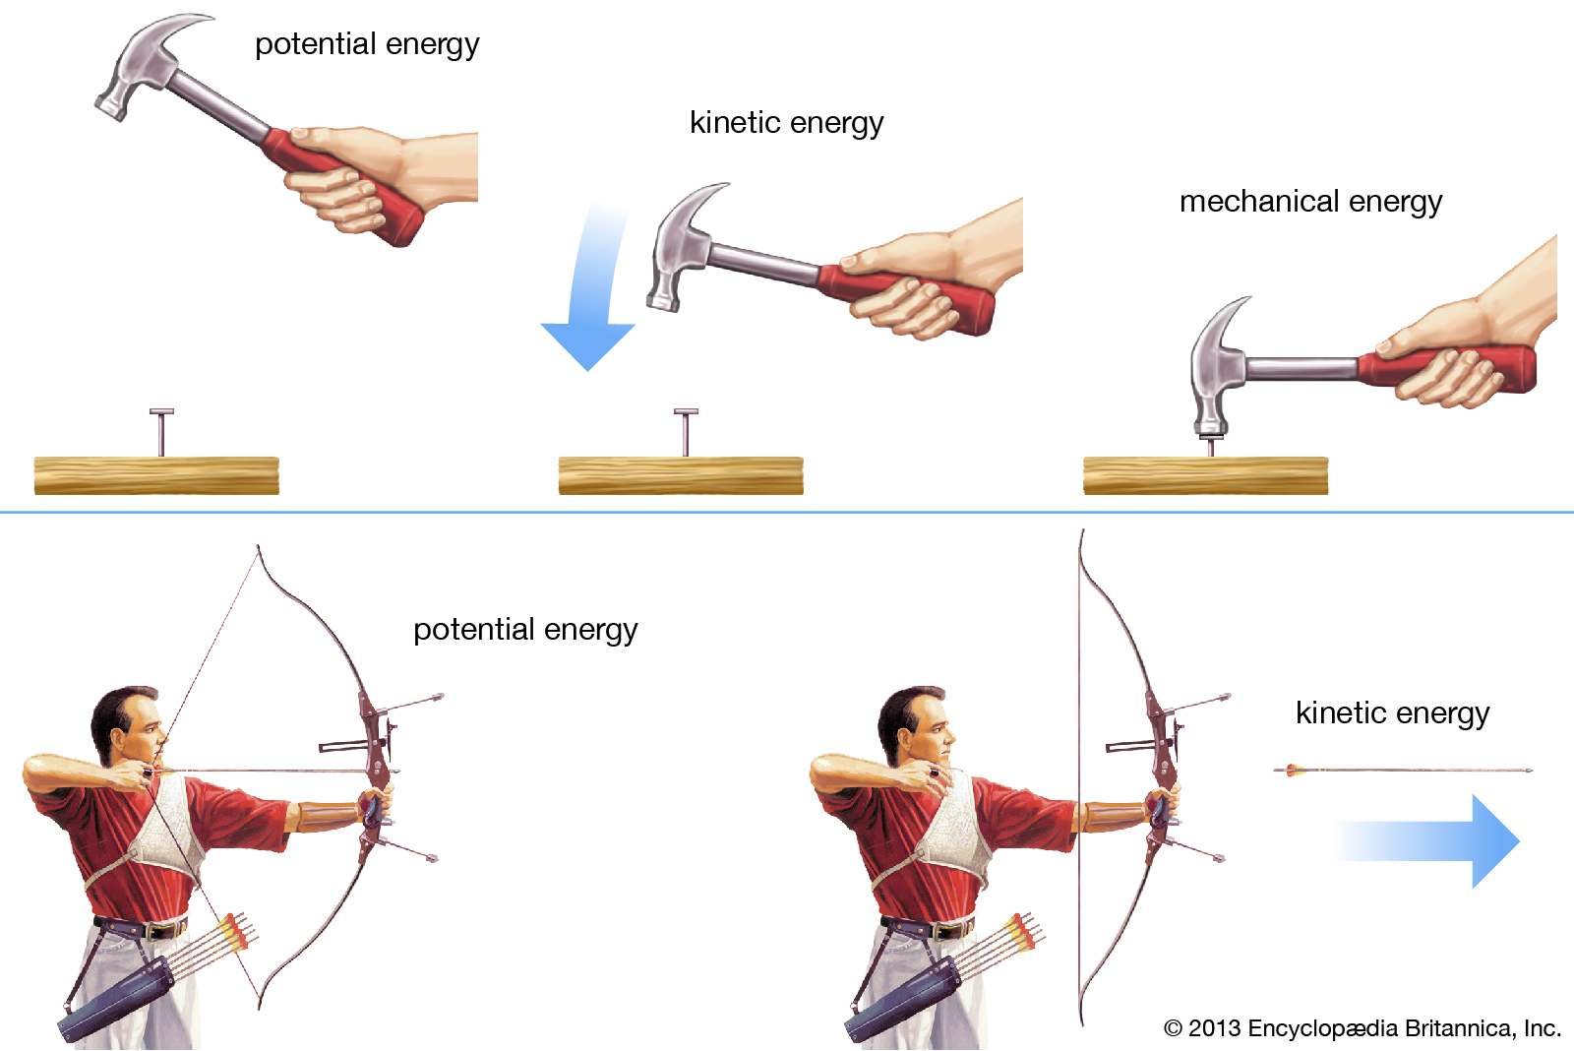
Review

Slide 14
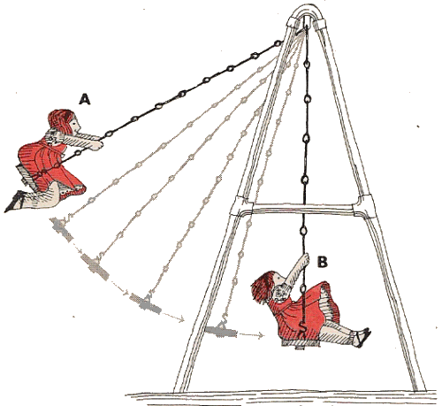
Review
Potential Energy
Kinetic Energy

Slide 15
Forms of Energy

Slide 16
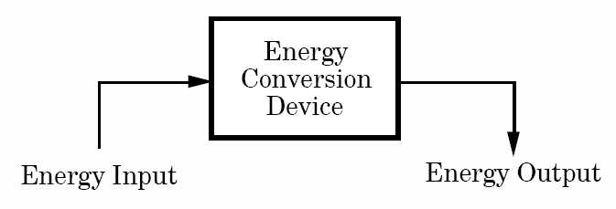
Energy Conversions
In order to do work energy constantly changes from one form to another
Input energy – energy that enters the system
Energy is changed from one form to another at the converter
Output energy – energy that leaves the system

Slide 17
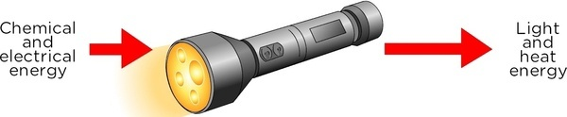
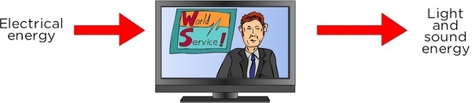
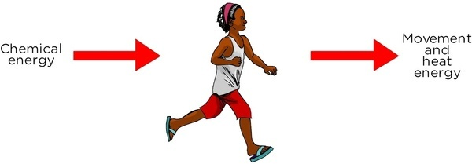
Input → Converter → Output

Slide 18
Chemical Conversions
The heat you feel during exercise is produced by a chemical reaction within the muscles of your body
Potential Energy from food is converted to Thermal Energy
Potential Chemical Energy → Kinetic Energy
Potential Chemical Energy → Thermal Energy

Slide 19
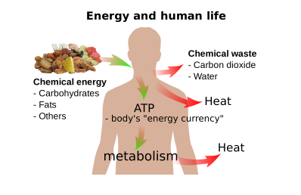
The Body

Slide 20
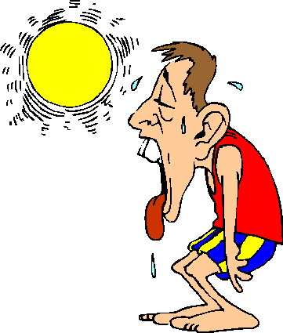
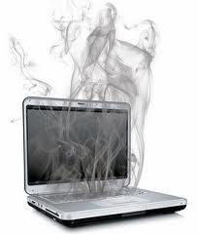
Thermal Energy Waste
Released during most activities – often as waste energy
Also produced by machines
Usually due to friction
Opposes motion
Excess heat can be dangerous in both man and machine

Slide 21

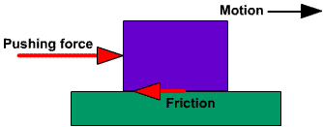
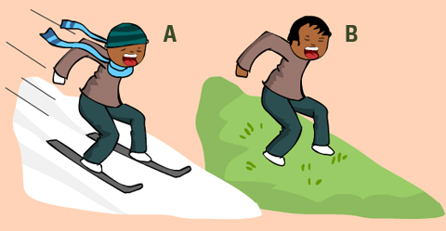
Friction

Slide 22

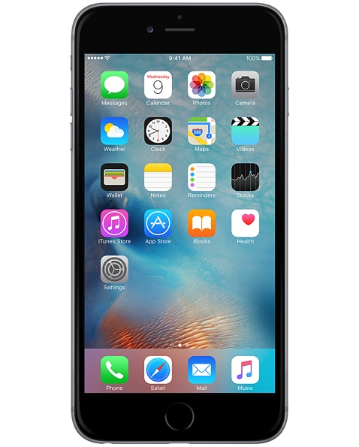
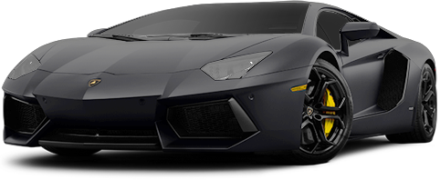
Conversion of Energy
What types of energy are produced by?

Slide 23

Conservation of Energy
Energy cannot be created or destroyed
Input Energy = Output Energy
IPhone
Input: Chemical Energy = Output: thermal + kinetic + light + sound
Energy does not disappear it is just changed to different forms that may be hard to detect

Slide 24

Energy Conversion System
Input Energy = Output Energy
But Input energy does not equal useful output energy
Every process will give off some sort of waste energy and not be 100% efficient
In cars only about 1/3 of the energy provided by gasoline is used to move the car
For lightbulbs 95% of the energy is waste energy in the form of heat

Slide 25
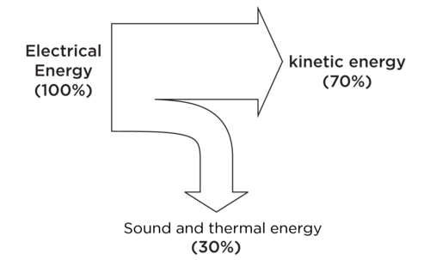
Example

Slide 26

End of Chapter 5

