Slide 1
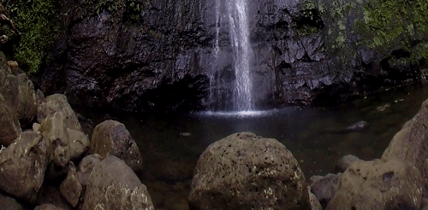
Chapter 15: Protecting the Environment

Slide 2
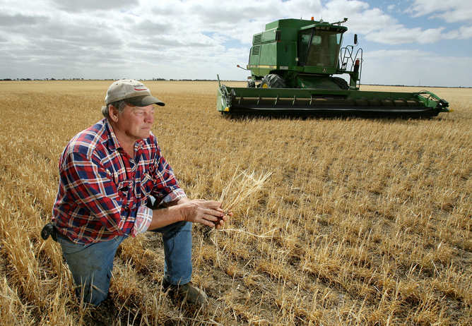
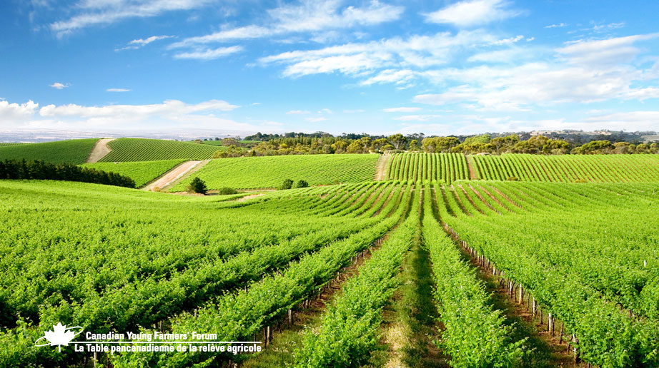
Producing more food
As humanity grows it creates a higher demand for food and resources
Farmers have to use technological advances to help produce more food, but they may have some consequences
2 main types of chemicals: Pesticides and Synthetic fertilizers

Slide 3
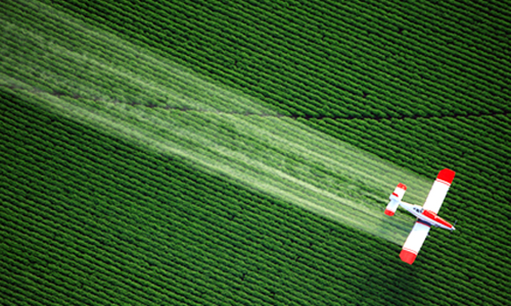
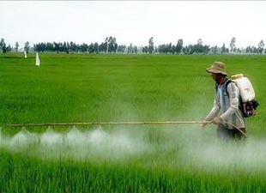
Pesticides
Chemicals that kill or control organisms that humans consider to be pests
Named after what they deal with
Insecticides – kill insects
Herbicides – kill weeds
Farmers and homeowners use these to kill those that want to eat their crops or grass, but it also affected other species

Slide 4
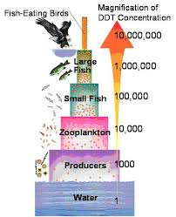
Biological Magnification
Often refers to the process whereby certain substances such as pesticides move up the food chain, through small organisms to form higher concentrations in larger animals
Becomes more dangerous as it moves up the food chain

Slide 5
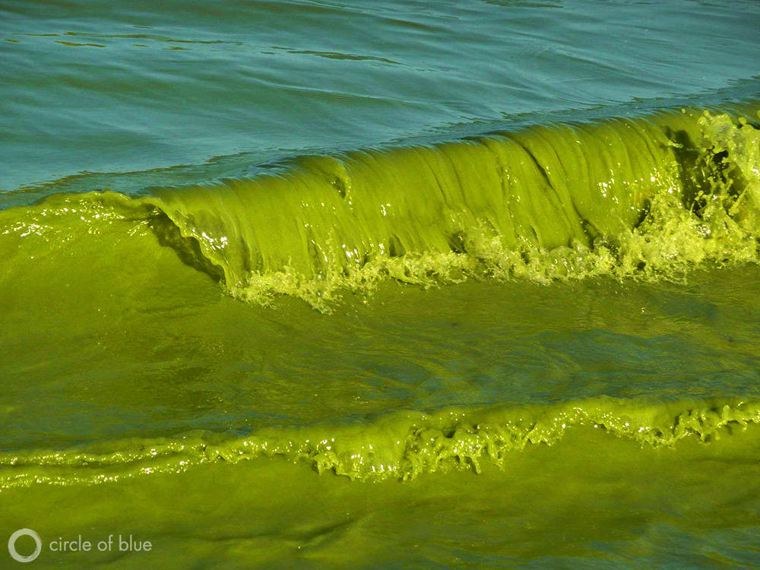
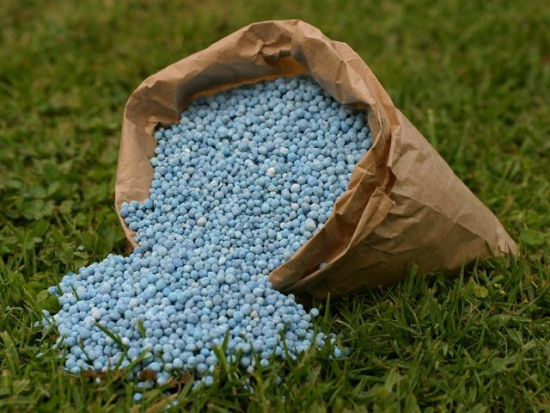
Synthetic Fertilizers
Synthetic – man made through chemical reactions
Contains plant nutrients such as nitrates – increase crop growth
Can affect Nitrogen Cycle
Can affect local ecosystems through run-off

Slide 6
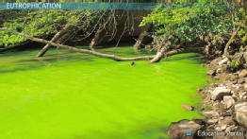
Eutrophication
As fertilizer runs into aquatic systems it creates an influx of nutrient – nitrates
1. Water washes fertilizer into lake/pond
2. Surface plants (algae) grow quickly and block sunlight from deeper water
3. Deep water plants die and can’t carry out photosynthesis – no oxygen produced
4. Plants die and eventually all the oxygen is used up which leads to death by fish and other aquatic animals

Slide 8
Producing More Energy
More people = higher energy demand
Most of our energy comes from fossil fuels
Fossil fuels in the forms of coal, oil, and natural gas which all form from the remains of organisms that lived millions of years ago
Formed when decaying remains were left in swampy areas then over time layers of sediment formed above them and applied pressure that changed them to fossil fuels

Slide 9
Formation

Slide 10
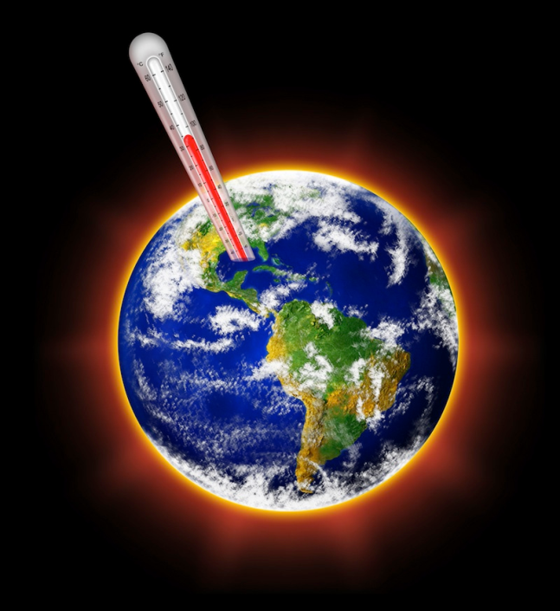
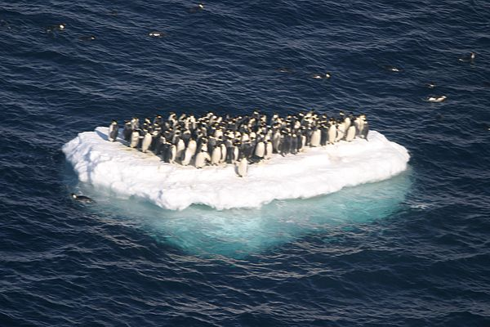
Carbon Dioxide and Global Warming
Greenhouse effect – carbon trapped in our atmosphere forms a “blanket” around the earth and retains heat
Effect is increase by excess fossil fuel use
Leads to global warming
Could cause: ice cap melting, drastic weather changes, droughts on agricultural land
Caused by CFCs (chlorofluorocarbon)

Slide 11
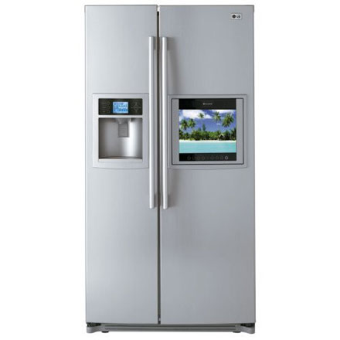
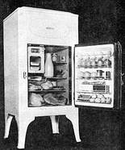
Refrigeration
Created by the desire to keep food from spoiling
Use a compressor, motor, and liquid (refrigerant) to remove heat
In the 1920s they used CFCS as a refrigerant because they were thought to be stable, harmless, and non-combustible
*Spoiler* they aren’t ☹

Slide 12
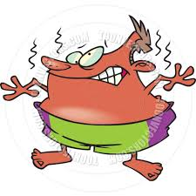
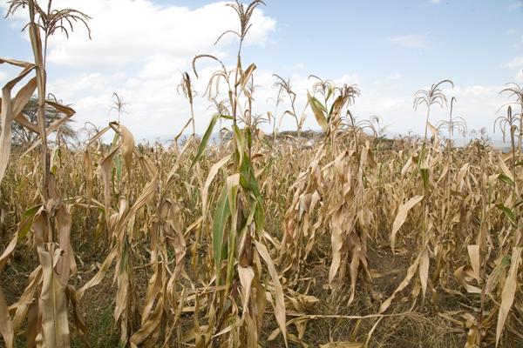
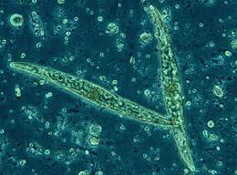
Effects of CFCs
Discovered to destroy the ozone molecules – led to a thinner ozone
As ozone becomes thinner it could lead to harmful consequences for many organisms
Increase UV radiation could lead to a rise in skin cancer
High levels of UV radiation will have negative effects on crops
Increase ocean temperature which kills phytoplankton – the main producer in the ocean

Slide 13
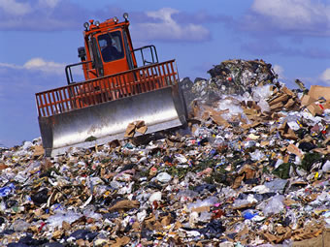
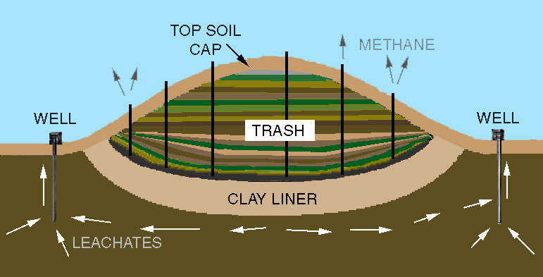
Waste - Garbage
The average Canadian throws out 2.2 kg of garbage a day
Most ends up in a landfill, which are designed to prevent waste from harming the environment
Difficult to build, as no one wants to live near one

Slide 14
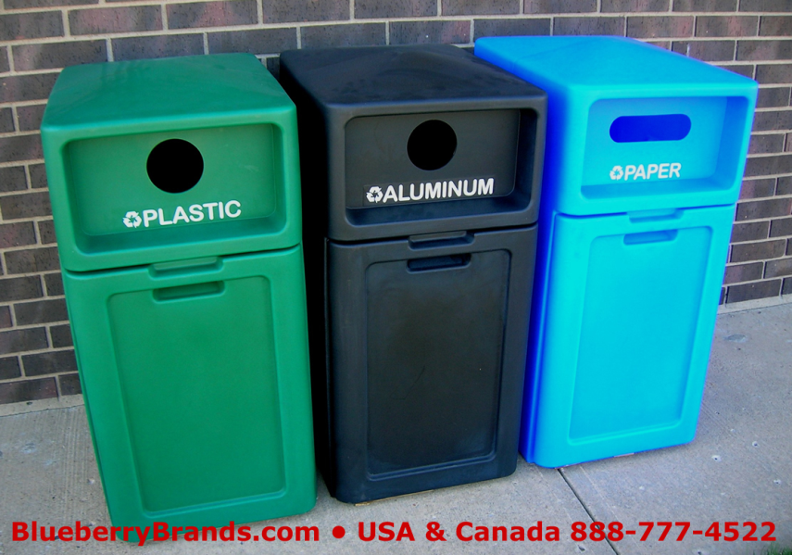
The 3 Rs
Reduce – buy ecofriendly goods – objects that won’t harm the environment as much
Reuse – find another use for something you would otherwise discard
Recycle – instead of throwing out an object take it to a recycle plant so it may be used for something else (cans, cardboard, paper, etc.)

Slide 15
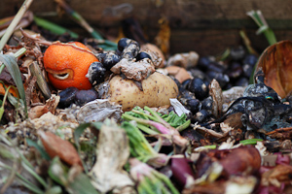
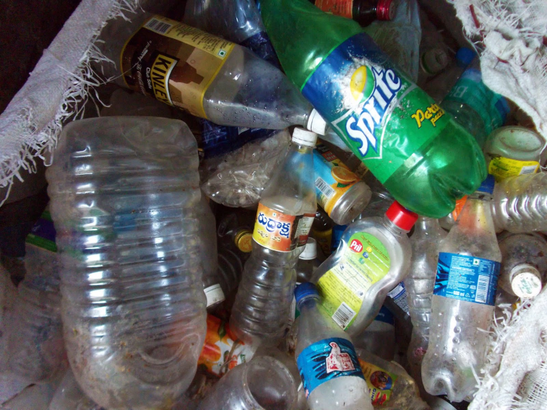
Biodegradable vs. Non-biodegradable
Biodegradable - things that can be easily decomposed by natural agents (water, oxygen, micro-organisms)
E.g. fruit compost, paper, plant and animal matter, etc.
Non-biodegradable - materials which cannot be broken down or decomposed into the soil by natural agents are labelled as non-biodegradable.
E.g. plastic materials, metal scraps, aluminum cans and bottles, hazardous chemicals
More hazardous to the environment

Slide 16
The end of Science 14!

Slide 17
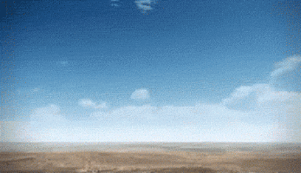
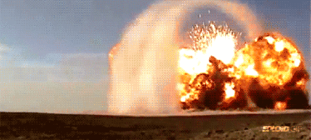
FINAL TOMORROW!

