Slide 1
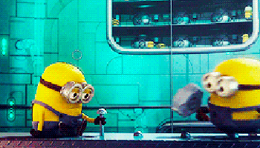
Ch.13 Populations

Slide 2
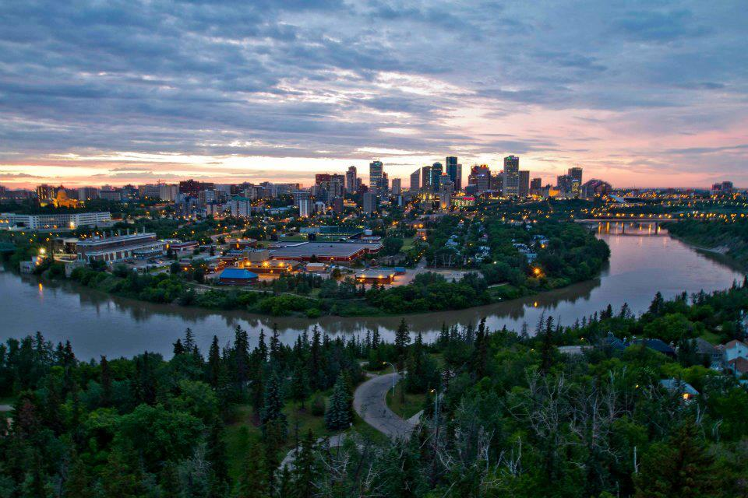
Changing Populations
Individuals – members of a populations
Population – a group of individuals of the same species living in the same place at the same time
Edmonton population…
812,200

Slide 3
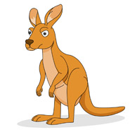
3 Keys to Determining Population
1. Species
2. Where they live
3. When they live #yolo

Slide 4
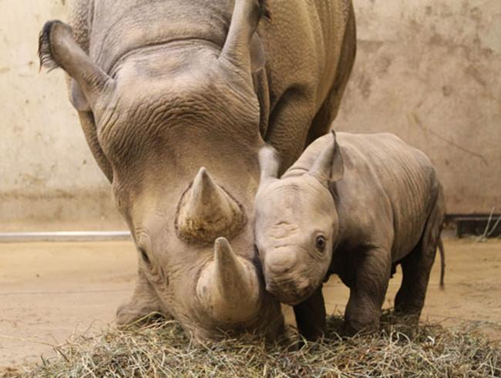
Population Factors
Determined by 4 factors:
Death Rate - # of individuals that die in a time period – affected by predation, disease, and completion for resources
Birth Rate - # of offspring produced by a population over a period of time – influenced by environmental condition, nutrition, population density, number of offspring produced by a single female

Slide 5
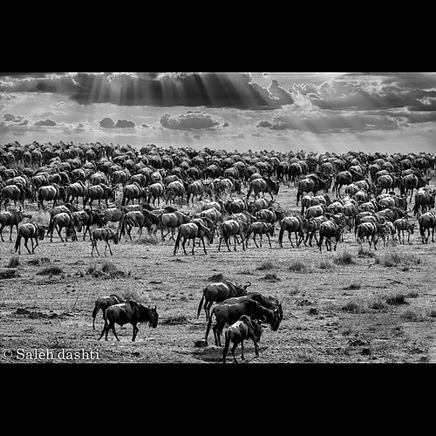
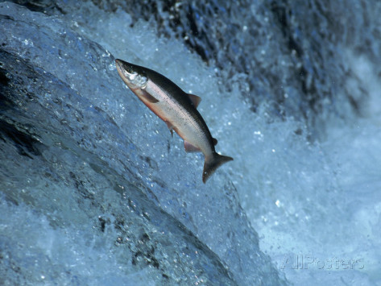
Population Factors
Immigration – new individuals entering a new population or area – could be looking for foody supply, safety, mate, etc.
Emigration – individuals leaving a population or area to go elsewhere – looking for food, safety, mate, etc.

Slide 6
Population Factors

Slide 7
Population Change
High Death Rate and Emigration lead to a decrease in population
High Birth Rate and Immigration lead to a increase in population

Slide 8
To be continued…

Slide 9
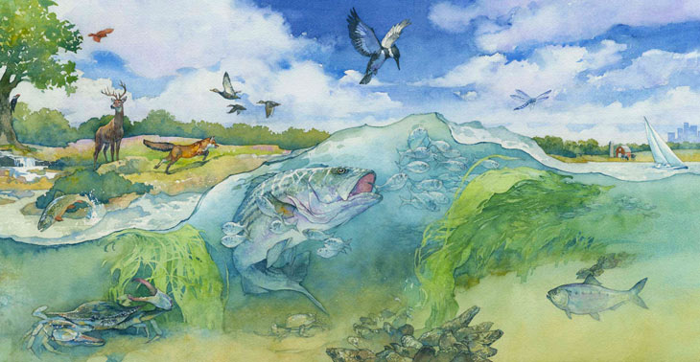
Biotic Limiting Factors
Ways that interactions among living organisms may affect the population size
Therefore affect can affect the birth rate, death rate, immigration, and emigration

Slide 10
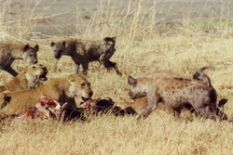
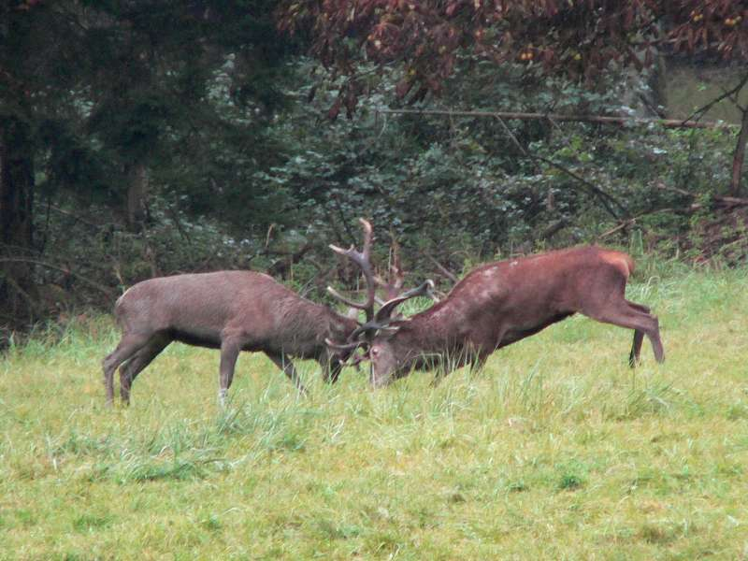
Competition
Individuals compete for resources such as food, nutrients, shelter, light, and water
Completion can be among different species or among a population
The strong triumph

Slide 11
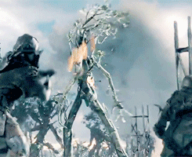
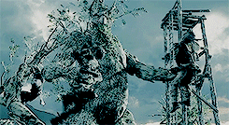
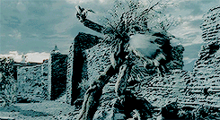
Plant Competition
Plants also compete for resources
Light, Water, Carbon Dioxide(CO2)
*Plant completion not as seen above

Slide 12
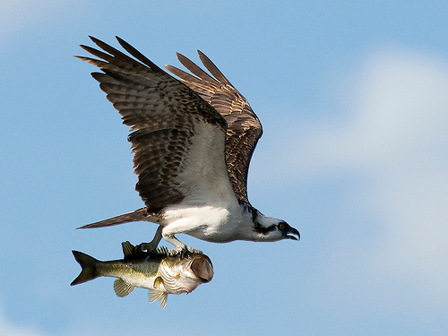
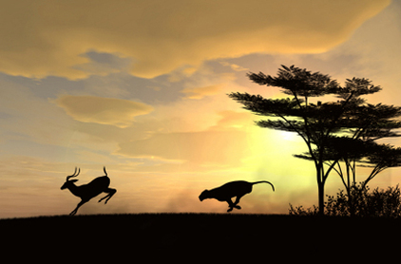
Predation
Relationship between a predator and prey
Predator – animal that hunts, captures, and eats other animals
Prey – victim to the predator
Helps balance population

Slide 13
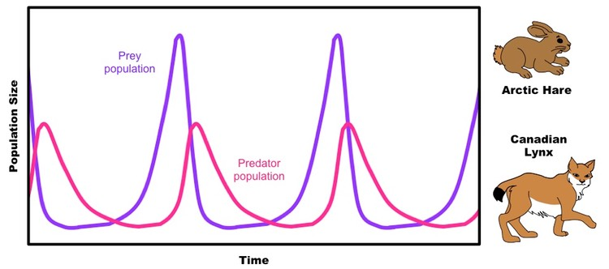
Population Balance

Slide 14
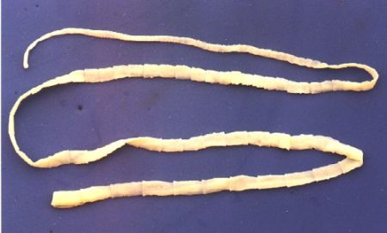
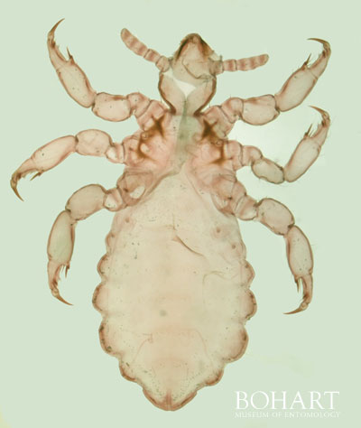
Parasitism
Organisms that live on/in another organism – parasites
Organism being affected is the host
Parasites take nutrients from the host through their blood, or external properties like hair, skin, feathers
Most parasites do not kill their host, only weaken

Slide 15
Zombie Snail

Slide 16
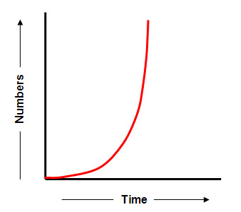
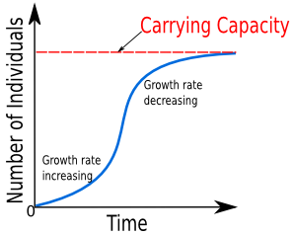
Reproduction Rates
Effected by both biotic and abiotic factors
Exponential Growth – without any controls or factors
Logistic Growth – growth rate with limiting factors

Slide 17
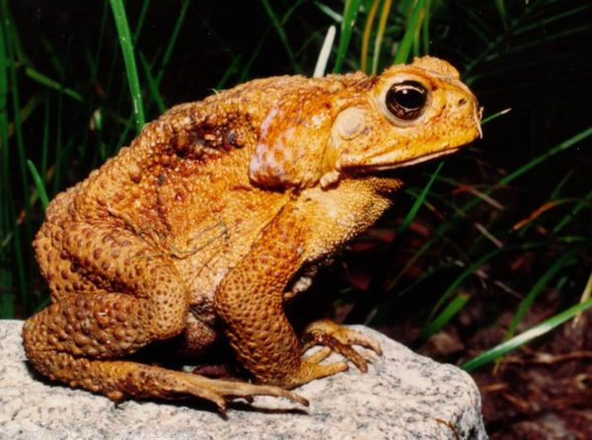
Human Impact
Video
As humanity’s demand for space increases, it is being decreased for different species
Exotic Species – species introduced into ecosystem by non natural methods – could be accidental or on purpose
Compete with native species – may outcompete them
Usually don’t have set predators, leads to increase growth

Slide 18
The End

