Slide 3
Review
Recall that Newton wrote his Second Law in terms of momentum. This could be arranged as:
From this, we can see that the product of force and time is momentum. Let's apply this to a real-life situation.

Slide 6
Now, just because the momentums are the same does not mean the force and time are the same:
eg) Δp = FΔt
12 Ns = (1 N)(12 s)
12 Ns = (2 N)(6 s)
12 Ns = (3 N)(4 s)
12 Ns = (4 N)(3 s) ...etc...
*Force and time can
vary, but as one goes up, the other goes down if momentum must be the same.

Slide 14
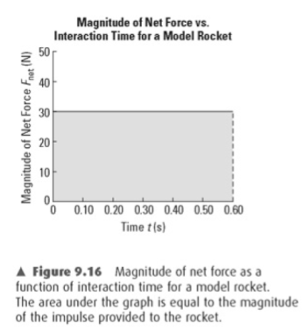
Graphs of F vs t
Another way of calculating impulse is from a force vs time graph.
The area under a graph of F vs t will give impulse:

Slide 15
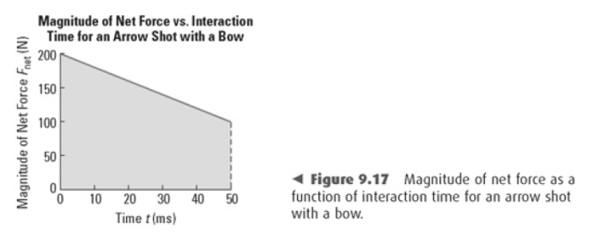
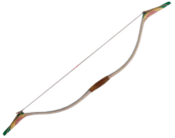
This is a particularly good method to use when the force is not constant.

Slide 16
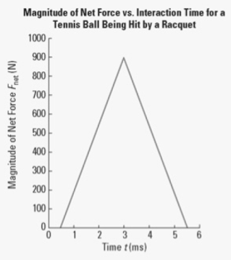
Example
a) From the graph, what is the magnitude of the impulse on the 48 g tennis ball?
b) What is the velocity of the ball when it leaves the racquet?

