Slide 3
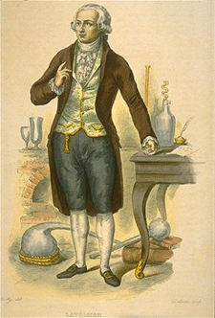
Review of Conservation Laws:
Conservation of Mass
Formulated by Antoine Lavoisier in the late 16th century.
"The mass of the reactants in a chemical reaction is the same as the mass of the products."

Slide 5
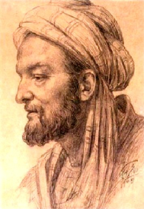
Now, mass and energy are not the only things that are conserved...there is yet another quantity!
And it has been known for thousands of years...
1000 AD, Sina describes a quantity called "impetus" which is weight multiplied by speed.
Abū Alī alusayn ibn Abd Allāh ibn Sīnā

Slide 6
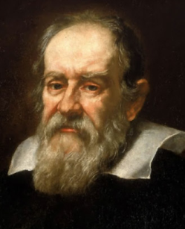
Mid 16th century, Galileo calls the quantity "impeto"

Slide 7
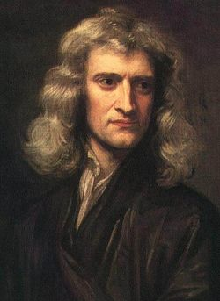
18th century, Newton calls the quantity "motus"

Slide 10

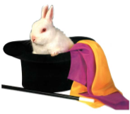
Units of momentum:
Hmm...looks like a Newton (kinda)
Can you turn a kgm/s into a N?

Slide 11
