Slide 1
Ch. 11 Maintaining Homeostasis

Slide 2
Homeostasis
A system in which variables are regulated so that internal conditions remain stable and relatively constant.
Your surroundings are always changing and your body has to have the appropriate responses
Eg. Body temperature, blood sugar levels, breathing

Slide 3
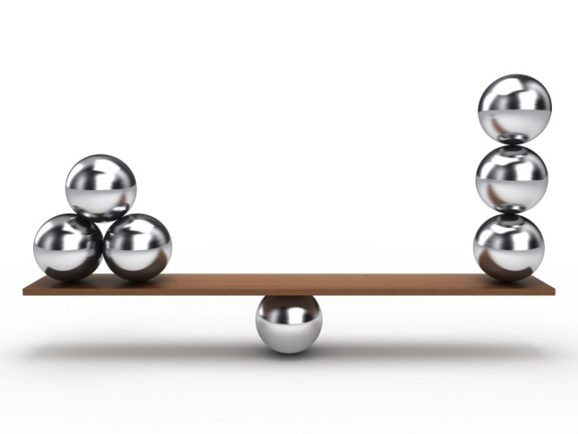
Homeostasis
Your body can go in and out of balance like a teeter totter
When balanced called equilibrium
All the body systems we covered have a part I achieving equilibrium

Slide 4
Body Temperature

Slide 5
Plays a part in…
Enzyme Levels
Waste Product Levels
Blood Sugar Levels
Concentration of Substances in Blood
Heart Rate
Water Balance – keep hydrated!

Slide 7
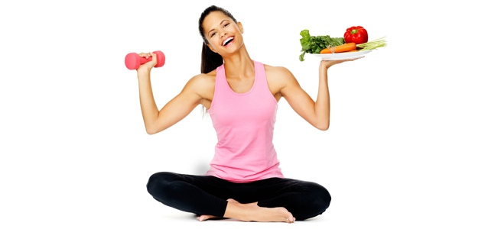
What affects Homeostasis
Our main focus is the relation between the circulatory and digestive system
If the circulatory system transports too few, many, or poor quality nutrients your body will suffer
Not enough exercise or sleep
Taking substances that harm your body

Slide 8
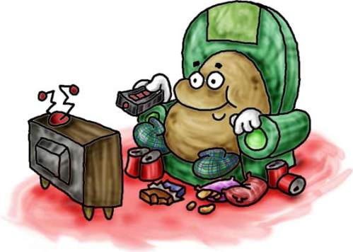
What affects Homeostasis
How to lower risk:
Stop doing whatever puts you at risk
Preparation for any genetic risks you may face – diabetics and eyes
Seek health professional for ideas about how to become more healthy

Slide 9
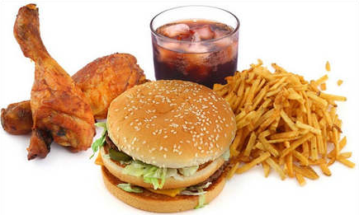
Diet
Bad fats and cholesterol
Make your body work harder
Clog blood vessels – stop blood from getting where it needs to go

Slide 10
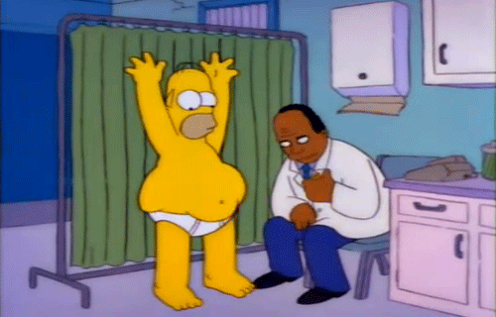
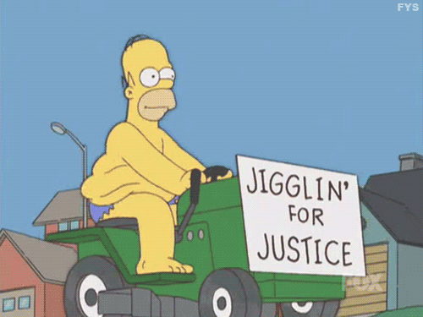
Body Size
People who are 10% over ideal body weight are considered obese
A calculation of BMI (Body Mass Index)
Often the result of overeating and inactivity
Puts stress on body organs

Slide 11
Calculating BMI
Body Mass Index is a simple calculation using a person’s height and weight.
The formula is BMI = kg/m²
where kg is a person’s weight in kilograms and m² is their height in metres squared.
A BMI of 25.0 or more is overweight, while the healthy range is 18.5 to 24.9. BMI applies to most adults 18-65 years.
The Rock
6ft 4in
270lbs

Slide 12
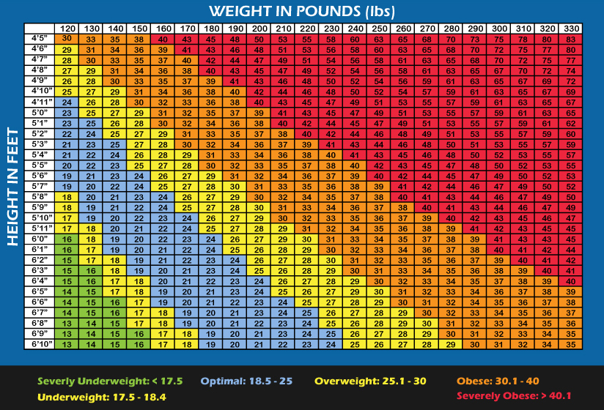

Slide 13
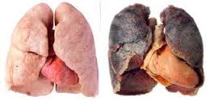
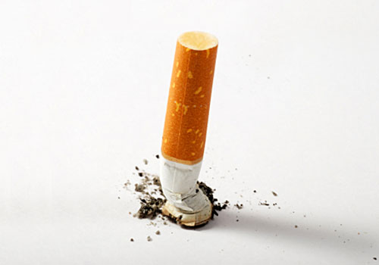
Smoking
Tar builds up and makes it harder for oxygen to get into heart
Linked to respiratory disease and lung cancer
Causes body to release a hormone that increases blood pressure

Slide 14
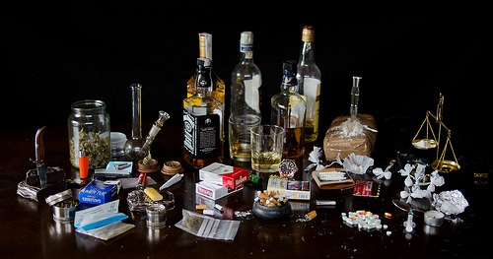
Substances
Stimulants
Depressants
Increase rate of life functions
Speeds up heart rate
Eg. Caffeine, nicotine, ecstasy
Decrease rate of life functions
Slows down brain activity
Eg. Sleeping pills, alcohol

Slide 15
11.3 When Your Body Can’t Cope
Earlier we discussed the importance of diet, lifestyle choices, and to an extent genetics, and how they affect your health
Today we’ll look at some disorders that can effect teens
THAT’S YOU!

Slide 16
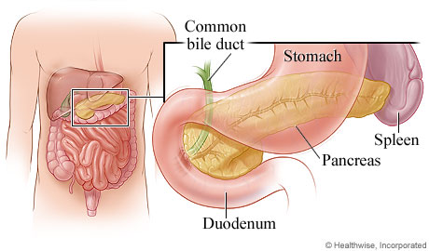
Diabetes
Have large amounts of sugar in their blood and urine
Problem stems from the pancreas – whose job is to create insulin and regulate blood sugars
Can be a result of lifestyle or genetics

Slide 18
Different Types
Type 1
Type 2
Pancreas no longer produces insulin
Individual must inject themselves when they eat
Mr. McCormack
Pancreas still produces insulin
Insulin just has no effect
Mr. Layton

Slide 19
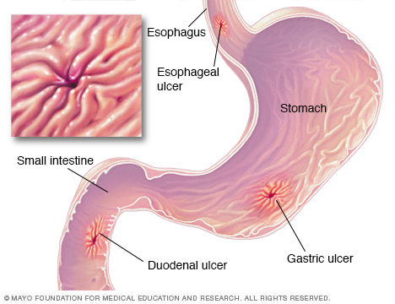
Ulcers
Consist of holes forming in the esophagus or stomach lining
Gastric acids harm the lining – causes burning feeling
Often believe to be a result of stress, more likely the result of genetics

Slide 20
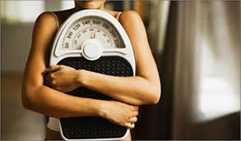
Eating Disorders
2 main types
Lifestyle causes
Leads to malnutrition and poor health
Treatments usually involve education and support counseling

Slide 21
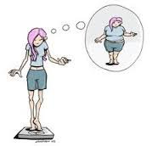
Anorexia
People do not eat enough
No matter they body size they are afraid of gaining weight
Often have a poor self image

Slide 22
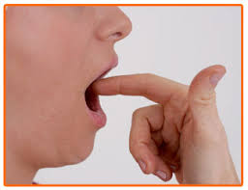
Bulimia
Eat them force themselves to vomit before the food can be digested
Others use laxatives to get the food out as quickly as possible – food not digested
Excessive vomiting causes backup of stomach acid that harms esophagus and teeth

Slide 23
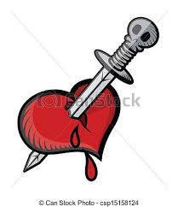
Heart Attack
Can result from genetics or lifestyle choices
Blood flow to heart is restricted
Heart’s stops pumping normally
Heart tissues are damaged
Cardiac arrest – when the heart stops
Treatment include CPR and electroshock

Slide 24
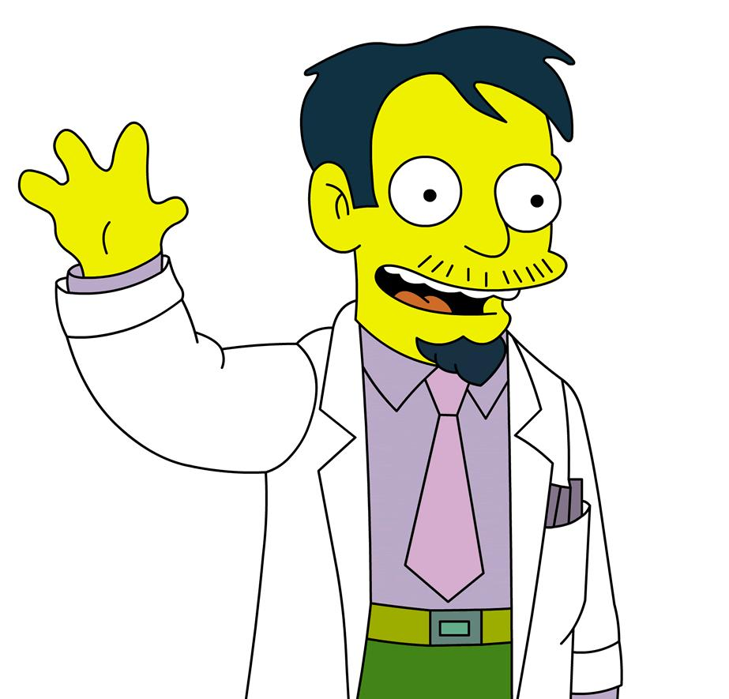
Technology that help maintain Homeostasis
We’ve talked about advancements in the medical field
So how do they help homeostasis?

Slide 25
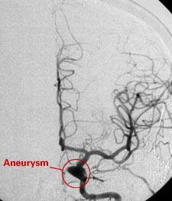
Angiogram
Provides an x-ray of blood vessels
Shows any irregular areas

Slide 26
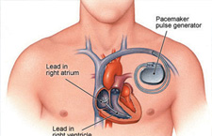
Pacemaker
An electrical device that maintains proper heart beat through electric pulses
Used if patient’s natural pacemaker no longer works

Slide 27
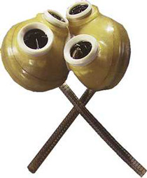
Jarvik - 7
Artificial heart
Used if donor heart not available

Slide 28
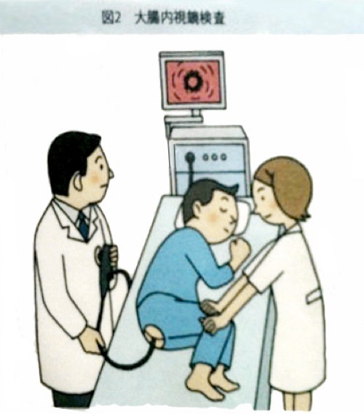
Colonoscopy
If the problem is an the back half of your digestive system
Checks for abnormalities, cancer, inflammation, and bleeding

Slide 29
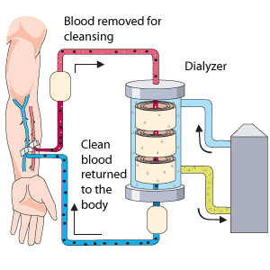
Kidney Dialysis
Kidneys no longer function
Blood instead flows into a machine where it is filtered

