Slide 3
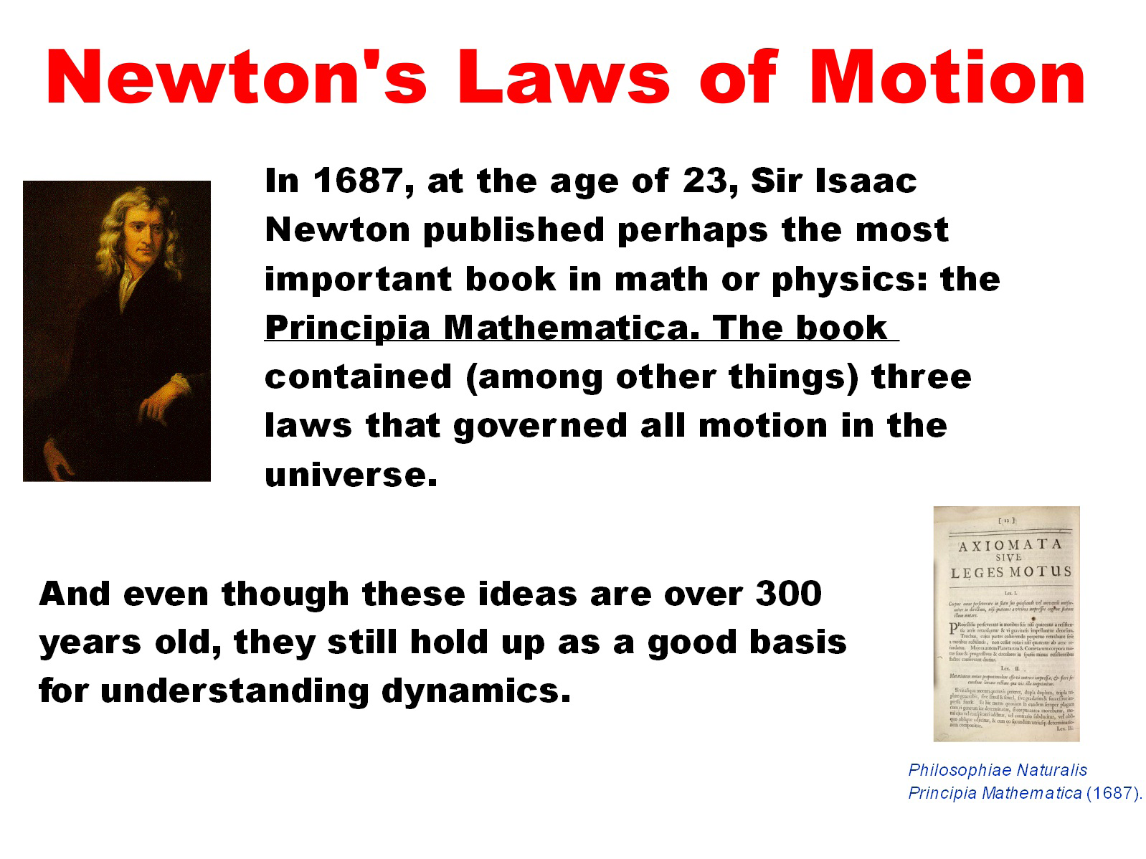

Slide 5
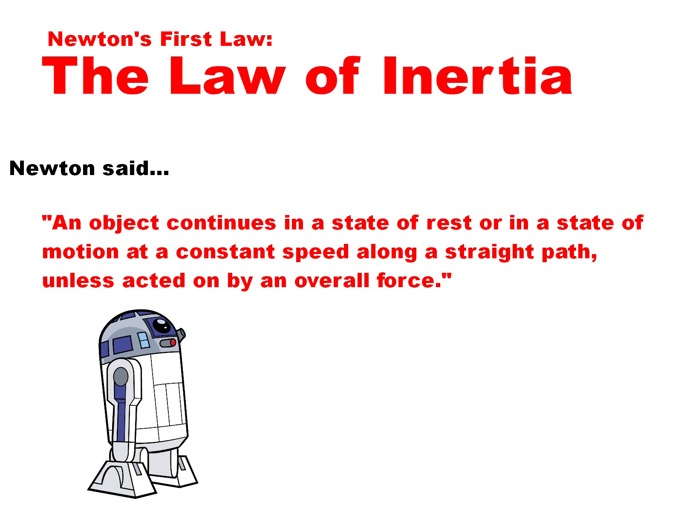

Slide 6
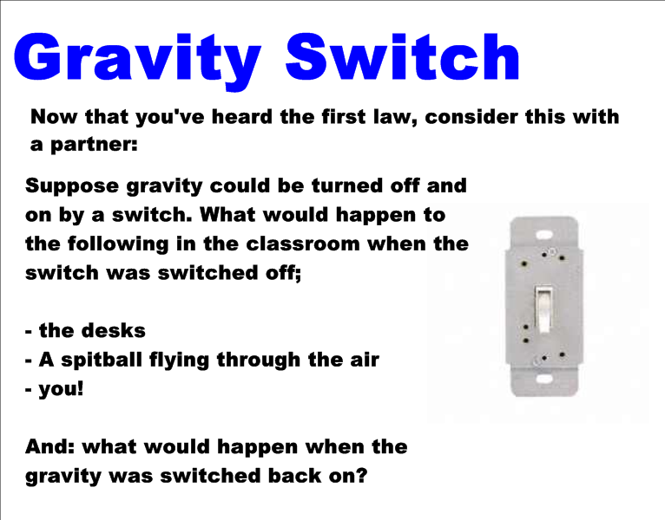

Slide 7
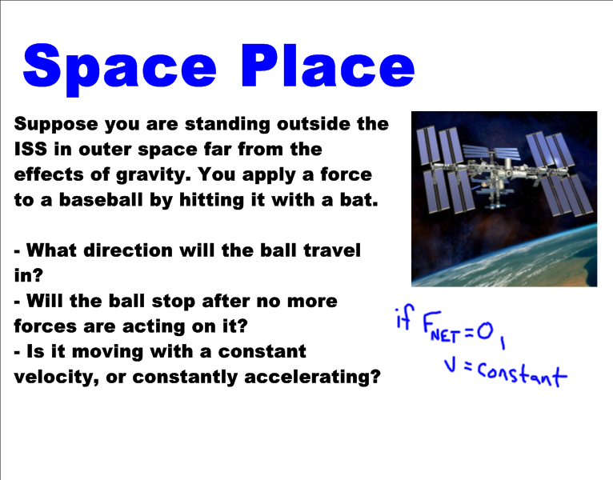

Slide 8
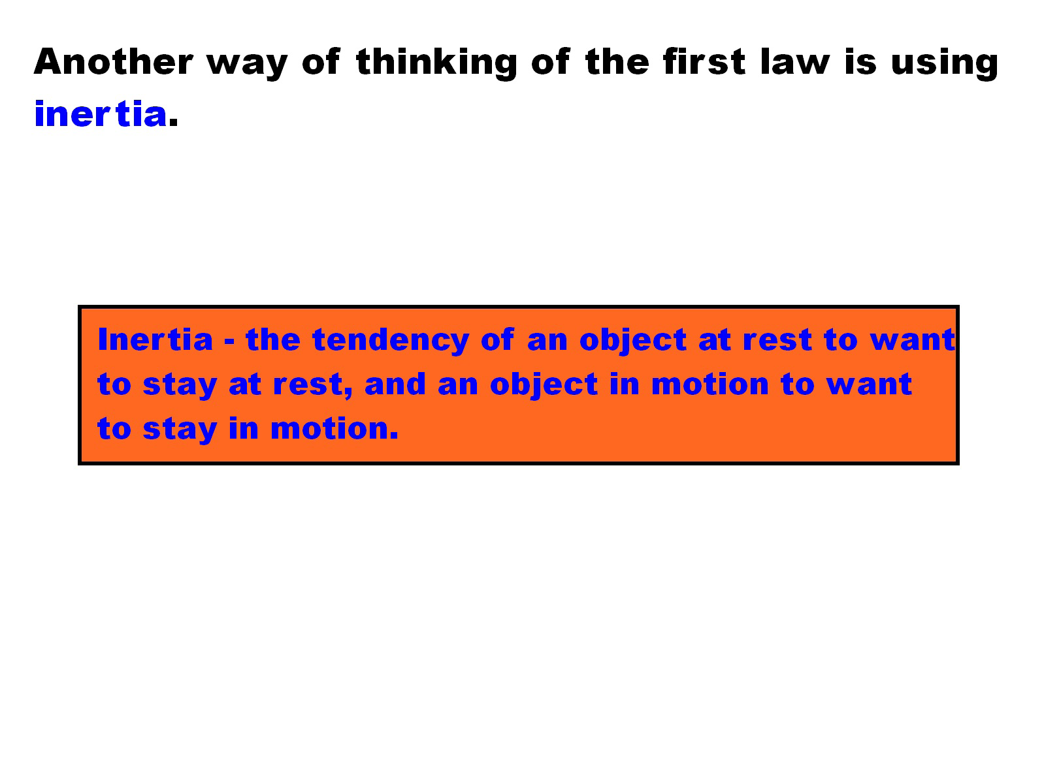

Slide 10
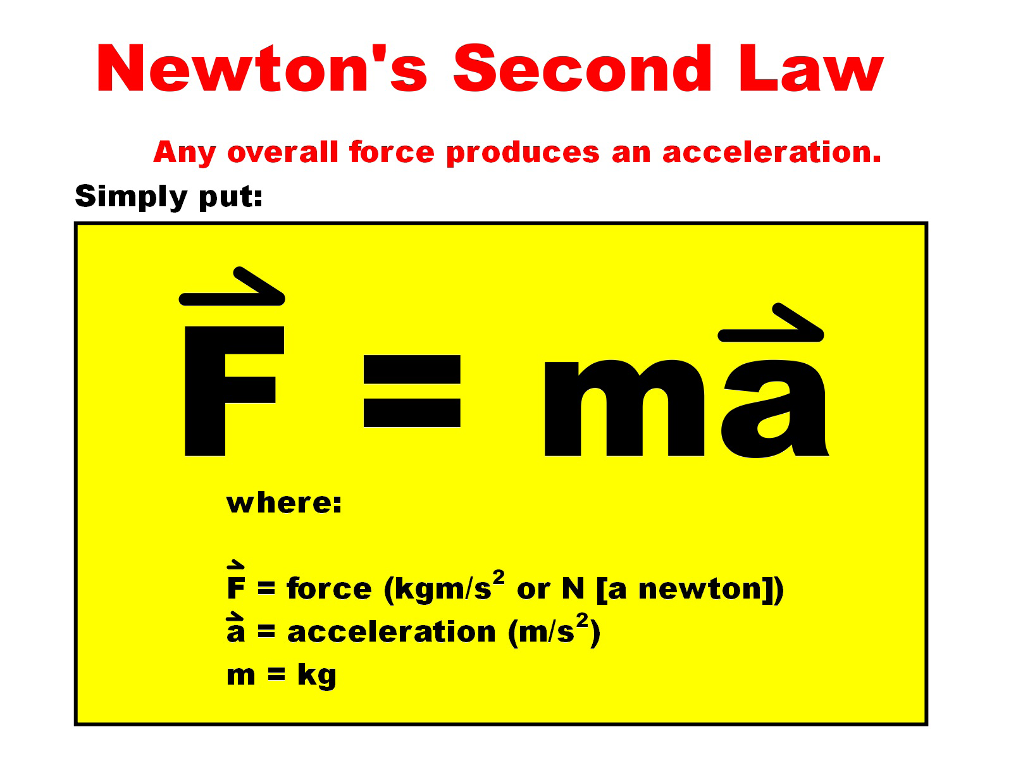

Slide 11
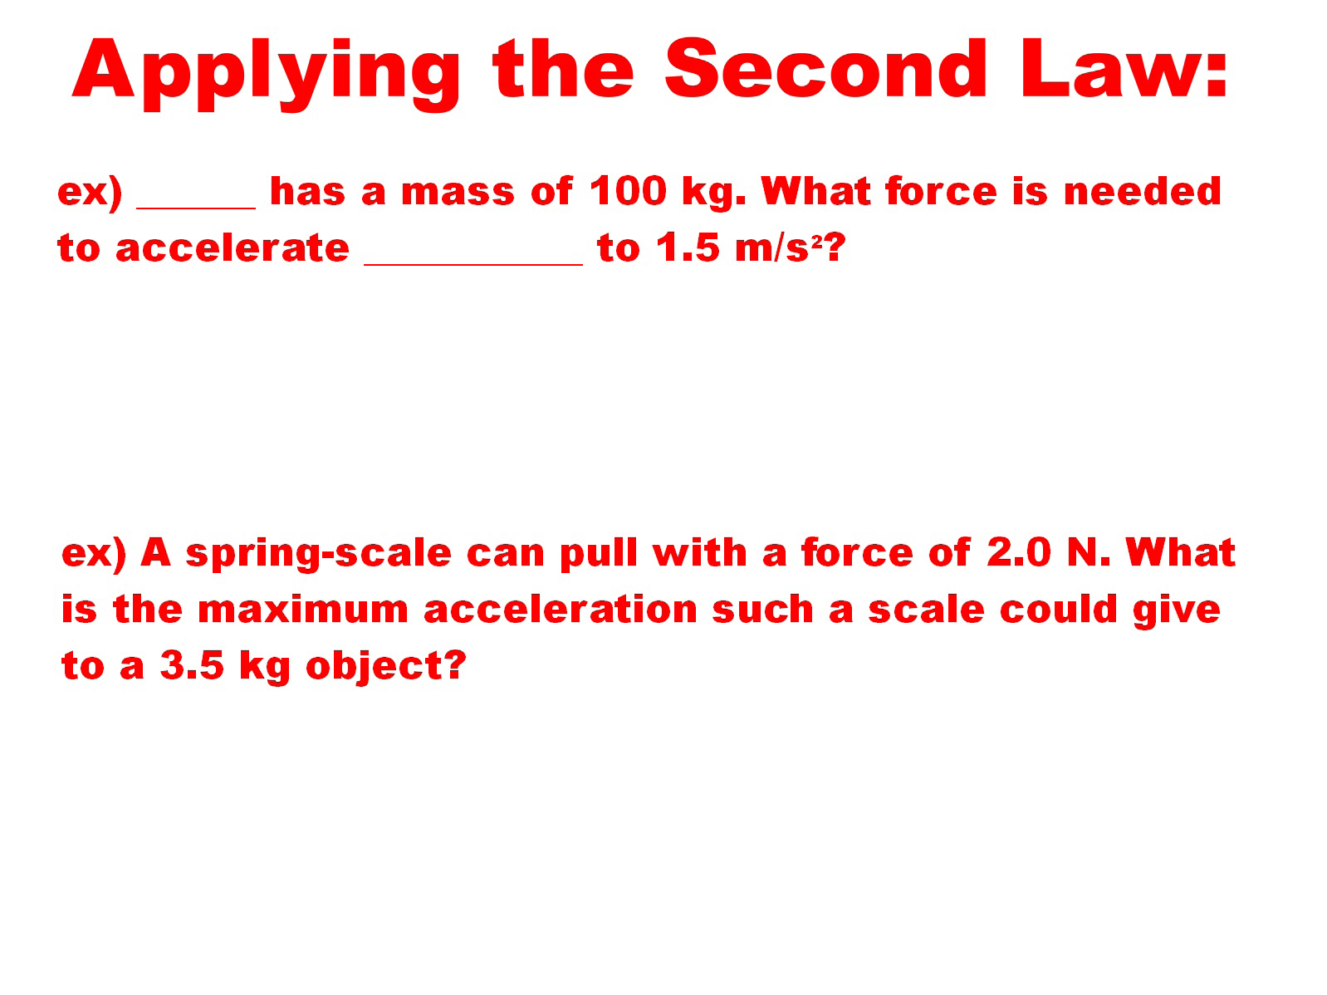

Slide 12
ex: Mr. P’s mass is 88.18 kg. What is his weight?
Hint: mass is measured in kg, but weight is measured in Newtons.

Slide 13
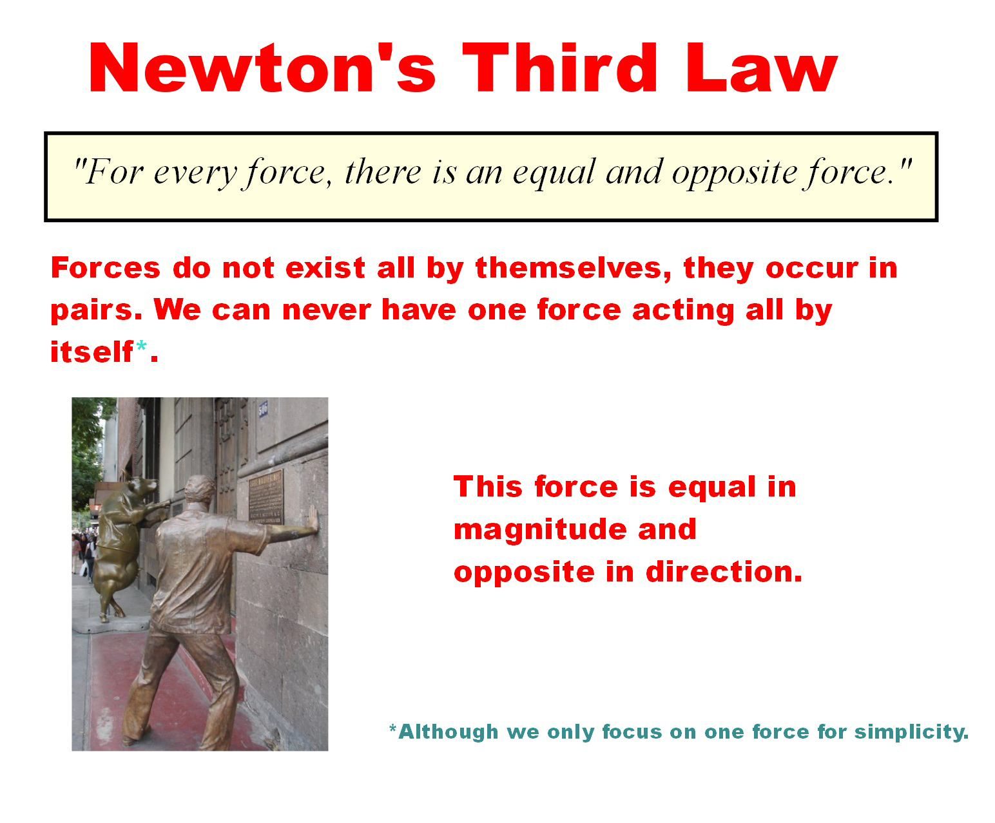

Slide 14
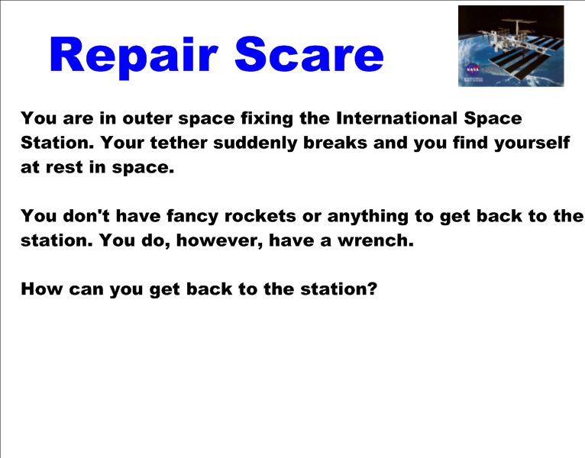

Slide 15
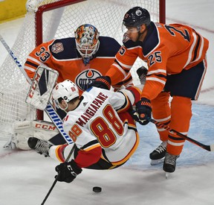
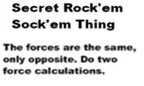
ex) Darnell Nurse has a manly mass of 100 kg. Andrew Mangiapane has a puny mass of 83 kg. If Nurse hits Mangiapane with a force of 15 N, what is the acceleration of both players?

