Slide 1
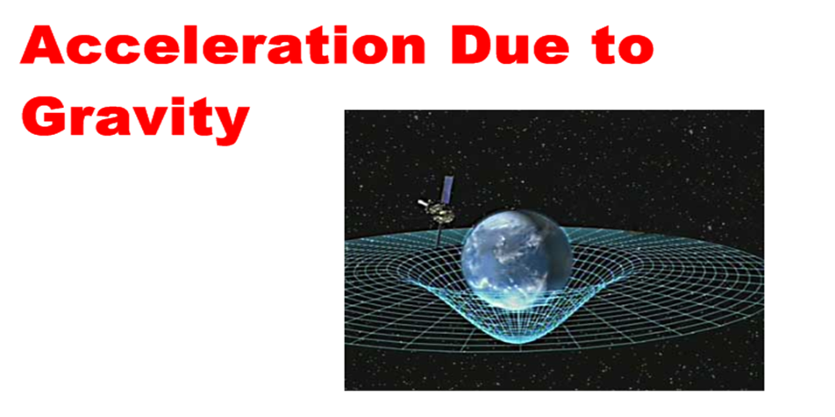
Science 20 Unit B: Physics

Slide 2
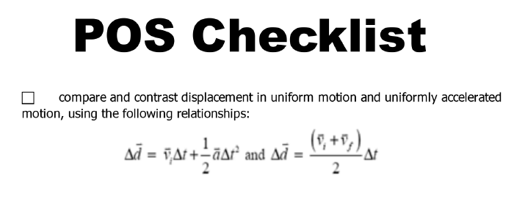

Slide 3
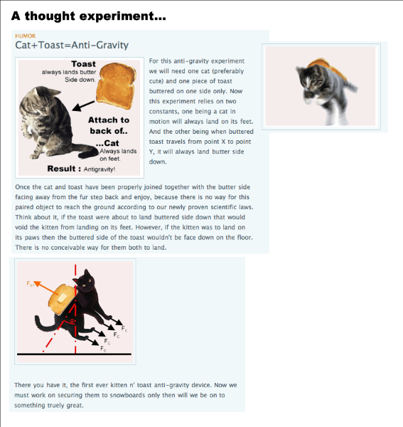

Slide 4
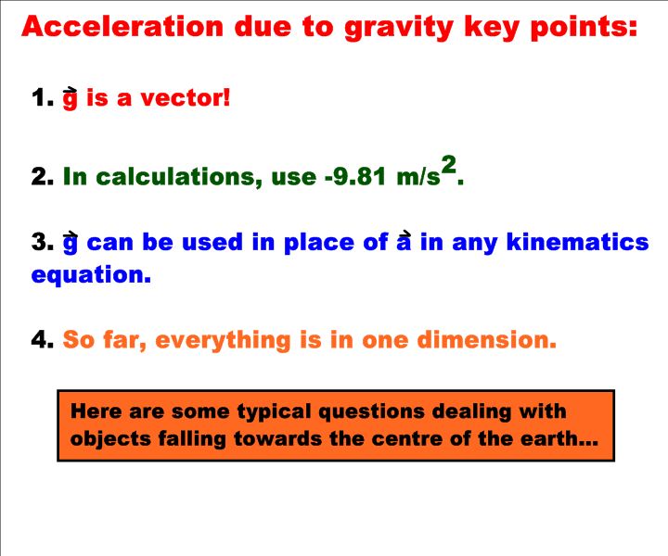

Slide 5
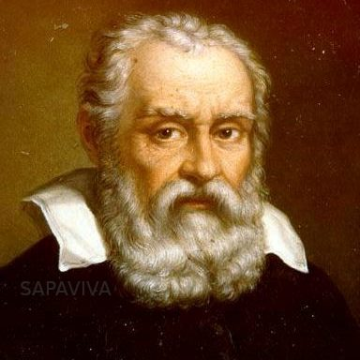
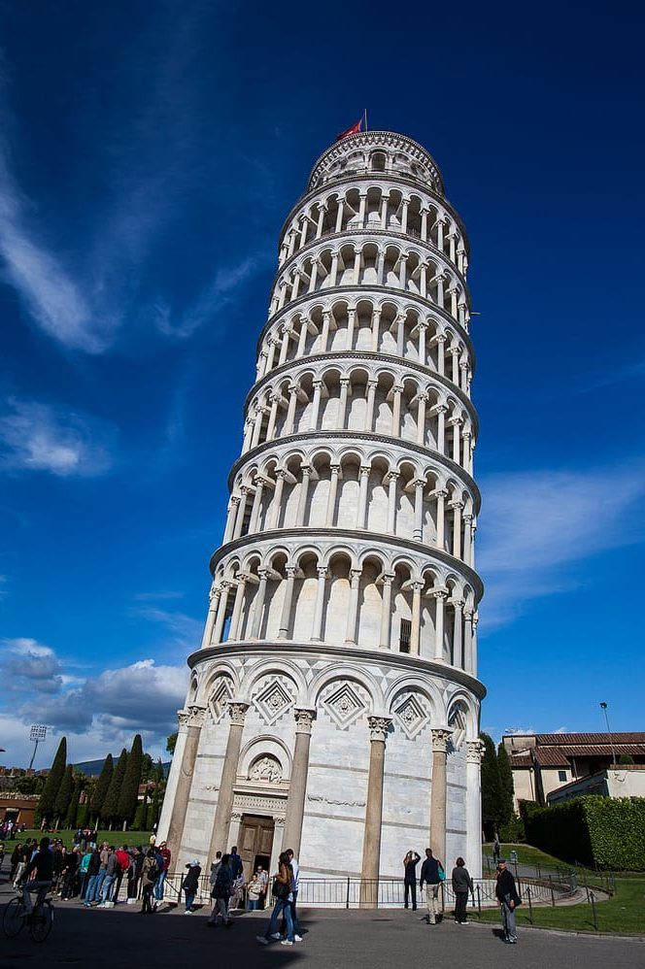
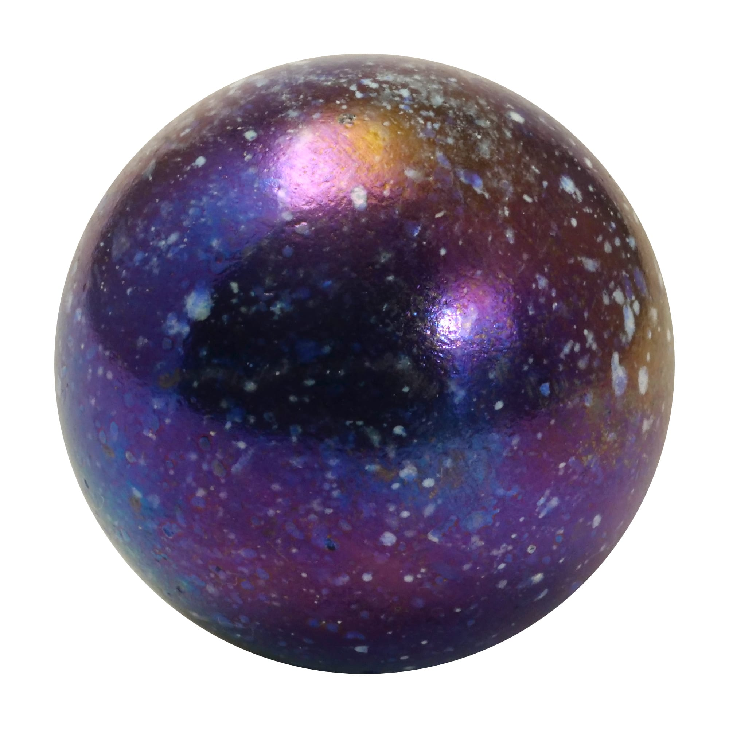

A falling
gedankin:

Slide 6
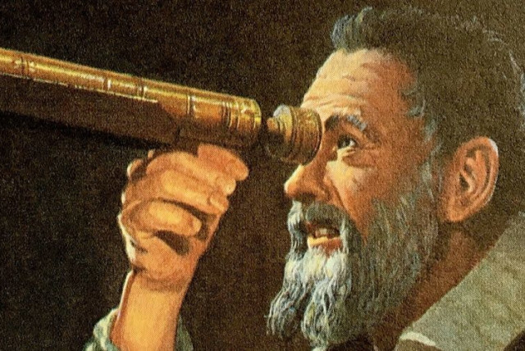
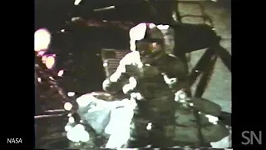
In the early 1600’s, Galileo performed many experiments and determined the answer: All objects fall at the same rate (or acceleration) if air resistance is ignored! This has been tested…

Slide 7
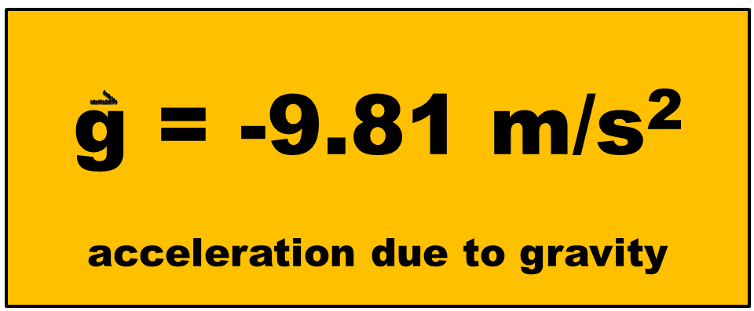
Galileo determined that the acceleration due to gravity is -9.81 m/s2 . This is the rate all objects fall at regardless of size or mass.

Slide 8
ex: Mr. P drops a rock on a Science 20 student to get them to work harder! Mr. P drops the rock from rest, and it takes 3.5 s to hit the ground. How high was the rock dropped from?

Slide 9
ex: A cannon ball is dropped form 150 m in the air. How long does it take to hit the ground?

Slide 10
